Slide 1
Successful Consecutive Connections
Public Drinking Water Supply Section
Water Quality Division
Oklahoma Department of Environmental Quality
Notes:
Good morning everyone, I am [NAME] with the PWS Engineering and Enforcement section of DEQ, and today I will be talking with you about successful consecutive connections.

Slide 2
Overview
Definition and Purpose
rTCR/GWR Additional Requirements
Communication
Disinfection and Disinfection Byproducts
Notes:
This presentation will touch on the definition and purpose of consecutive connections, communication between systems, disinfectants and disinfection byproducts, and additional requirements of the revised total coliform rule.

Slide 3
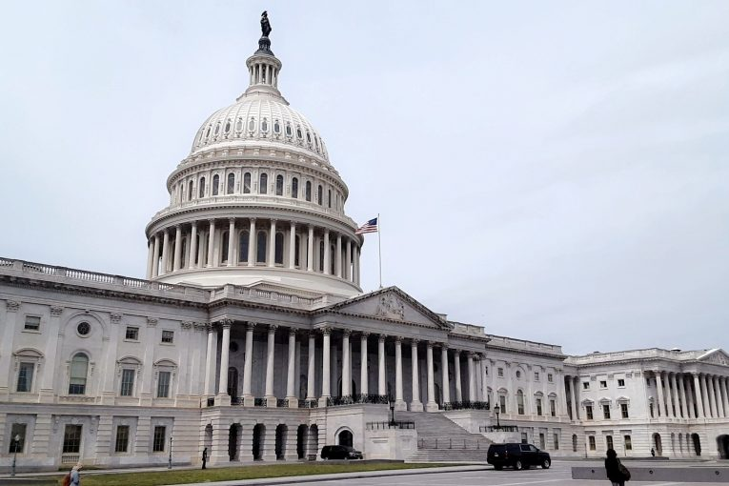
Definition
Defined in Oklahoma Administrative Code (OAC) 252:626-1-2
“Consecutive system means a public water supply system that receives some or all of its finished water from one or more wholesale systems. Delivery may be through a direct connection or through the distribution system of one or more consecutive systems.”
Notes:
Lets start by defining “Consecutive Connection.” A formal definition is provided in the Oklahoma Administrative Code, or OAC, Title 252, Chapter 626, Subchapter 1, Section 2.
Read definition
Or, in simplest terms, if one system purchases finished water from a different system, that’s considered a consecutive connection.
As a fun fact, this section of OAC 252:626 provides numerous definitions for acronyms and terms commonly used in the public water supply field.

Slide 4
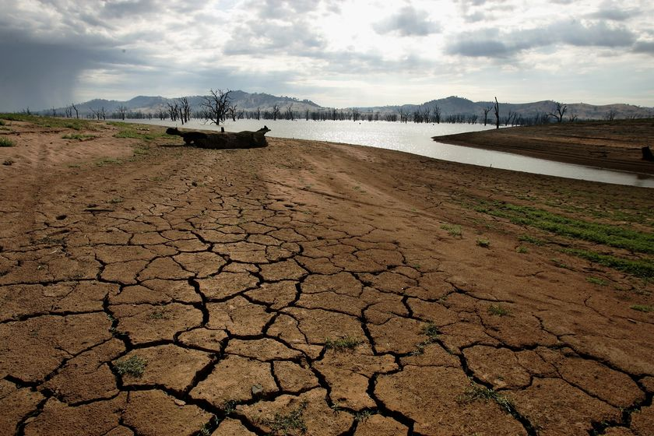


Purpose
Communities may lack resources needed to meet demands
Inadequate quality or quantity of source water
Financial limitations
Rapid population growth
Notes:
Why would a system want or need to become a purchase system? One of the most common reasons is a lack of access to a source with adequate quantity or quality of water. Summertime can pose a serious threat to groundwater and surface water systems alike, as water demand begins to rise. Swimming pools and seasonal watering of lawns and crops are common culprits. A drought, which limits regenerative flows back to the source, during this time can leave a system unable to meet the demands of their customers. In other situations, the quality of the available sources is poor. While this can be addressed through treatment for a larger system with an established treatment plant, it can leave a smaller system with a simpler treatment process unable to utilize the available water. As emerging contaminants continue to become regulated, once adequate sources can be left unusable until treatment modifications can be made.
Towns and communities with smaller populations can struggle to balance the cost of operation and maintenance of a treatment plant with keeping water rates reasonable for their customers. It may be more beneficial for both the community and the customer to purchase water from a neighboring system rather than to continue to supply their own water.
Less common, but population growth can outpace infrastructural advancements. A current example here in Oklahoma would be Piedmont, who has seen a 19.1% increase in population from 2020 to 2023. For comparison, the State as whole growing by 2.4% in that same time period. Rapid unexpected population booms can leave a PWS system unable to meet their new demand, requiring the system to establish a consecutive connection to support the population growth.

Slide 5

Communication Between Operators
Regular communication between operators is essential
Monitor water quality parameters across all systems
Compare sample results and water quality parameters
Complete view from treatment plant to last customer
Modifications to treatment process
Monitoring effects of changes
Troubleshooting current issues
Notes:
Now that we have talked about some of the motivations of a consecutive connection, lets talk about navigating them.
Developing and maintaining a working relationship between the operators of purchase and wholesale systems is the key to a successful consecutive connection.
As a baseline, communication between operators should include comparison of water quality parameters, sample results, and any noticeable trends in the data. Mapping water quality parameters from the point of entry into distribution of the first system to the most distant point the water is sold to allows the operators to see if the treatment process is working as intended. A wholesale system that is only looking at the water quality within their distribution system may be unaware of issues that the purchase system is facing, and vice versa.
Modifications to the treatment process should also be discussed. Purchase system operators that are aware of changes to the treatment process can better monitor the effects of those change in their distribution system. If the changes were made to address issues in the purchase systems distribution system, the purchase system operator are encouraged to also be regularly reporting any noticeable effects of the change. Operators can also work collaboratively when brainstorming solutions to any issues facing their systems are experiencing.

Slide 6
Communication Continued
Emergencies
Equipment failure or malfunction
Leaks or line breaks
Contamination risks
Board Meetings
Provide representation for purchase system
Collaborative future planning
Notes:
Continuing with communication, another key point would be communication related to emergencies. DEQ requires water systems to have emergency response plans in place,. If a system has a consecutive connection, a section should be included that lists up-to-date points-of-contact for each consecutive connection. Events like equipment failure and malfunctions should be shared with the operators of the consecutive systems. For example, if a chlorine booster station in the wholesaler’s system were to go down, a purchase system can increase monitoring of disinfectant residuals in response. Some purchase systems blend purchased water with water of their own and may be able to adjust their chlorine feed rate to temporarily compensate.
The failure of a booster pump can increase the risk of system depressurization. Purchase systems that were made aware of the booster pump failure can notify the public to limit water usage to minimize this risk. Similarly, line breaks increase the risk of system depressurization and can be addressed in the same way. A phone call isn’t required for every minor leak though, so use discretion to avoid overwhelming the other operator.
Lastly, we encourage the attending board meetings, specifically those focused on water system. This is a good opportunity to provide representation for the purchase system’s customers, as well as learn about any future projects or major changes the wholesale system plans to make.

Slide 7
Disinfection Byproducts
As water age increases, DBP concentrations increase
Most effective flushing is unilateral flushing from wholesaler to purchaser
Optimize storage volumes
Connection point of consecutive system
For purchase systems
Maintain or invest in wells
Capability to produce own water is valuable
Allows for mixing and dilution of DBPs, and other contaminants
Notes:
Disinfection byproduct concentration are impacted by water age. Generally, water age is higher in a consecutive system’s distribution compared to a wholesalers. Because of this, purchase systems tend to be at high risk for compliance issues with DBP MCLs.
Because of this, I wanted to talk about some strategies to control DBP. Some of these can be done without any additional equipment and some will require infrastructural development.
Flushing is a go-to solution for a reduction in water age. To maximize the effectiveness of this technique, flushing should be conducted unilaterally starting from the first wholesaler in the chain of systems and working outwards. This ensures that the water being brought into the system has as low a water age as possible. We encourage consecutive systems to discuss flushing credits with wholesale systems during the drafting of the contractual agreements.
Optimization of storage tank volumes is another technique that can be used to limit water age. When considering changes to normal operating levels of storage tanks, operators should ensure pressure is maintained throughout the distribution system.
Minimizing the time the water spends in distribution before the connection point to the purchase system also limits water age. A direct pipe from the wholesaler’s treatment plant to the connection point of the purchase system is preferable to say a connection point after a storage tank in the wholesaler’s distribution. We also encourage systems to talk with their compliance coordinator about placing a DBP sample point at this connection point.
Lastly, the ability of a purchase system to produce its own water allows for the dilution of contaminants such as DBPs. Maintaining and rehabilitating existing wells or drilling of new wells is a proven and effective technique for financially capable systems.

Slide 8
Compatible Disinfectants
Blending of chloraminated and chlorinated water can cause water quality issues
Free chlorine can bond to existing monochloramines, forming di- and tri- chloramines
Result is weaker disinfectants, lower residuals, and taste and odor
Increases risk of nitrification and bacterial growth
Notes:
As touched on a few times, some purchase systems blend purchased water with water they produce themselves. If a purchase system is considering blending water, the operator should ensure the compatibility of disinfectants. Chloramines have begun to rise in popularity due to the reduction of DBPs when used as the secondary disinfectant but require precision to maintain the balance of chlorine and ammonia in the water. This balance can be disrupted by mixing chloraminated water with chlorinated water. The free chlorine in chlorinated water has the capability to bond with the existing monochloramines in the chloraminated water, forming di- and tri-chloramines. The overall result is water with a weaker disinfectant at a lower residual, and an increase in taste and odor. The system is also at a higher risk of nitrification and bacterial growth.

Slide 9
RTCR/GWR Additional Requirements
TC+ Within Purchase System’s Distribution
Purchase systems must notify groundwater wholesaler with 24 hours
Sample all active purchase system groundwater sources
Wholesaler must sample groundwater sources within 24 hours of notification
Wholesale System
E. coli positives taken at a wholesaler groundwater source will results in a mandatory boil order for all purchase system within 24 hours
Notes:
Consecutive connections do have additional requirements pertaining to E. coli and Total Coliform positives, which I wanted to discuss. This slide highlights only these additional requirements, and is not a comprehensive list of required actions.
Consecutive systems must notify their wholesale system within 24 hours of being notified of the routine RTCR total coliform positive sample result. This will require the wholesaler to sample all active groundwater sources at the time of sample collection. If the consecutive system was utilizing any of their own groundwater sources at the time of the routine RTCR sample collection, the consecutive’s groundwater sources must also be sampled.
If the GWR source sample is E. coli positive, the wholesaler must also notify all consecutive systems within 24 hours of being notified of the EC+ source sample result.

Slide 10
Questions?

