Slide 1

Asset Management
Capacity Development Section
Water Quality Division
Oklahoma Department of environmental Quality
Notes:
Hello everyone, my name is (Insert name). Today I am presenting on the topic of asset management. First, we will define what asset management is as well as introduce the 5 core components of asset management. Then we will talk about some of the benefits that can be achieved by water systems who implement an asset management program. We will discuss how you can request assistance from DEQ and other technical assistance providers on how to get started on one. Finally, I will discuss DEQ’s very own Asset Management tool.

Slide 2

Framework to help utilities
  Provide desired level of service at the best appropriate cost
  Decide how and where to best spend limited time, resources, and money
Notes:
So what is Asset Management? Simply put, Asset Management is applied common sense. It’s a framework that helps you maximizes the value of the capital as well as the operation and maintenance dollars that you put into your system. It does this while still providing the desired level of service to your customers at the lowest possible cost to your system.
When we say “desired level of service”, this is what utilities want their assets to provide. And when we say “the best appropriate cost”, that is the lowest life cycle cost.
Essentially, we want to get into a business mind-frame. Then we want to use tools to help us decide how, where and when to utilize our time, resources and money.

Slide 3
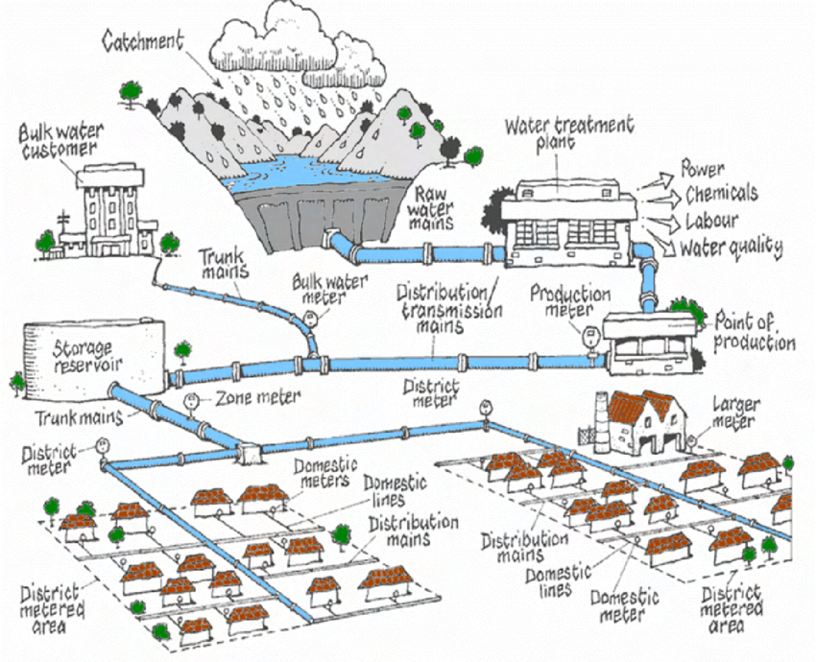
What are Assets?
All the components needed to deliver safe and clean water
Notes:
What are assets?
Assets can be any component needed to deliver safe water to the consumers.
From source to distribution, assets are things like:
Wells, Intakes, or Master meters to a neighboring system.
Pumps like booster and high service.
Chemical feed pumps, filters, clarifiers and clearwells.
Monitoring and testing equipment
SCADA systems
Storage tanks
Valves, hydrants and all the pipe in the system.
Residential and Commercial meters
Even things like the water office building and treatment plant building, vehicles, heavy construction equipment, and generators.

Slide 4
5 Core Components
Current State of Assets
Level of Service
Criticality of Assets
Life Cycle Cost
Long-term Funding
Notes:
Asset management can be broken down to 5 core components.
The first of these components is current State– which is basically a detailed list of every asset or component needed to deliver safe drinking water to the consumers and the condition it is in.
Next, we have level of service. Level of service asks the questions like “What do your customers expect from you?” and “how do you plan to meet and obtain those customer needs?”
The third component is criticality. This looks at the probability and consequence of asset failure.
Next, we have life cycle cost. This looks at the total cost of an asset including purchase and replacement cost.
The final component is long term funding. This looks at how you plan to pay for the assets that are expected to fail in the future.

Slide 5

Building an Asset Management Plan
Notes:
We will now go through the steps of building an asset management plan

Slide 6
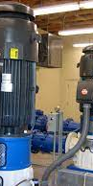
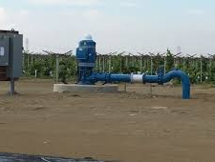
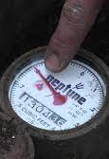
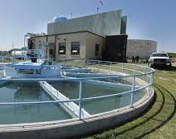
Asset Inventory
  Identify
  Categorize
Notes:
First, when building an asset management plan, we want to identify all the utilities assets.
It may be helpful to start building your list in a linear fashion. For example, starting at your source and listing all those components. For example.. wells, well pumps, well house, or intake structures and those components or even a master meter to a consecutive connection . Then you could move on to treatment processes and listing all those components For example sedimentation basins, filters, chemical feed pumps and even SCADA systems. Finally ending at components in your distribution system. For example, you would want to list all the pipes, any flush or fire hydrants, meters both residential and commercial and other things like valves.
Another way, would be to categorize your assets. Listing all the pumps in your entire water system, and then breaking them down by type. Same thing for valves, pipes etc.

Slide 7

Evaluate Assets
Age and condition
Maintenance history
Notes:
Once you have your assets listed, you will want to note the age of the asset. When was it installed or purchased?
What is the condition of the asset? You will want to note if it in “Great, Good, Fair or Bad” condition.
Note any maintenance history on the asset.
Evaluate if the asset is exceeding its intended design capacity.
Then consider if the rate of repairs has increased.

Slide 8

Asset Criticality
Backups
Consequence of Failure
Probability of failure
Notes:
Assets do fail. But not every asset fails at the same rate or with the same risk.
When we think about the criticality of an asset, we need to account for and consider any back up assets. Back up assets should be on hand or easily acquired in a timeframe that allows your system to maintain its level of service. An example of this might be, I do not have an extra pump in storage, but I can acquire one in 24 hours.
Consequence of failure – we should ask ourselves, if this asset fails, would it lead to a regulatory violation or would the public or the environment be at risk. How many customers could be affected.
Finally, after accounting for age, lifespan, rate of repairs, increase in rate of repairs the probability of failure can be defined.

Slide 9

Sources of Information
Receipts (cost, purchase date, make & model)
Staff (current and previous)
As‐built drawings
Design drawings
Manufacturers’ manuals
Bid documents
Photos and videos
Notes:
Other useful sources of information to help you complete an asset management plan are purchase receipts. Receipts may have information such as the purchase date, make & model as well as the cost.
Staff both current and previous if available can be a wealth of knowledge. Documenting this knowledge is vital for the sustainability and health of any water system.
Other things like , As built drawings, Manuals, Bid documents,
Photos and videos, can be helpful as well.

Slide 10

Assistance
DEQ
Capacity Development and Technical Assistance - Oklahoma Department of Environmental Quality
ORWA
Technical Assistance - Oklahoma Rural Water Association (orwa.org)
Other technical assistance providers
Notes:
Along with the Capacity Development section of DEQ, ORWA can assist your water system with starting an Asset Management Plan. Both DEQ and ORWA have on our websites links to request technical assistance.
There are also other technical assistance providers like Communities Unlimited that can also assist with Asset Management plans.

Slide 11


DEQ’s Asset Management Tool
Notes:
Let’s take a look at the tool DEQ has to help manage your assets

Slide 12
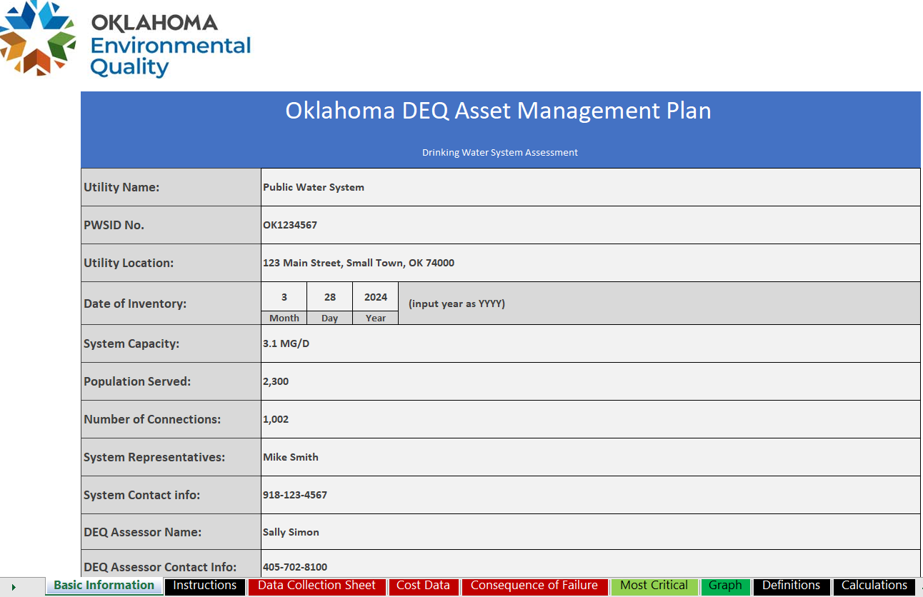
Notes:
Now I will go over DEQ’s very own Asset Management tool. This tool is totally free for any Oklahoma water system to utilize.
Its an excel based program, which we felt was commonly obtainable as part of the Microsoft suite. Most people have a basic knowledge of Excel and its very easy to use.
The first tab on the worksheet, is the “Basic Information” page where you will list your utility information. If a Capacity Development Coordinator assists you in creating a plan, our contact information will also be listed.
It is important to fill out the date of inventory in this section, because certain automatic calculations will be based off the year that you input.

Slide 13
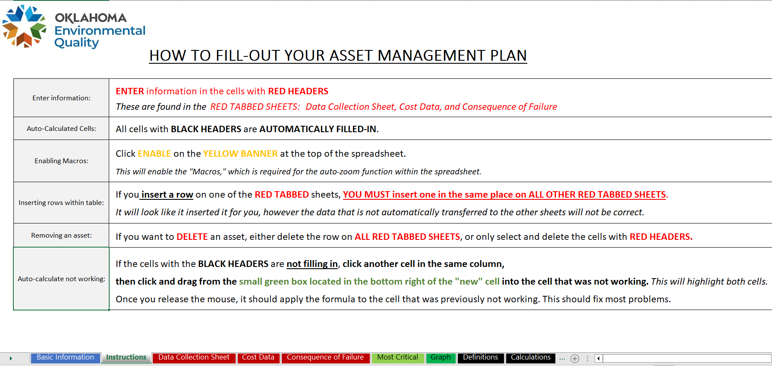
Notes:
The second tab is the “instructions” page. It has some helpful hints about which columns you will need to input data into as well which columns auto populate.
Any columns that are black in color are auto populated and the columns in red are where data needs to be filled in.
This tool can sometime be finicky, especially with deleting assets, therefore it is not recommended. But if you need to, there are helpful hints on how to do it.

Slide 14
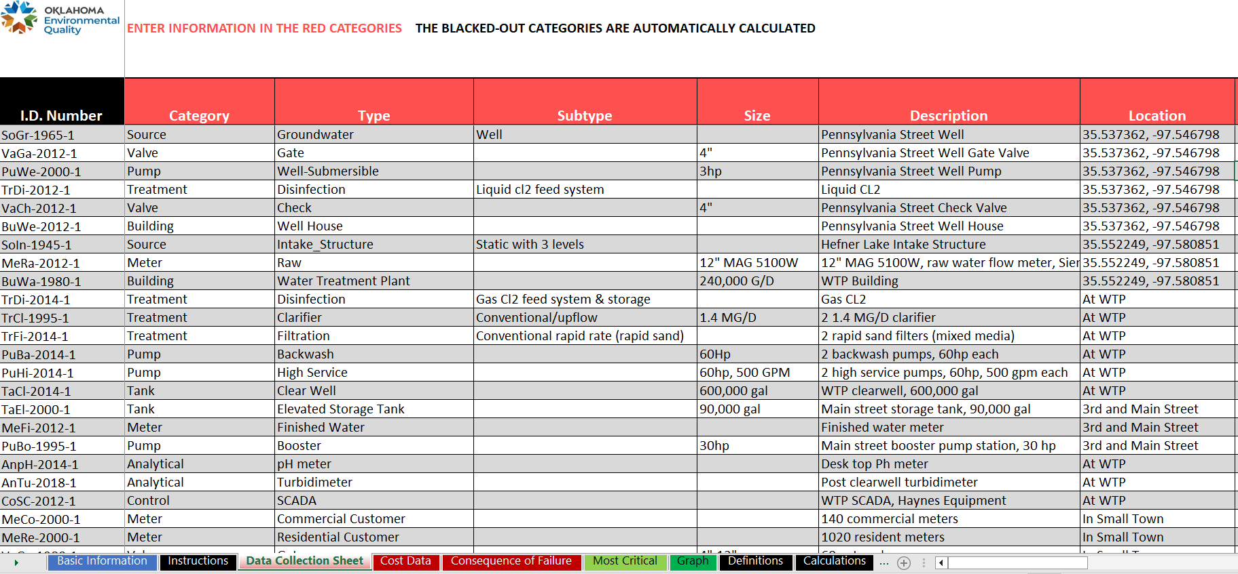
Notes:
The third tab is the data collection sheet. This is the meat and potatoes' of the asset management tool.
As noted on the instruction page, the first column on the left, in black, is auto –filled. This column is auto filled based to the first two letters of the category, then the first 2 letters of the type, followed by the year, then by ascending numbers to order them if there are assets that have identical category, type and year. This column can be edited to any identification number the water system chooses.
Moving onto the first three columns, we will need to select from drop down lists the choices for “Category, Type and Subtype”. Not all types have subtypes, but every category has a type.
In the size column, you can input helpful information about the assets. Such as volume for tanks, horsepower of pumps, and diameters of pipes etc.
In the location column, you can input coordinates like lat/lons, addresses or general locations.

Slide 15
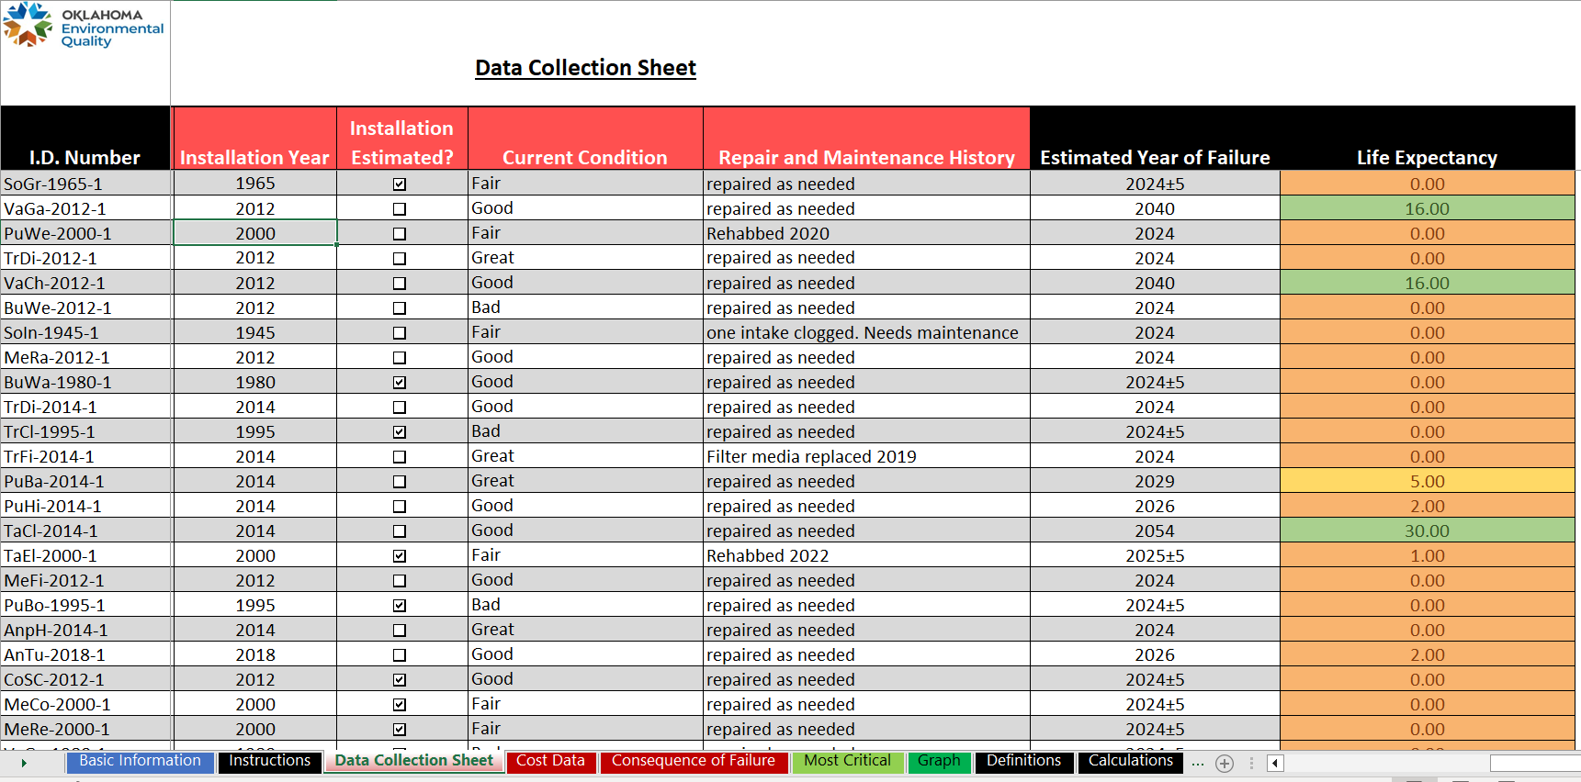
Notes:
Continuing on to the right side of the data collection sheet, you will want to input the age of the asset in the instillation year. If the age of the asset is unknown, estimates are perfectly acceptable.
In the next column you will want to select the condition of the asset, from the options of “Bad, Fair, Good or Great”.
In the last column, you can notate any repair and maintenance history on the asset.
The far right two columns are auto-populated and show the estimated year of failure and the life expectancy.

Slide 16
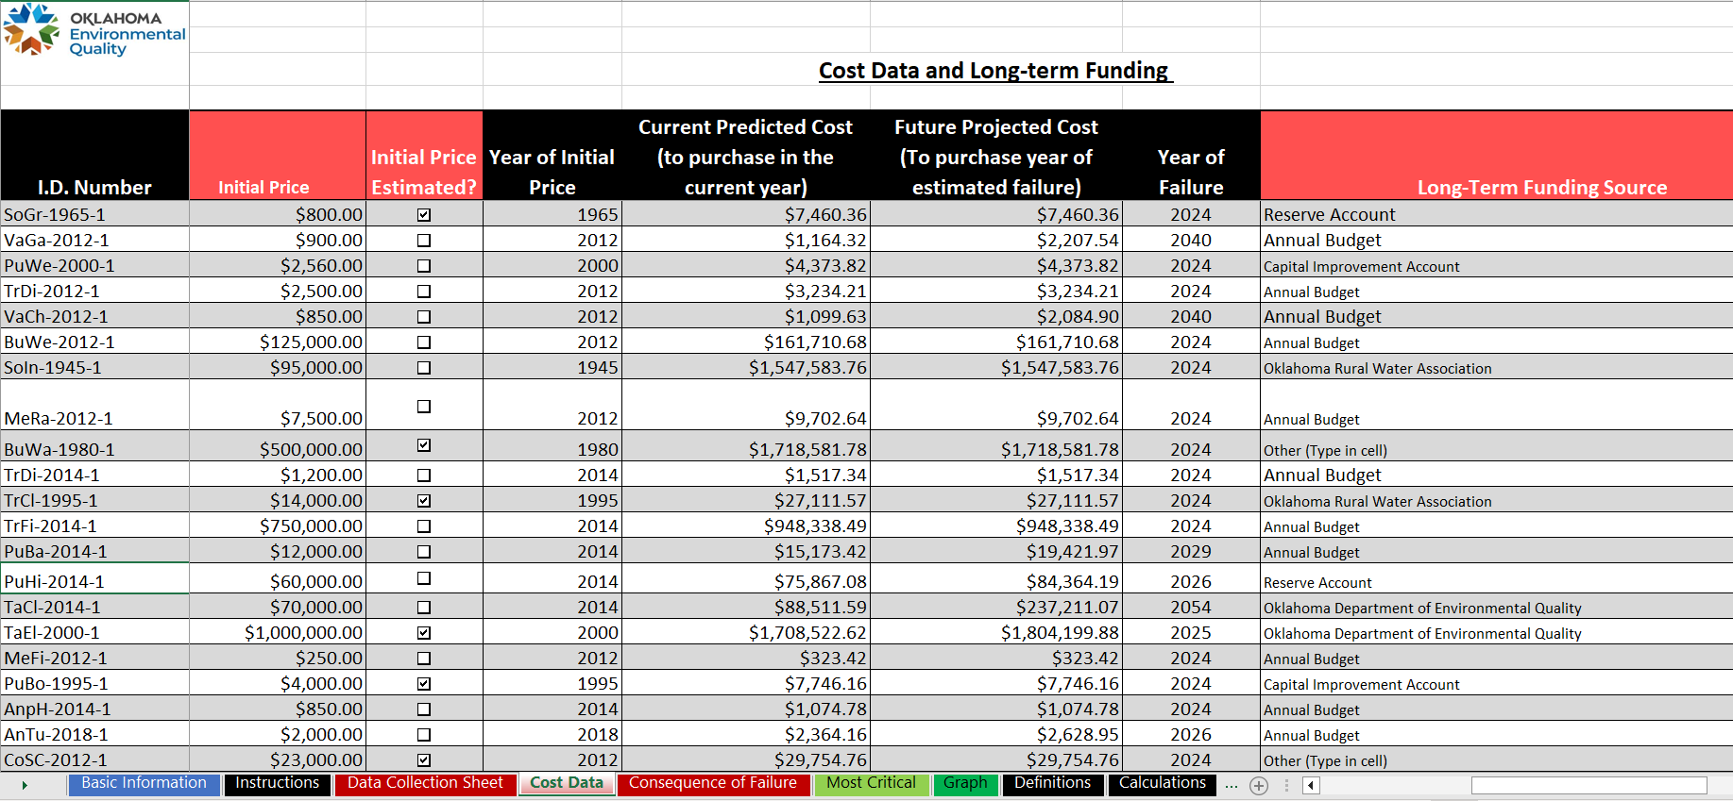
Notes:
Moving on to the Cost Data Tab.
Here you should input the cost of the asset when it was first purchased. If the initial cost of the asset is unknown, don’t worry. There is a box to check to show that it was estimated. Sometimes we may not know what the asset cost many years ago, but with this tool you can work backwards if you know the cost to purchase the item today.
This tool will calculate the cost to purchase in the current year as well as the predicted year of failure.
You can also notate the funding source for replacement of these assets to better plan financially.

Slide 17
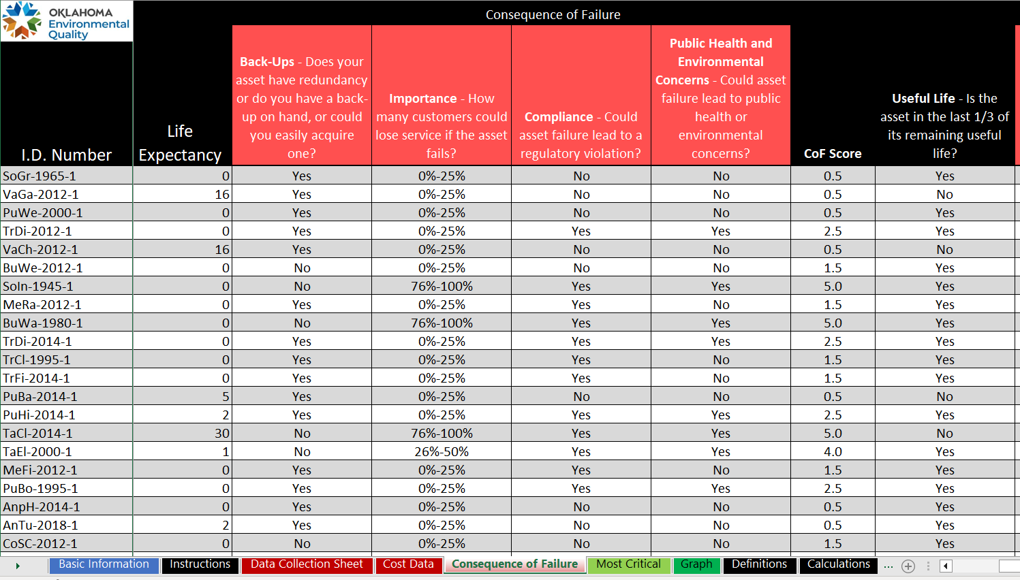
Notes:
The next tab is “Consequence of Failure”.
Here we are going to ask ourselves questions like “do I have a back up pump sitting in my storage”. Or “I may not have a back-up, but could I acquire one in 24 hrs. ?”
If this asset failed, would any customers lose service?
If this asset failed, would it lead to a violation or a public health concern?

Slide 18
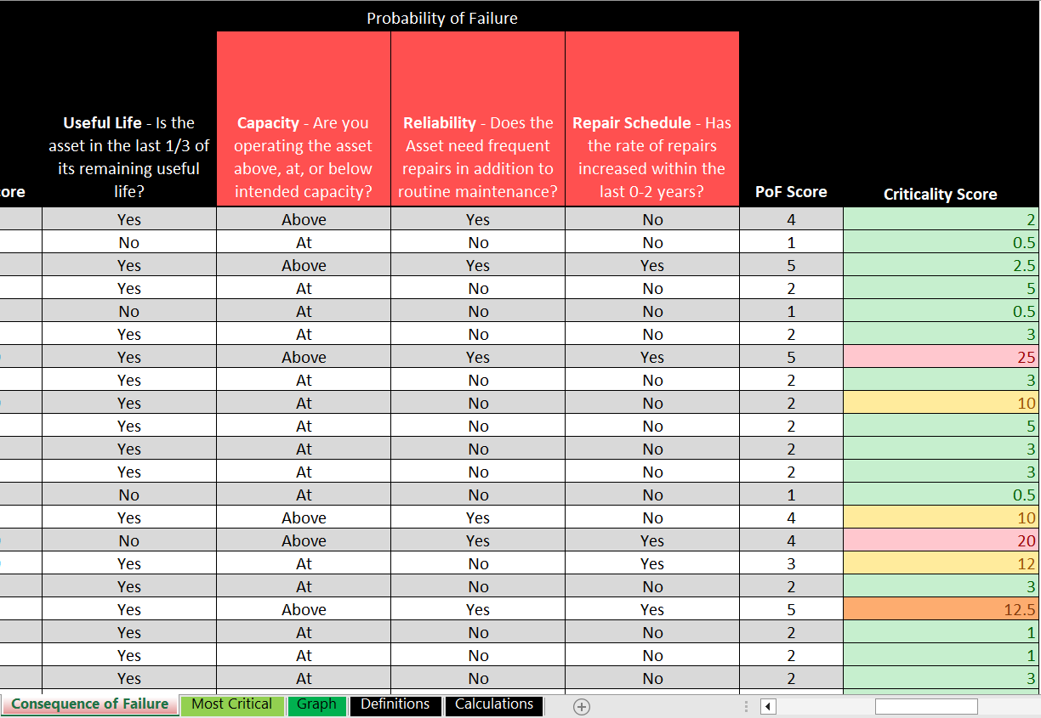
Notes:
Is this asset operating at, above or below its intended capacity?
Besides normal routine maintenance, has the rate of repairs increased?
After answering these questions, the tool calculated a criticality score.

Slide 19
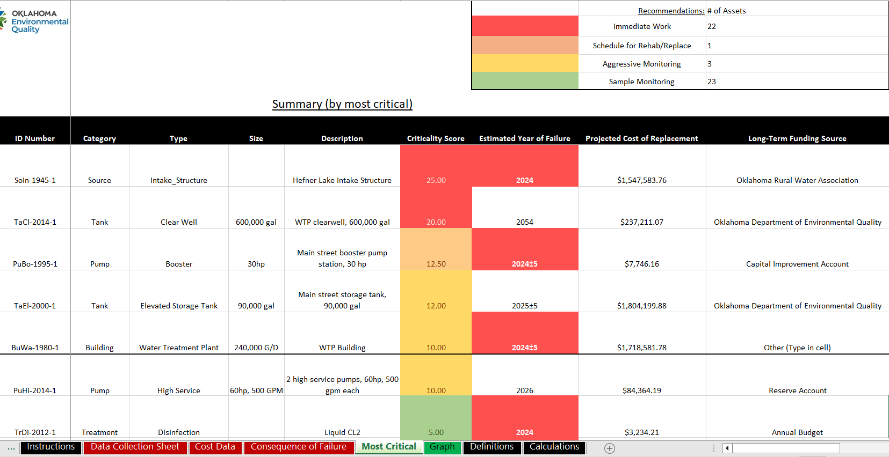
Notes:
Those scores are then ranked on the “Most Critical” tab. This is good summary page.
It ranks the most critical assets based on the age, condition, life span, and criticality.

Slide 20
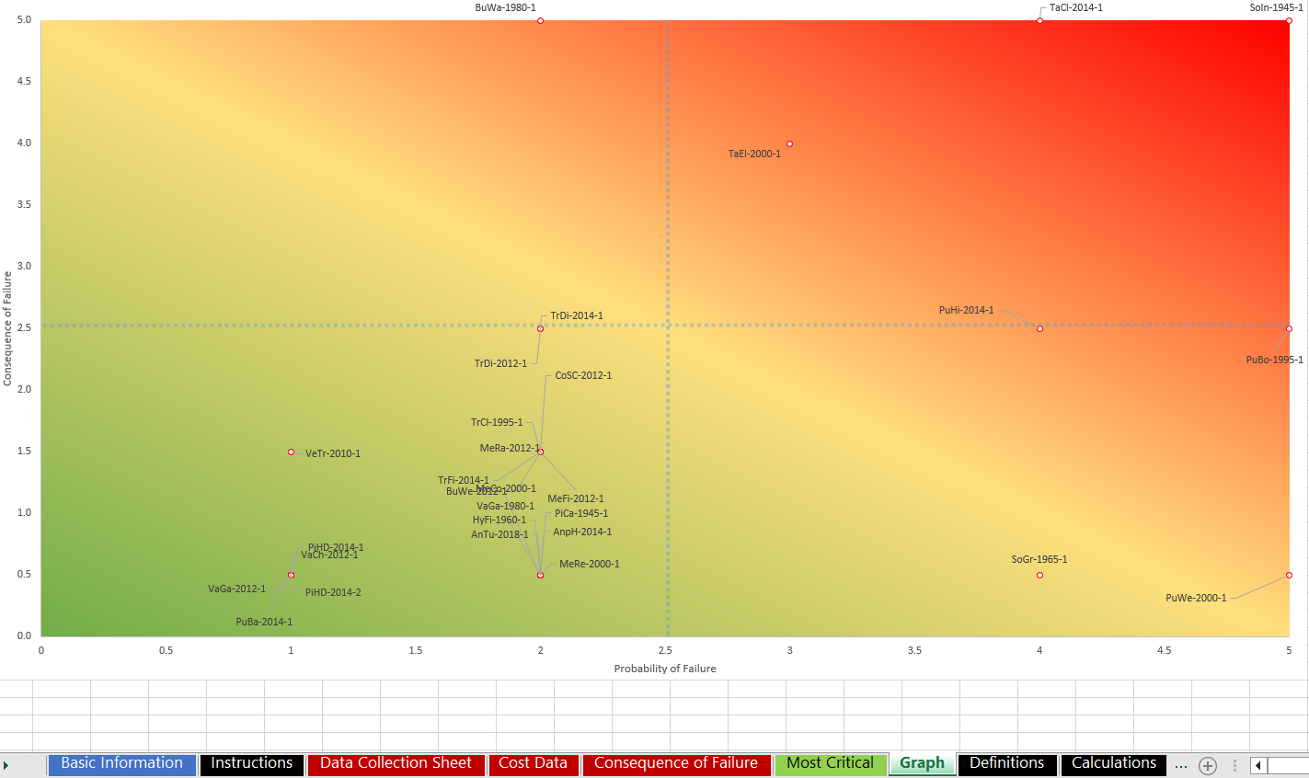
Notes:
Another way to see the data is with our heat chart, where the top right corner in red is ranked high on probability and consequence of failure and the bottom left is ranked lower.

Slide 21
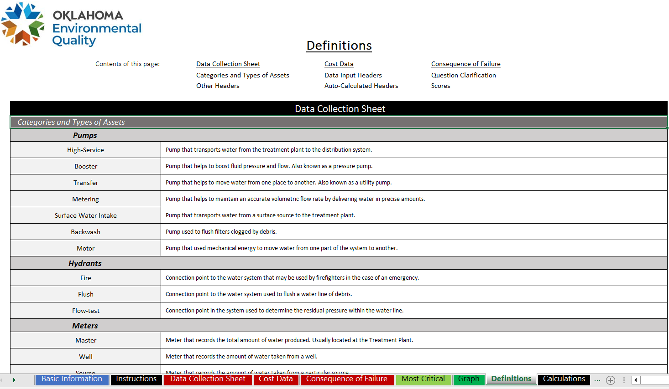
Notes:
The last two tabs on the right are the definitions page and calculations page.

Slide 22
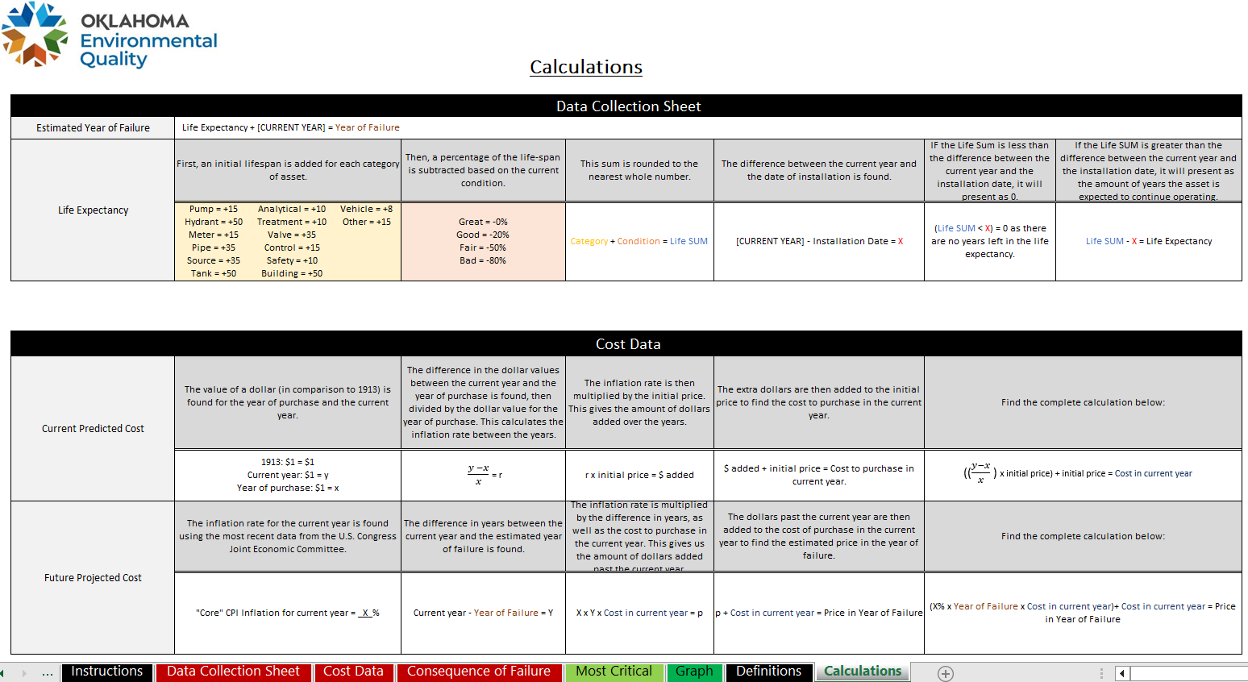
Notes:
On the calculations page, you will find the equations for how the life expectancy is calculated as well as the predicted costs.

Slide 23
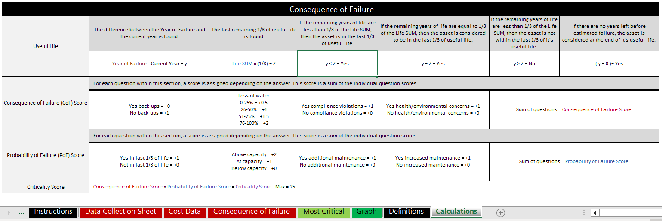
Notes:
Further down on the calculations page, it is shown how the criticality score is calculated. It is calculated by taking the consequence of failure score and multiplying it by the probability of failure score.

Slide 24
Conclusions
A plan is no use unless it is in use
Notes:
In conclusion, implementing an asset management plan will help you:
Identify assets
Determine the life cycle
Estimate the cost of repair or replacement
Project financial budgets

Slide 25



Questions?
Notes:
In conclusion, implementing an asset management plan will help you:
Identify assets
Determine the life cycle
Estimate the cost of repair or replacement
Project financial budgets

