Slide 1

COVID-19
Benefits of Vaccination (more than just preventing infection!)
Dale W. Bratzler, DO, MPH, MACOI, FIDSA
Chief COVID Officer – University of Oklahoma
Professor Colleges of Medicine and Public Health
Chief Quality Officer – OU Health
Interim Dean - Hudson College of Public Health
Edith Kinney Gaylord Presidential Professor
Email: dale-bratzler@ouhsc.edu
Office Phone: (405) 271-2201
August 5, 2022

Slide 2
Do the Vaccines Work?
What benefits can we discuss with the people we care for?

Slide 3
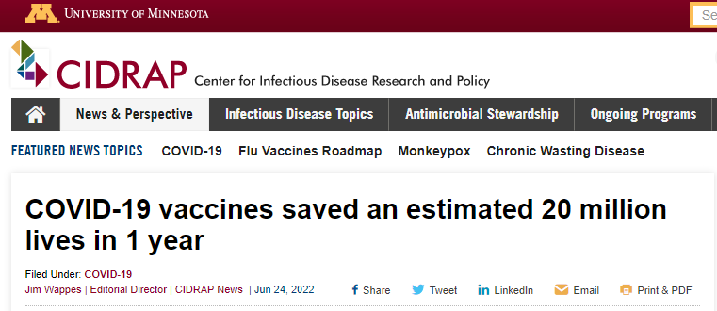
https://www.cidrap.umn.edu/news-perspective/2022/06/covid-19-vaccines-saved-estimated-20-million-lives-1-year

Slide 4
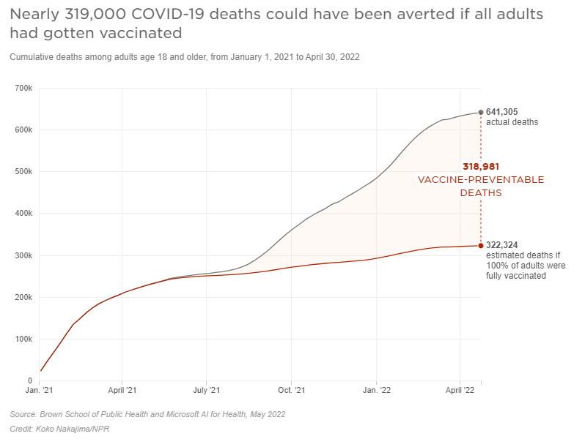
https://globalepidemics.org/vaccinations/

Slide 5
We all know fully vaccinated people who have gotten infected. So what’s the benefit?

Slide 6
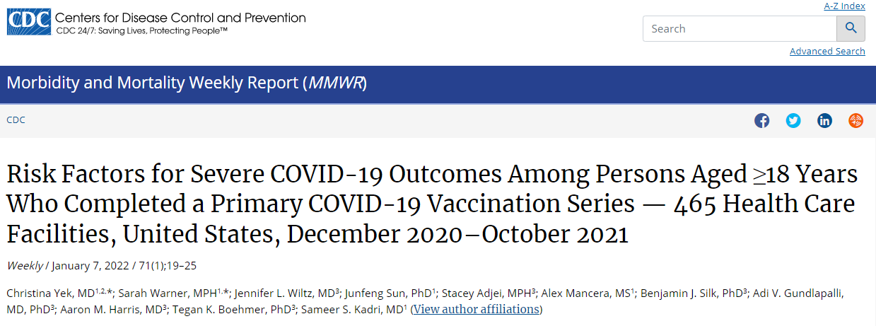
Very large study of 1.2 million people who had completed the primary COVID vaccinations between December 2020 and October 2021.
https://www.cdc.gov/mmwr/volumes/71/wr/mm7101a4.htm

Slide 7
Bottom Line Findings
Fully vaccinated persons were protected from most complications:
  Risk of severe COVID-19-associated outcomes – 0.015%
  Risk of death – 0.0033% (but a few – 36 – did die!)
All persons with severe outcomes had at least one (out of eight) underlying risk factor for poor outcomes
Of those who died, 78% had four or more risk factors.
Severe COVID-19 outcomes were defined as hospitalization with a diagnosis of acute respiratory failure, need for noninvasive ventilation (NIV), admission to an intensive care unit (ICU) including all persons requiring invasive mechanical ventilation, or death (including discharge to hospice)
https://www.cdc.gov/mmwr/volumes/71/wr/mm7101a4.htm

Slide 8
Eight Risk Factors and Oklahoma Prevalence
Risk Factor | Increased Risk of Severe Disease or Death* | Oklahoma Rank or Prevalence
> 65 years | 3.2-fold higher risk | ~635,000 (16% of population)
Immunosuppressed | 1.9-fold higher risk | 3-4% of US population
Diabetes | 1.5-fold higher risk | 4th in the nation
Chronic kidney disease | 1.6-fold higher risk | 25th in the nation
Chronic neurologic disease | 1.5-fold higher risk | 9th highest in the nation for stroke
Chronic cardiac disease | 1.4-fold higher risk | 1st in the nation
Chronic pulmonary disease | 1.7-fold higher risk | 2nd in the nation
Chronic liver disease | 1.7-fold higher risk | 5th in the nation
*In fully vaccinated individuals.
Most ranking data from CDC: https://www.cdc.gov/nchs/pressroom/states/oklahoma/oklahoma.htm

Slide 9
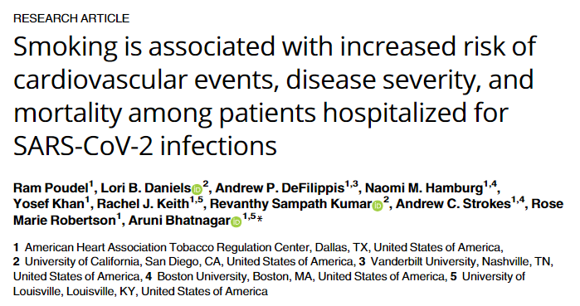
Based on odds ratios, smokers were:
41% more likely to die
15% more likely to be on a mechanical ventilator
27% more likely to have a major cardiovascular event
https://journals.plos.org/plosone/article?id=10.1371/journal.pone.0270763

Slide 10
mRNA Vaccine Effectiveness against laboratory-confirmed COVID-19 hospitalization (Age 50 and over)
*During the Omicron BA.2/BA.2.12.1–predominant period.
Link-Gelles R, Levy ME, Gaglani M, et al. Effectiveness of 2, 3, and 4 COVID-19 mRNA Vaccine Doses Among Immunocompetent Adults During Periods when SARS-CoV-2 Omicron BA.1 and BA.2/BA.2.12.1 Sublineages Predominated — VISION Network, 10 States, December 2021–June 2022. MMWR Morb Mortal Wkly Rep. ePub: 15 July 2022. DOI: http://dx.doi.org/10.15585/mmwr.mm7129e1

Slide 11
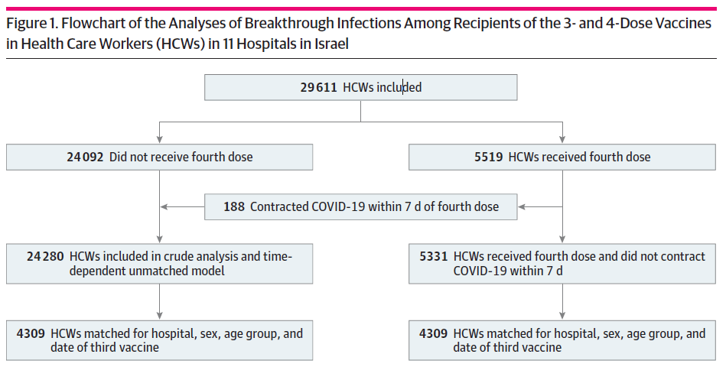
JAMA Network Open. 2022;5(8):e2224657. doi:10.1001/jamanetworkopen.2022.24657

Slide 12
44% Reduction in Breakthrough Infections in matched recipients!
JAMA Network Open. 2022;5(8):e2224657. doi:10.1001/jamanetworkopen.2022.24657

Slide 13
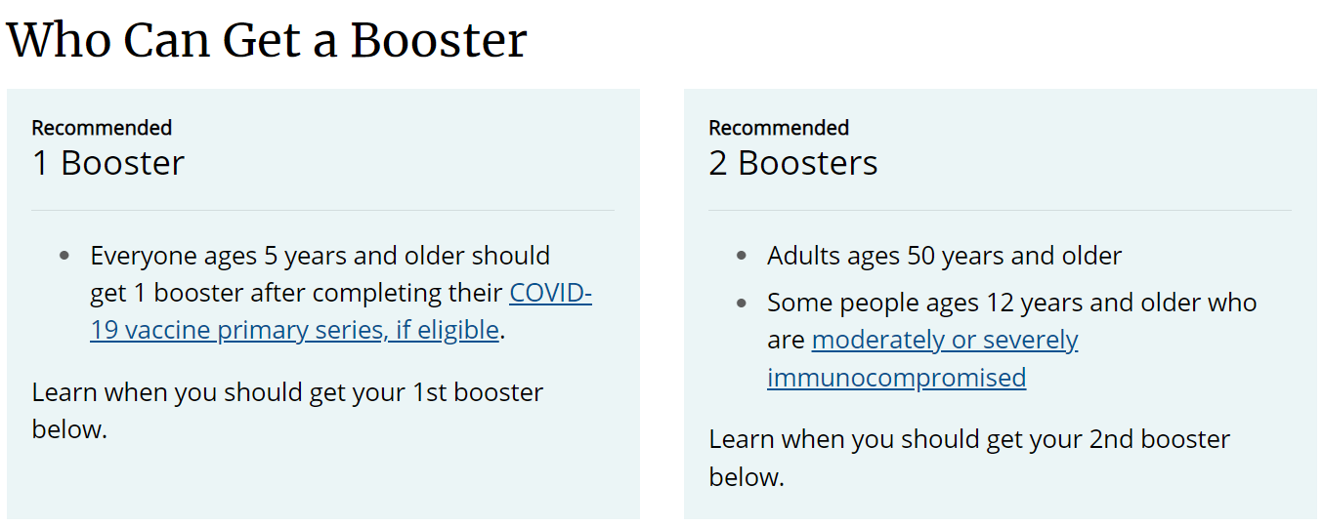
https://www.cdc.gov/coronavirus/2019-ncov/vaccines/booster-shot.html

Slide 14
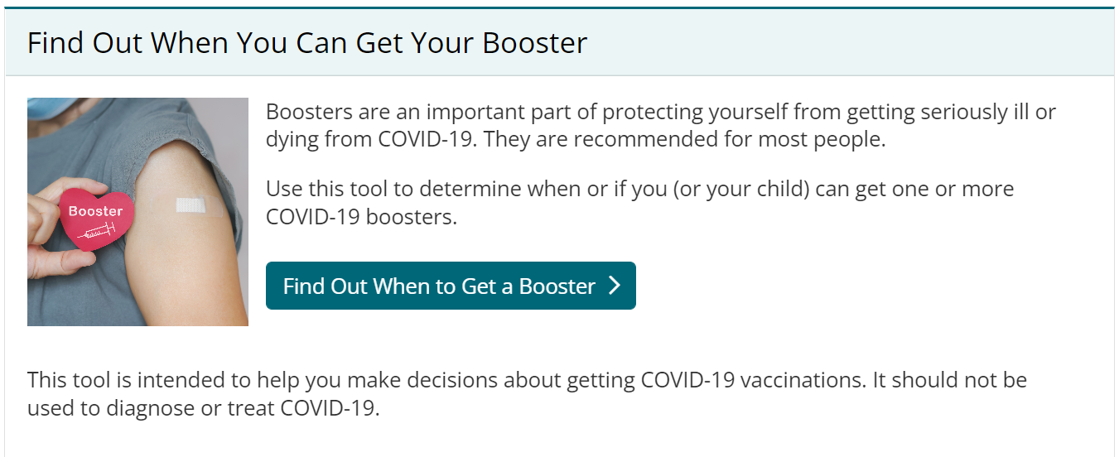
https://www.cdc.gov/coronavirus/2019-ncov/vaccines/booster-shot.html

Slide 15
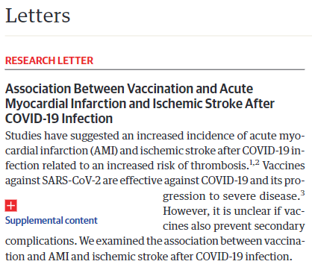
“This study found that full vaccination against COVID-19 was associated with a reduced risk of AMI and ischemic stroke after COVID-19.”
In those fully vaccinated:
52% reduction in AMI
60% reduction in ischemic stroke
JAMA Published online July 22, 2022.

Slide 16
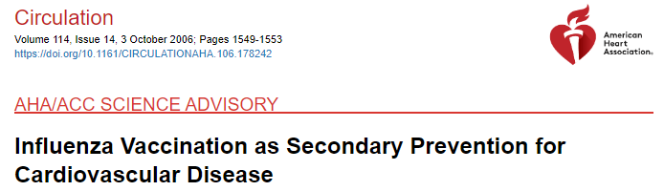
That COVID vaccines might prevent stroke and heart attack did not surprise me……
Many viral infections increase the risk for blood clots!
Seasonal influenza represents a major preventable threat to the health of persons with CVD. Clinical trials and observational studies have demonstrated that vaccination against influenza is associated with significantly reduced risk of cardiovascular death and nonfatal events. Vaccination is currently recommended for persons with diabetes, a condition common to patients with CVD. On the basis of this evidence, the AHA and ACC recommend inactivated influenza vaccination as a component of secondary prevention for persons with coronary disease and other atherosclerotic vascular conditions (Class I, Level B).

Slide 17
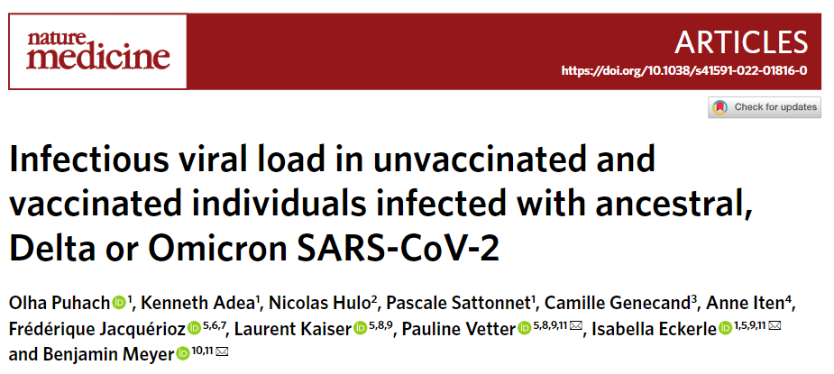
Our findings indicate that vaccines may lower transmission risk and, therefore, have a public health benefit beyond the individual protection from severe disease.

Slide 19
So, when I am asked why people should be vaccinated against COVID
The vaccines do reduce the likelihood of infection.
Most importantly, they reduce your risk of hospitalization, complications (including AMI and stroke), and death from COVID
They reduce the likelihood of long-COVID syndrome (PACS)
If you do get infected, they may reduce the chance that you spread the disease to someone else.

Slide 20
Finally, my long-term soap box……….
Far too often, we fail to provide indicated vaccines to patients that are in our care!
Arch Intern Med. 2002;162:2349-2356.

Slide 21
dale-bratzler@ouhsc.edu

