Slide 1
Advisory Committee Meeting
May 18, 2021

Slide 2
Accreditation Staff
Jessica Ventris, Accreditation Manager
Dr. Justin Lockwood, Deputy State Director
Sandra McKnight, Financial Aid Specialist
Alan Nahs, Civil Rights Coordinator
Kim Downey, Project Assistant

Slide 3
Advisory Committee
Alicia Smith | Financial Aid Director | Metro
Andrew Hammontree | Director of Financial Aid & Scholarships | Francis Tuttle
Angela Jones | Executive Assistant to the State Director | ODCTE
Angela Teeman | Program Specialist-STEM | ODCTE
Ashely Hernandez Torres | Financial Aid Officer | Meridian
Barbara Hagy | Director of Instructional Services | Tulsa Tech
Becki Foster | Chief of Staff/SAA Representative | ODCTE
Brian Ruttman | Superintendent | Moore Norman
Brook Holding | Assistant Superintendent | Red River
Caiden Olliso | FCCLA | Great Plains
Cara Adney | Marketing & Media Relations Coordinator | Meridian
Cori Gray | Deputy State Director | ODCTE
Diane Duffy | Nursing Instructor | Chisholm Trail
Doug Hall | Deputy Superintendent | Kiamichi
Dr. Marcie Mack | State Director | ODCTE
Jacob Schonfield | BPA State President | Central Tech
James Bishop | Director of Instruction | Great Plains
Jeff Huffman | Director of Full-Time Programs | Autry
Jenny Cypert | BIS Director | Pontotoc
Joann Simon | HR Director | Southern
Justin Lockwood | Deputy State Director | ODCTE

Slide 4
Advisory Committee
Kenneth Stull | Manager of Information Services | Mid-America
Kerri Watkins | Information Management Division – Manager | ODCTE
Kerry Eades | Assessment Specialist | ODCTE
Kerry Evans | BIS Director | Southwest
Letha Bauter | Federal Programs Manager/State ABE Director | ODCTE
Linda Sanford | Instructional Leader | Wes Watkins
Margi Cooper | Digital Delivery Coordinator | ODCTE
Mike Lindley | BIS Director | Wes Watkins
Millisa Ellefson | Dir. Of Community Outreach and Communications | EOC
Nancy Rodriguez | Professional Development | ODCTE
Patrick Clanin | Regional Coordinator | ODCTE
Rebecca Eastham | BIS Director | Meridian
Rusty Gilpin | Health Programs Coordinator | Gordon Cooper
Sharon Baker | Disabilities Services Specialist | ODCTE
Shawna Nord | Academic Coordinator | ODCTE
Shelly Mounce | Executive Assistant to the Superintendents | Northeast
Steven Aragon | Equity/Diversity Specialist | ODCTE
Traci Thorpe | Superintendent | Pioneer
Zachary Hope | Automotive Instructor | Mid-Del

Slide 5
NACIQI Update, Dr. Justin Lockwood

Slide 6
Civil Rights Update, Alan Nahs
Title 34 CFR Part 106, §106.8(a) Designation of coordinators, dissemination of policy, and adoption of grievance procedures.
The Annual Nondiscrimination Notice and the Continuing Nondiscrimination Statement must now contain the Title IX and 504 Coordinators email in it.
Distance Education (DE), World Wide Web Consortium (W3C), the guidelines noted in the DE portion of the accreditation standards.
All Inclusive, color blindness and dyslexia

Slide 7
Financial Aid Update, Sandra McKnight
28 districts participate in FSA, all 28 have served as a peer examiners
Typically 2 peers and myself per visit:
3.3b(1)
6.5b(1-12) and related Met/Not Met
Consumer Information of Exhibit 6 (pgs 70-76)
10-20 student files
Related interviews
corrective actions have been related to clock-hour compliance

Slide 8
2021 Schedule
Mid-America Technology Center -
Sept. 1 Virtual New Examiner Training
Sept. 7 Virtual Examiner Prep Day
Sept. 8-9 Hybrid Visit (Sept. 8 Virtual Interviews. Sept. 9 Onsite)
Western Technology Center -
Sept. 15 Virtual New Examiner Training
Sept. 20 Virtual Examiner Prep Day
Sept. 21-23 Hybrid Visit (Sept. 21 Virtual Interviews. Sept. 22-23 Onsite)
Kiamichi Technology Center -
Sept. 28 Virtual New Examiner Training
Oct. 4 Virtual Examiner Prep Day
Oct. 5-7 and Oct. 12-14 Hybrid Visit (Oct. 5-7 Virtual Interviews. Oct. 12-14 Onsite)
Francis Tuttle Technology Center -
Oct. 27 Virtual New Examiner Training
Nov. 1 Virtual Examiner Prep Day
Nov. 2-5 Hybrid Visit (Nov. 2-3 Virtual Interviews. Nov. 4-5 Onsite)

Slide 9
Hybrid Model
Virtual group interviews
Virtual examiner collaboration
Onsite for verification, individual interviews, program observations
Onsite exit report, virtual option

Slide 10
Online Examiner Training Materials
Simplified
Accreditation Overview
Electronic Data Entry Exercises

Slide 11
New Examiner Training
Week before visit
Overview of the process
Q&A time

Slide 12
Virtual Prep Day
In place of Boot Camp
Brief training
Examiners review application
Examiners develop interview questions, documentation requests, etc.
Team collaboration
Cross team collaboration

Slide 13
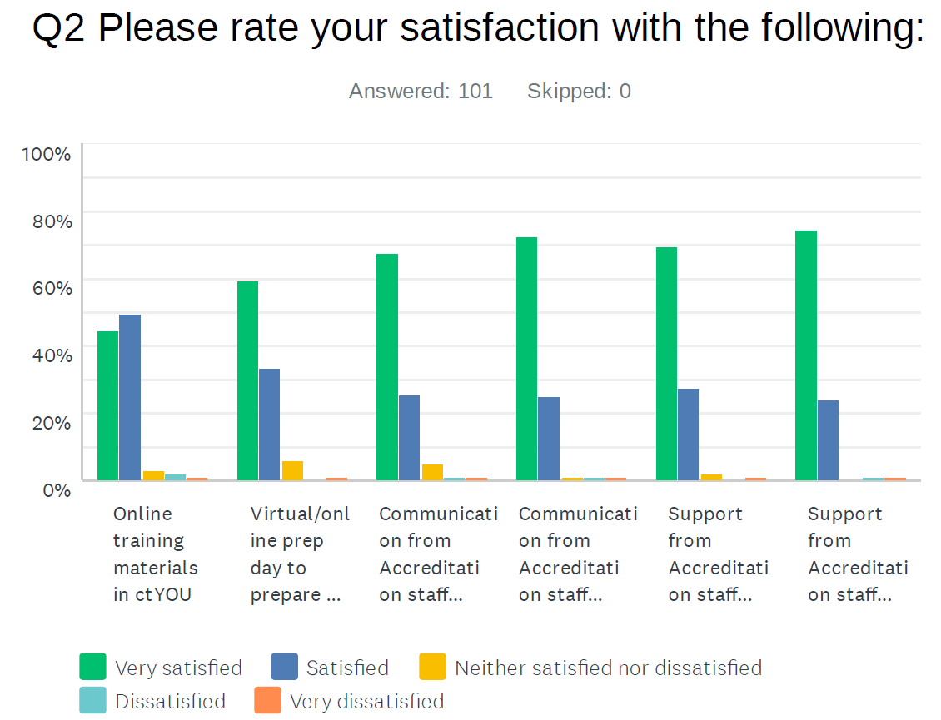
2020 Survey Results - Examiners

Slide 14
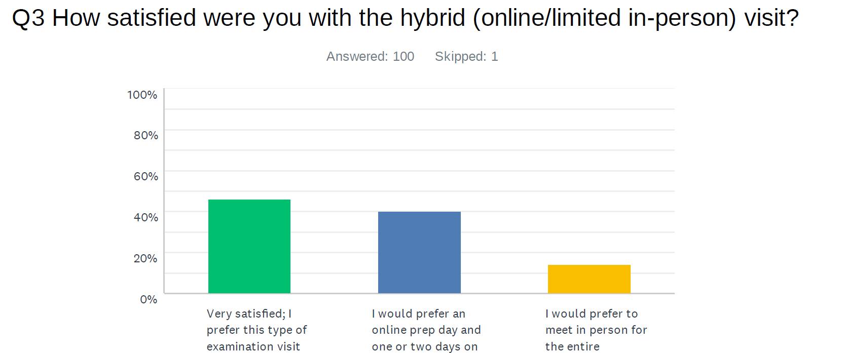

Slide 15
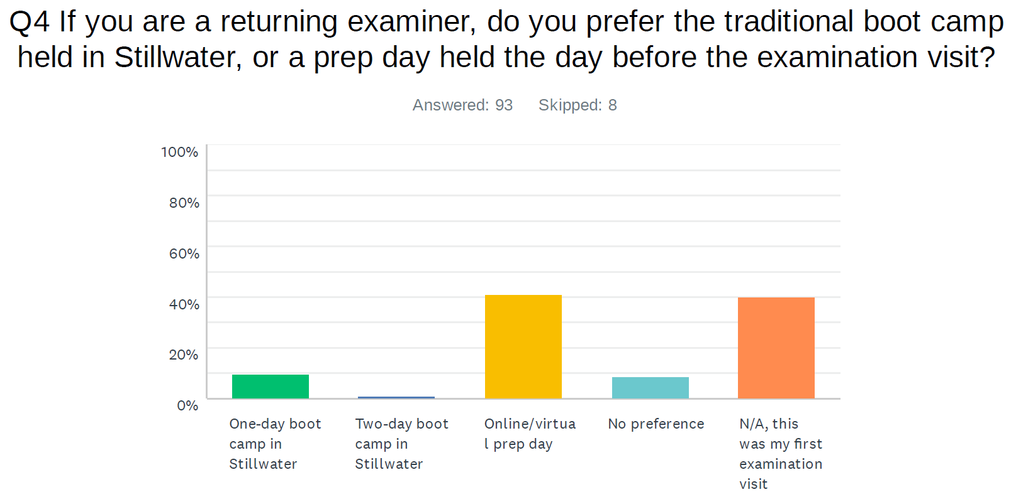

Slide 16
2020 Survey Results – Technology Centers

Slide 17
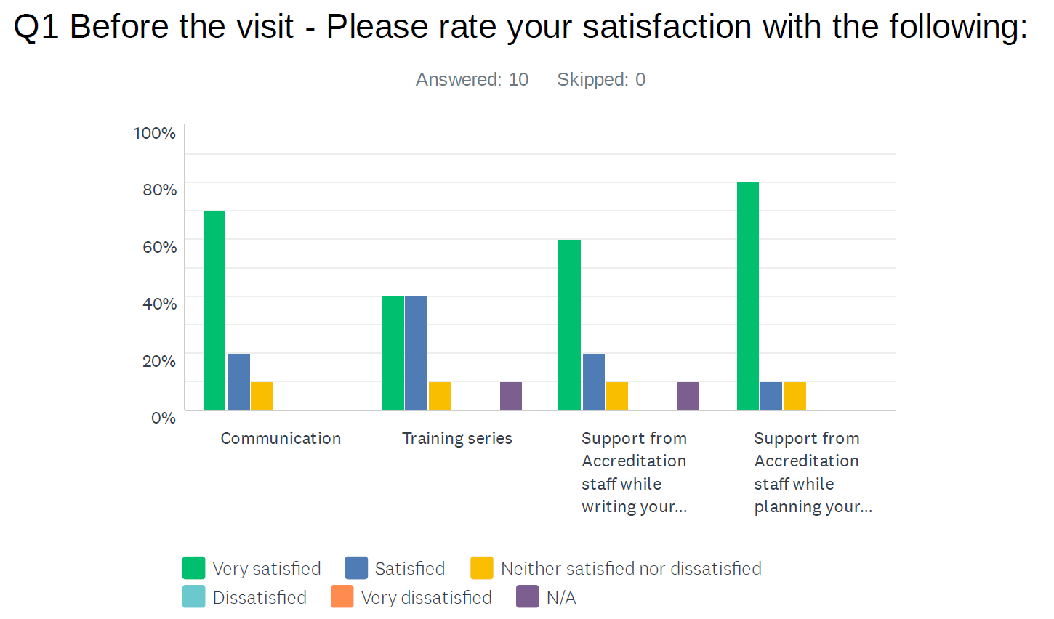

Slide 18
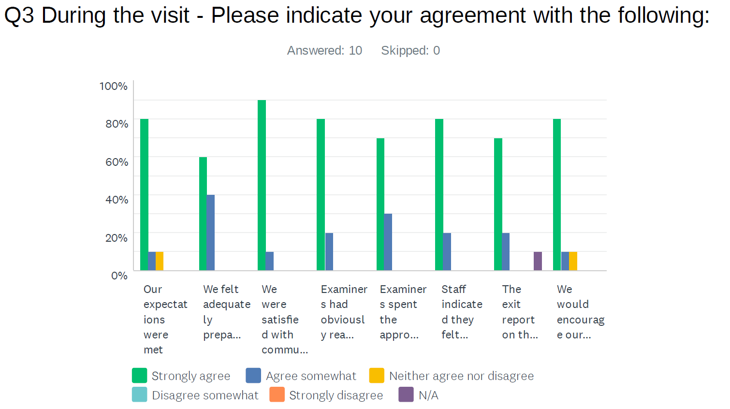

Slide 19
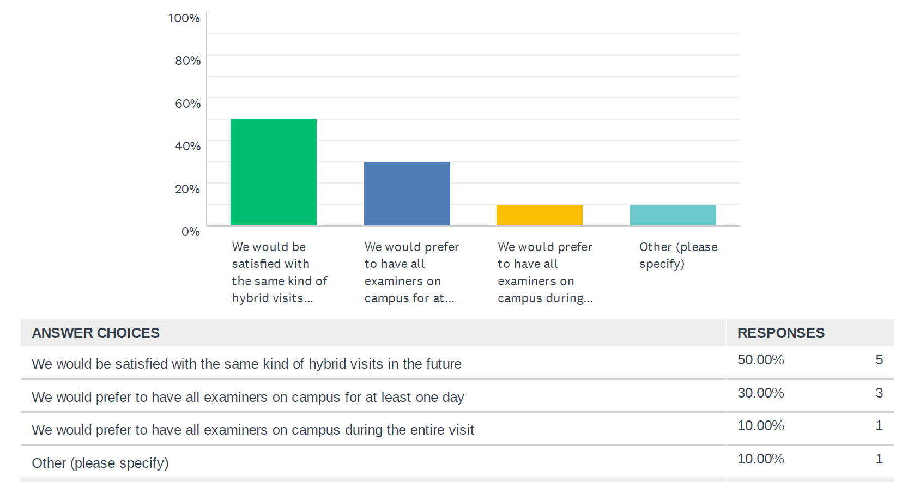

Slide 20
Break Out Discussions
What improvements can be made? What stays and what goes?
Examiner Training – Online and Virtual
Prep Day vs Boot Camp
Visits – Hybrid vs. All Virtual vs. All In Person

Slide 21
Guideline Updates
Clarity
Format

Slide 22
Definition Updates

Slide 23
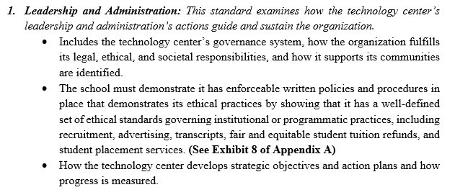
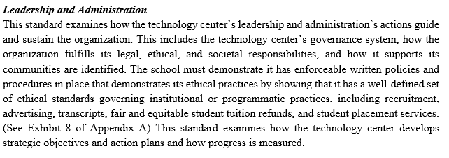
Standards

Slide 24
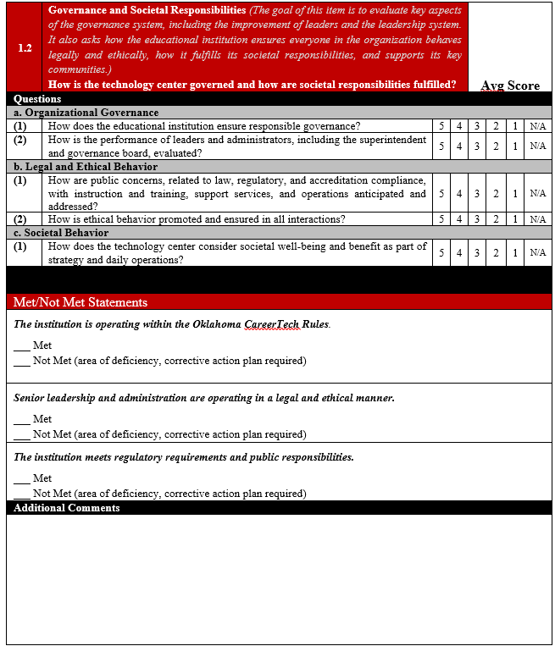
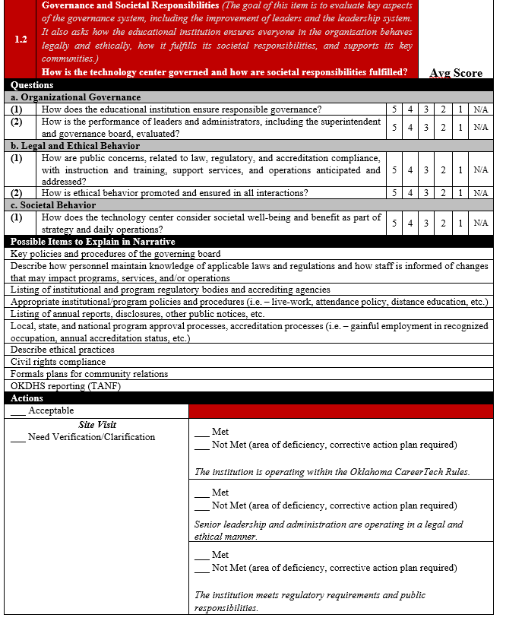
Rubrics

Slide 25
Distance Education, Sandra McKnight
Pre COVID-19, 3 CT districts with 1 program approved with synchronous DE
Temporary DE flexibilities due to COVID-19 instruction interruption
March 2020 – through the payment period following the end of the nationally declared pandemic
No end date announced yet
Sept 2, 2020 Final Rules DE published. Nationally clock-hours now eligible for accreditor approval for Title IV
Tech Center DE approvals pending accreditation process:
2 with single synchronous program
2 planning 1 or more programs with asynchronous DE

Slide 26
Training Series for Technology Centers
Virtual Model
What are the most important items to cover?

Slide 27
Thank you!

