Slide 1
Livestock Production in Oklahoma

Slide 2
Beef in Oklahoma
Unit 2 Lesson 2.2: Beef Cattle in Oklahoma

Slide 3
Economic Impact
Oklahoma ranks 4th in total beef inventory
More than 43,000 farms in Oklahoma have cattle
More than 4,500,000 cattle in Oklahoma
In 2021, the US consumed 30 billions pounds of beef
The average American eats 67 pounds of beef per year
That's 25 billion hamburgers!
Oklahoma exported nearly $350,000,000 in beef in 2020, adding $2.7 billion to Oklahoma's economy

Slide 4
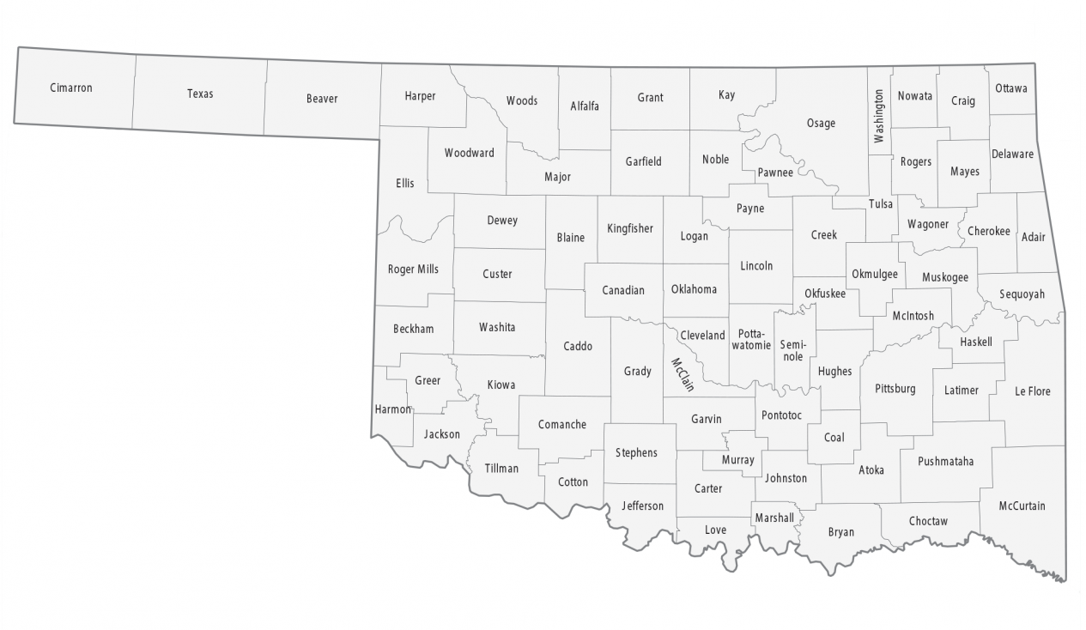
Beef in Oklahoma
Top beef cattle producing counties are:
Texas
Osage
Grady
Cimarron
Craig

Slide 5
Stages of Production: Cow-Calf Operations
Production of cattle for beef/breeding
Goal: 1 calf/year produced per cow
Timeline: Conception to 6-12 months
Conception: AI, Natural processes
Birth: 60-100 lbs
6-12 months: 450-700 lbs
Weaning: taking off milk
1 bull per 25 females
2 options:
Keep for breeding (bulls, replacement heifers)
Sell

Slide 6
Stage 2: Stocker Operations
Goal: Grow Beef animals for eventual meat production
Gain productive (lean) weight
Timeline: Weaning-16 or so months
Grown on forage or pasture

Slide 7
Stage 3: Finishing/Feedlot
Goal: Add marbling, fat, cover, desirable characteristics for flavor
Timeline: 4-6 months with grain, 6-10 months on grass
Goal Weight: 1200-1400 lbs (18-22 months)
Usually done in feedlots

Slide 8
Finishing/Feedlot Locations
El Reno
Keyes
Buffalo
Boise City
Gage
Felt
Texhoma
Guymon
Hooker
Lone Wolf

Slide 9
Pork in Oklahoma
Unit 2 Lesson 2.3: Pork Production in Oklahoma

Slide 10
Economic Impact
Oklahoma ranks 9th in total hog production
2.18 million pigs in 2022
Oklahoma produced 2.07 billion pounds of pork in 2023
$369.8 million exported from Oklahoma
34,000 jobs are supported by Oklahoma Pork industry

Slide 11
Pork in Oklahoma
Top 5 Pork producing counties:
50% of pigs are in Texas county
Hughes
Caddo
Harper
Coal

Slide 12
Stages of Production: Farrow-to-Fish
Most common type of production
Vertical integration of production
Timeline:
Nursery (50 lbs)
finish barn (240-270 lbs)
~170 days

Slide 13
Stages of Production: Feeder Pig Production
Sows produce piglets that will be sold
Produce piglets to sell when they are ~50 lbs (8-10 weeks)

Slide 14
Stages of Production: Market Hog Production
Purchase pigs at ~50 lbs and feed pigs until they reach maturity at 240-270 lbs

Slide 15
Poultry in Oklahoma
Unit 2 Lesson 2.4: Poultry Production in Oklahoma

Slide 16
Economic Impact
1.5 billion pounds of broiler meat produced every year
$744 million value
$6.74 billion impact
565 million eggs produced
$81 million value
$770 million impact
Oklahoma Ranks 12th in total poultry production

Slide 17
Poultry Meat in Oklahoma
Top broiler producing counties are:
LeFlore
McCurtain
Delaware
Adair
Haskell

Slide 18
Poultry Egg in Oklahoma
Top egg producing counties are:
Delaware
McCurtain
Adair
Muskogee
Sequoyah

Slide 19
Chicken Production
Breeder-Bird
Growing pullets and cockerels for reproduction
Pullet
Raising day-old females to replace hens
Maturity is reached around 18-20 weeks
Layers
Hens kept to produce eggs
Chickens average 250 eggs per year
Broiler Production
Meat chickens
6-8 week process

Slide 20
Dairy in Oklahoma
Unit 2 Lesson 2.5: Dairy Production in Oklahoma

Slide 21
Economic Impact
$17 million in dairy exports
$177 million in economic impact from dairy
300 dairy farms in Oklahoma
715 million lbs of milk produced in Oklahoma
143.7 million gallons
37th in total milk production

Slide 22
Top Milk Inventory in Oklahoma in Oklahoma
Top milk cow inventory producing counties are:
Mayes
Tillman
Delaware
Adair
Kingfisher

Slide 23
Goats and Sheep in Oklahoma
Unit 2 Lesson 2.6: Goat Production in Oklahoma

Slide 24
Economic Impact
57,000 sheep in Oklahoma
31st in Wool production
83,000 lbs of wool produced in 2024
25th in total inventory of sheep
17th in market sheep production
79,000 goat in Oklahoma
5th in total inventory
7,300 milk goats in Oklahoma
18th in total milk goat inventory

Slide 25
Top Sheep Inventories in Oklahoma
Top sheep inventory counties are:
Lincoln
Craig
Payne
Mayes
Johnston

