Slide 1
Introduction to the 3-Circle Model of Agricultural Education

Slide 2
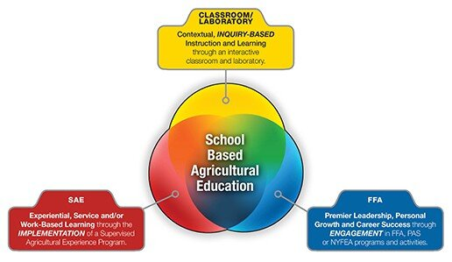
What is the 3-Circle Model?
Describes what a student's experience in agricultural education should look like
Helps students gain knowledge, practical experiences, and leadership skills to succeed in an agricultural career

Slide 3
Classroom/Laboratory Instruction
Formal learning in both the classroom and laboratory

Slide 4
Supervised Agricultural Experiences
Allows students to gain hands-on experiences outside of the classroom
Students will take what they learn in the classroom and apply it to the outside world
You will design, participate, and reflect on a project this year

Slide 5
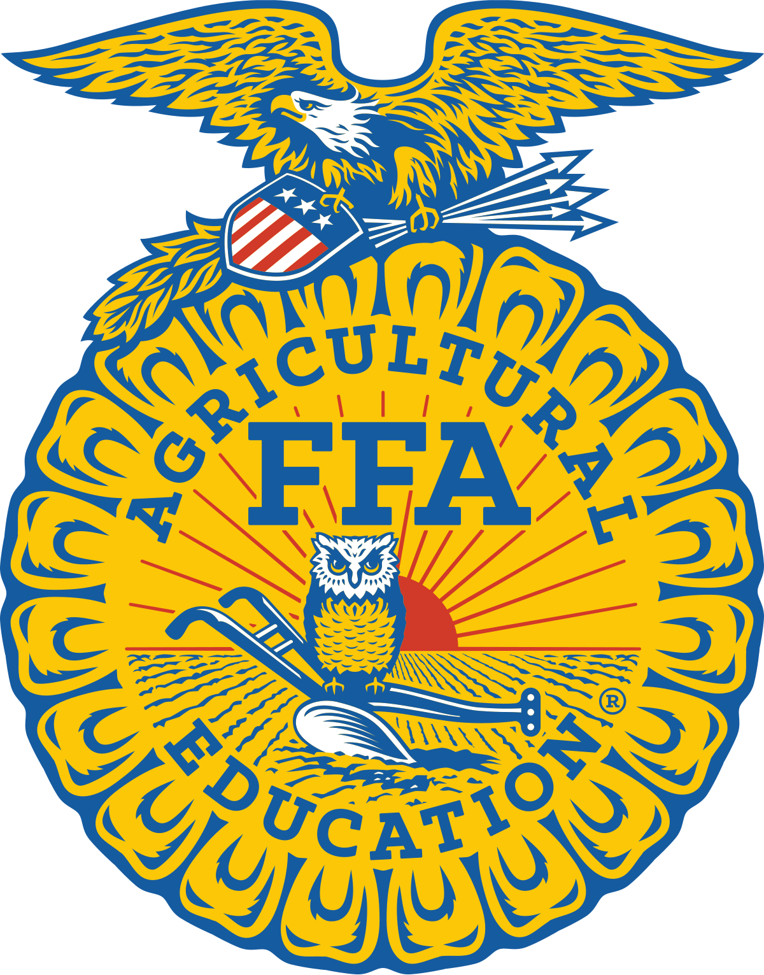
FFA
Leadership organization that provides opportunities for personal growth, career development, and community service
Students can participate in leadership training, competitions, travel opportunities, and team bonding experiences
FFA members develop critical skills like teamwork, communication and problem-solving

Slide 6
How Do The 3 Circles Work Together?
The classroom and laboratory provides students with foundational knowledge
SAEs allow students to apply this knowledge in real-world situations
FFA fosters personal growth, and allows students to further apply knowledge

Slide 7
Conclusion Questions
What does the 3-Circle model describe?
What are the 3 components of the model?
How do the components of the 3-Circle model work together?
Which part of the 3-Circle model do you think is the most important?

