Slide 1
Orientation to Agriculture in Society
Unit 1: Ag in Society

Slide 2
What is Agriculture?
Unit 1 Lesson 1

Slide 3
Lesson 1 Objectives
Define agriculture and describe its impact
Explore agriculture's role in feeding the world
Summarize sciences used in agriculture
Discover agriculture in your own community

Slide 4
What is Agriculture?
Think of everything you’ve done in the last 24 hours
  Put on clothes, ate, drove to school, played sports, etc.
What have you done that involved agriculture?
The real question: how are you NOT involved in agriculture?

Slide 5
What is Agriculture?
Growing and raising plants and animals for food, clothes, shelter
Agriculture helps feed the world and make money for ag producers like farmers and ranchers
Can include:
  Agronomy – science of growing crops and managing soil
  Horticulture – Cultivating and growing fruits, vegetables, flowers, and other plants
  Livestock production – raising animals for food, fiber, or other products

Slide 6
Are You Involved in Agriculture?
Even if you don’t raise livestock or grow crops, how could you be involved in agriculture?

Slide 7
Feeding the World’s Growing Population
The world's population keeps growing
  The world population is currently a little more than 8 billion
  World population is expected to be ~9.7 billion by 2050
  Meaning we need more food every day
    Total food demand will increase by ~57% by 2050
    33% of food is wasted
    If we stay on the current trajectory, we need to produce 70% more food by year 2050 to feed the world’s population and end food insecurity

Slide 8
Food Insecurity
Food Insecurity – condition of not having access to sufficient food to meet basic needs
  13.5% of US households are food insecure
  15.4% of Oklahoma households are food insecure
  Projected 8% increase in food insecurity by 2050.

Slide 9
Feeding the World
Food System – the sum of all activities related to food production, distribution, consumption, and waste.
  ~33% of food is wasted
    Do you ever waste food?
    Do you think food waste is a problem?
How are you involved in the food system?
How could you get involved in the food system?
What role does agriculture play in feeding the world?

Slide 10
The Science of Agriculture
Ag producers use science to grow better, and more food
What science subjects do you think they use?

Slide 11
Agriscience
Agriscience – field of science that deals specifically with agriculture. Application of fields like biology, botany, ecology, meteorology, chemistry, and engineering in the field of agriculture.
  Helps us:
    Grow more food with less land
    Protect the environment
    Keep animals and plants healthy
    Increase efficiency and productivity of agricultural production

Slide 12
Sciences in Agriculture
Biology: Study of living organisms like animals and plants
  Botany: The scientific study of plants
  Animal science: Study of livestock and other animals
  Ecology: Branch of biology that deals with relationships of organisms to one another and to their surroundings
Meteorology: Branch of science dealing with weather and the atmosphere
Chemistry: Study of matter and its properties
Engineering: Design, building, and use of engines, machines, and structures

Slide 13
How Could Each of these Sciences be Used in Agriculture?
Biology
Meteorology
Chemistry
Engineering

Slide 14
Agriculture in Our Community
You will learn about agriculture and its impact to society in this class
You will have an SAE
  Supervised Agricultural Experience
  Student-led, instructor supervised learning experiences outside the classroom
You can join FFA
  Intracurricular student organization for those interested in agriculture and leadership
  Local activities can include: __________________________________

Slide 15
Unit 1 Lesson 1 Review
What is agriculture?
How does science help farming?
How can you learn about agriculture in your school?
Key terms: Agriculture, livestock, agronomy, horticlture, food insecurity, food system, agriscience, FFA, SAE

Slide 16
Significance of Agriculture
Unit 1 Lesson 2

Slide 17
Lesson 2 Objectives
Summarize the history of agriculture from hunting and gathering to today
Create a timeline outlining agricultural history in the US
Discover where food is grown in the US
Locate where food is grown in Oklahoma
Explore careers in agriculture

Slide 18
History of Agriculture
Long ago, people hunted and gathered for food.
Then they started farming — this is called domestication.
Farming allowed people to build society
  Cities and communities, art, sports, comforts and safety all exist because of agriculture
They began trading farm products, called commodities.

Slide 19
History of Agriculture – Independent Research
What were the first animals domesticated? Where were they domesticated, and why? What impact did that have on the peoples who domesticated the animals?
What were the first plants domesticated? Where were the first plants domesticated, and why? What impact did that have on the peoples who domesticated the plants?

Slide 20
History of Agriculture in the US
Before 1492
  People cultivated crops like maize, beans, tobacco
  Sustainable production for small communities
1500-1700
  Staple crops included corn, tobacco, wheat, barley
  Cattle, pigs, chickens and horses were imported and produced
  Tobacco dominated crop markets in places like Carolinas and Virginia
1700-1800
  Grain, Dairy, Livestock were grown in the northern US
  Cotton, Rice, and Tobacco were grown in the southern US
    Plantation Economy – System of large-scale ag production, reliant on a specific cash crop like cotton
    Relied on enslaved African Labor

Slide 21
History of Agriculture in the US
1800-1860
  Ag production in the Midwest grew, including crops like wheat and corn
  Steel plow and mechanical reaper improved ag production efficiency
  South continued to produce high levels of cotton
1860-1900
  Homestead Act deeded new lands to potential ag producers, increasing production
  Railroad expansion boosted grain and livestock markets
  USDA is created
  Morrill Act of 1862: Granted states federal land to establish colleges (Land Grant Schools)
    Oklahoma State University is a land grant school
    Focus on agriculture and mechanical arts
  Cattle Drives move cattle from plains areas to markets in places like Kansas
    Chisholm Trail: Cattle trail that started in Texas and went through Oklahoma. Highway 81 follows the same route

Slide 22
History of Agriculture in the US
1900-1930
  FFA is founded
  Chemical fertilizers and pesticides are being to see adoption on US farm
  Mechanized agriculture began to increase ag production, especially in crop production
    Tractors and other mechanized equipment replaces animal labor
1930s
  Dust Bowl
    Environmental disaster that affected areas of Oklahoma, Texas, Kansas, Colorado, and New Mexico
    Caused by poor soil conservation practices and overproduction
  New Deal Efforts included programs to improve farming conditions in the Great Plains
    Soil Conservation Service was started to combat soil erosion and restore degraded land

Slide 23
History of Agriculture in the US
1940-1970
  Ag productivity continues to increase because of: hybrid seeds, synthetic fertilizers, and mechanization
  US increases participation in global food markets
1970-2000
  Growth of niche food markets like organic labeling
  The first commercially-available GMO is introduced
    These include tomatoes, corn, cotton, soybeans, and canola
2000-Present
  Consumers have more choices in their food than ever before
  Use of precision agriculture improves efficiency

Slide 24
Agriculture in the United States Today
The U.S. is a leader in agriculture production around the world
  Commodities: materials or products that can be bought or sold
    Including crops like corn and beef
    Farmers will produce a commodity like cattle or corn and sell it
    That commodity is then processed and turned into something useful
      Turning cattle into steaks
Agriculture and food add money to our economy
  US ag and food industries support more than 19 million jobs (10% of US employment)
    Less than 2% of all people are directly involved in production ag
  GDP: Gross Domestic Product
    Country’s total value of goods and services
    Agriculture and food industry makes up about 6% of the US GDP

Slide 25
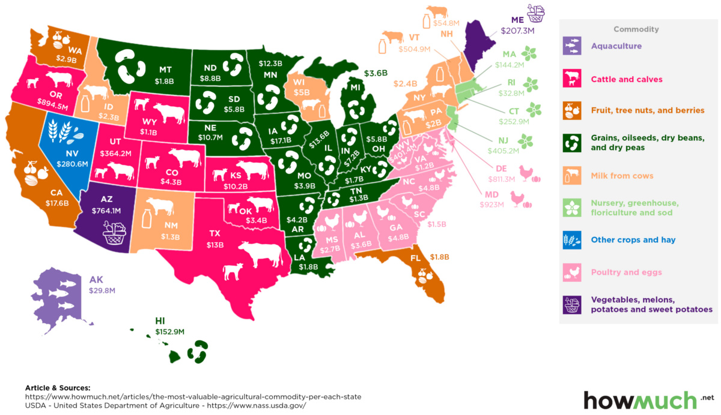
Where is Your Food Grown?

Slide 26
Agriculture in Oklahoma
Oklahoma’s top commodities include: Cattle, Wheat, Pork, Poultry
Farming is a big part of our state’s identity and economy
  There are more than 86,000 farms in Oklahoma
  Supports more than 188,000 jobs
Agriculture adds $9.8 billion to Oklahoma GDP

Slide 27
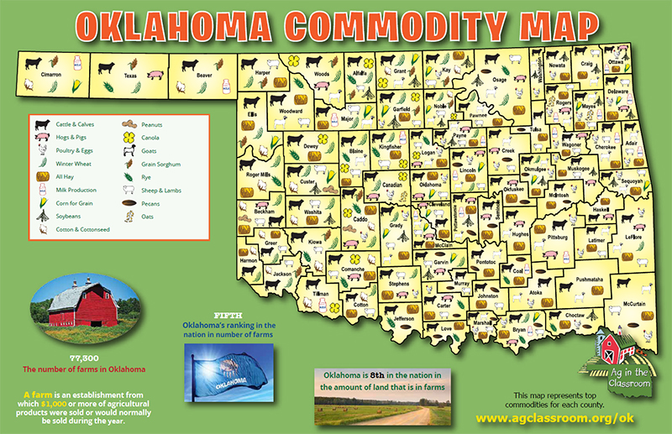
Where is Food Grown in Oklahoma?

Slide 28
Careers in Agriculture
You don’t have to be a farmer to work in agriculture!
You can be a scientist, teacher, truck driver, engineer, or even a lawyer.
You can try out careers with SAEs, CDEs, and LDEs through FFA.
Don’t know if an ag career is in your future?
  Take the MyCareer Quiz
  https://agexplorer.ffa.org/
  Write down your top 3 ag careers based on the results of the test

Slide 29
Lesson 2 Review
What did early farmers do?
What does Oklahoma grow or raise?
What career in agriculture sounds fun to you?
Key Terms: Domestication, Commodities, GDP, Career, Livestock, Agronomy, Horticulture, CDE, LDE

Slide 30
Orientation to Agricultural Education and FFA
Unit 1 Lesson 3

Slide 31
Lesson 3 Objectives
Name and describe the components of the 3-circle model
Recite the FFA motto and mission statement

Slide 32
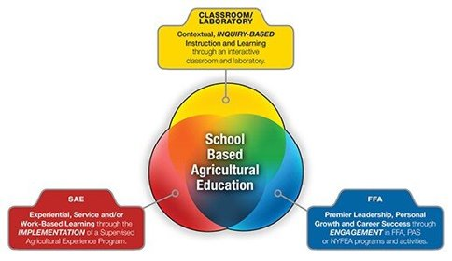
Agricultural Education and the 3-Circle Model
Describes what a student's experience in agricultural education should look like
Helps students gain knowledge, practical experiences, and leadership skills to succeed in an agricultural career

Slide 33
Classroom/Laboratory Instruction
Formal learning in both the classroom and laboratory
It's what you are experiencing right now
In this class, you will learn about the foundations of agriculture and its impact on society

Slide 34
Supervised Agricultural Experiences
Allows students to gain hands-on experiences outside of the classroom
Students will take what they learn in the classroom and apply it to the outside world
You will design, participate, and reflect on a project this year

Slide 35
SAEs and Record Keeping
SAE: A project you work on like growing a garden or raising a pig
  You learn by doing
You must track your progress using record keeping
SAEs can vary from student to student, but each student will:
  Develop an SAE plan that focuses on their interests
  Participate in experiences or activities related to their SAE
  Keep records of their plan on AET

Slide 36
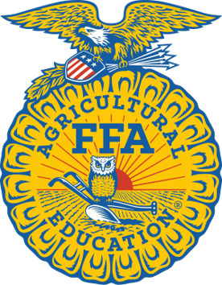
FFA
Leadership organization that provides opportunities for personal growth, career development, and community service
Students can participate in leadership training, competitions, travel opportunities, and team building experiences
FFA members develop critical skills like teamwork, communication and problem-solving

Slide 37
FFA Motto and Mission
FFA Motto:
  "Learning to Do, Doing to Learn, Earning to Live, Living to Serve"
FFA Mission Statement:
  FFA makes a positive difference in the lives of students by developing their potential for premier leadership, personal growth, and career success through agricultural education

Slide 38
Lesson 3 Review
What are the 3 parts of ag education?
What does FFA help you do?
What kind of SAE would you like to do?
Review Words: 3-Circle Model, FFA, SAE, CDE, LDE, Career

Slide 39
Unit Review
What is agriculture?
Why is it important in your community and the world?
How can YOU be involved in agriculture?
Challenge Question:
How can you use what you’ve learned to help others or solve problems?

