Slide 1
Bidders Conference
2022-2026 ABE Grant Competitions
Wednesday, December 8, 2021

Slide 2
Welcome
Presentation is being recorded and will be posted to the ODCTE ABE Grant Competitions webpage shortly after conference.
All questions must be submitted into the chat box. Questions that were not addressed during the conference will be addressed in the Q&A document on the webpage by January 1, 2022.
All grant information will be posted via the webpage.

Slide 3
Objectives for Bidders Conference
Outline the requirements of the grant.
Explain the application components.
Define budget and program requirements.
Provide guidance and answer questions.

Slide 4
Request for Proposal (RFP)
General Information

Slide 5
Request for Proposal (RFP) Information
ODCTE will host three separate grant competitions.
Instructions, scoring rubrics, and supplementary documents will be included for each separate grant by January 1, 2022.
Applications are fillable PDF documents.
All grant-related information, including the RFP applications, are located on the ODCTE ABE Grant Competitions webpage.
All correspondence related to the grant competition must be emailed to abe@careertech.ok.gov.

Slide 6
Grant Award Periods
Initial Period of Performance July 1, 2022, to June 30, 2023.
Annual Renewals
  Renewal Period July 1, 2023, to June 30, 2024
  Renewal Period July 1, 2024, to June 30, 2025
  Renewal Period July 1, 2025, to June 30, 2026
The amount received by eligible recipients will be held steady for not more than two years.

Slide 7
Priorities of Funding
As required by WIOA, funding is prioritized for the following applicants:
Who have demonstrated effectiveness in improving the literacy of eligible individuals, especially with respect to eligible individuals who have low levels of literacy;
Whose services are aligned with local workforce strategies, priorities, and partners; and
Whose services are responsive to the needs of persons with barriers to employment.

Slide 8
Timeline
December 8, 2021 | Bidder’s Conference
January 1, 2022 | ODCTE begins accepting proposal for funding applications.
January 1, 2022 – February 15, 2022 | Grant RFP applications may be submitted to ODCTE via abe@careertech.ok.gov.
February 15, 2022, at 11:59 PM CST | Deadline to submit applications.
February 16, 2022 – April 14, 2022 | ODCTE conducts a review of the applications, conducts a pre-award risk assessment, and makes the final determination of who will receive an award during 2022-2026. Local workforce development area boards will review applications to determine alignment of the applications with their local plans and provide recommendations to the ODCTE.
April 15, 2022 | Applicants will be notified of award recipient status via email.

Slide 9
Direct and Equitable Access
The competitive grant process ensures:
All eligible providers will have direct and equitable access to apply and compete for grants;
The same grant announcement and application processes are used for all eligible applicants in the State; and
All applicants must respond to the same thirteen (13) federal considerations.

Slide 10
Legislation and Policies
Applicants need to be familiar with the:
Laws (WIOA and Title II)
Applicable Federal and State regulations (EDGAR, UGG)
Oklahoma’s State Plan for Workforce Development
Regional/Local Workforce Development Plans
Oklahoma Adult Education and Literacy Handbook, 2021
Oklahoma Assessment Policies

Slide 11
Workforce Innovation and Opportunity Act (WIOA), 2014
Requires the alignment of workforce, education and economic development systems to support access to high-quality, comprehensive and accessible workforce service for all individuals, including those with significant barriers to employment.

Slide 12
Four Titles Under WIOA
Title I: Adults, Youth, and Dislocated Workers
  US Department of Labor/OESC
Title II: Adult Education
  US Department of Education/ODCTE
Title III: Wagner-Peyser Employment
  US Department of Labor/OESC
Title IV: Vocational Rehabilitation Program
  US Department of Education/ ODRS

Slide 13
Allowable Activities
Adult Education: Academic instruction and education services below the postsecondary level that increase an individual’s ability to do the following: (A) Read, write, and speak in English and perform mathematics or other activities necessary for the attainment of a secondary school diploma or its recognized equivalent. (B) Transition to postsecondary education and training. (C) Obtain employment.
Adult Education & Family Literacy Activities: Programs, activities and services that include adult education; literacy; workplace Adult Education & Family Literacy activities; family literacy activities; English language acquisition activities; integrated English literacy and civics education; workforce preparation activities; or integrated education and training.
English Language Acquisition Program: A program of instruction that meets the following criteria: (A) Is designed to help eligible individuals who are English language learners achieve competence in reading, writing, speaking, and comprehending the English language. (B) Leads to attainment of a secondary school diploma or its recognized equivalent, and transition to postsecondary education and training or employment.
English Language Learner: An eligible individual who has limited ability in reading, writing, speaking, or comprehending the English language and whose native language is a language other than English; or who lives in a family or community environment where a language other than English is the dominant language.
Family Literacy Activities: Activities that are of sufficient intensity and quality to make sustainable improvements in the economic prospects for a family, that better enable parents or family members to support their children’s learning needs and that integrate all the following activities: (A) Parent or family Adult Education & Family Literacy activities that lead to readiness for postsecondary education or training, career advancement and economic self-sufficiency. (B) Interactive literacy activities between parents or family members and their children. (C) Training for parents or family members regarding how to be the primary teacher for their children and full partners in the education of their children. (D) An age-appropriate education to prepare children for success in school and life experiences.

Slide 14
Allowable Activities (Continued)
Integrated English Literacy and Civics Education: Education services provided to adult English language learners, including professionals with degrees and credentials in their native countries, that enable them to achieve competency in the English language and acquire basic and advanced skills needed to function effectively as parents, workers, and citizens of the United States. Such services shall include instruction in literacy and English language acquisition and instruction on the rights and responsibilities of citizenship and civic participation and may include workforce training.
Integrated Education and Training: A service approach that provides Adult Education & Family Literacy activities concurrently and contextually with workforce preparation activities and workforce training for a specific occupation or occupational cluster for the purpose of educational and career advancement.
Literacy: An individual’s ability to read, write and speak in English, compute, and solve problems at levels of proficiency necessary to function on the job, in the family and in society.
Workplace Adult Education & Family Literacy Activities: Adult Education & Family Literacy activities that are offered by an eligible provider in collaboration with an employer or employee organization at a workplace or an off-site location and that are designed to improve the productivity of the workforce.
Workforce Preparation Activities: Activities, programs or services designed to help an individual acquire a combination of basic academic skills, critical thinking skills, digital literacy skills and self-management skills, including how to use resources and information, work with others, understand systems and obtain skills necessary for successful transition into and completion of postsecondary education or training or employment.

Slide 15
Grant Competition Opportunities

Slide 16
Grant Competition Opportunities
Adult Education & Family Literacy (AEFLA)
  WIOA, Section 231; State 731 Funds
Correctional/Institutional (C/I)
  WIOA, Section 225 Funds; State 733 Funds
Integrated English Literacy & Civics Education (IELCE)
  WIOA Section 243 Funds; State 732

Slide 17
Adult Education & Family Literacy
The purpose of this grant proposal is to fund programs that:
Assist adults to become literate and obtain the knowledge and skills necessary for employment and economic self-sufficiency.
Assist adults who are parents or family members to obtain the education and skills that (A) are necessary to becoming full partners in the educational development of their children, and (B) lead to sustainable improvements in the economic opportunities for their family.
Assist adults in attaining a secondary school diploma and in transitioning to postsecondary education and training, including through career pathways.

Slide 18
Adult Education & Family Literacy (Continued)
Assist immigrants and other individuals who are English language learners in
  (a) improving their i. reading, writing, speaking and comprehension skills in English. ii. mathematics skills.
  (b) acquiring an understanding of the American system of government, individual freedom, and the responsibilities of citizenship (AEFLA Section 202).
Notes:
Hi Letha.

Slide 19
Correctional/Institutional Education (C/I)
Funds under Correctional/Institutional Education may be used to support educational programs for transition to re-entry initiatives and other post-release services with the goal of reducing recidivism.
Such use of funds may include educational counseling or case work to support incarcerated individuals' transition to re-entry and other post-release services.
  Examples include assisting incarcerated individuals to develop plans for post-release education program participation, assisting students in identifying and applying for participation in post-release programs, and performing direct outreach to community-based program providers on behalf of re-entering students.
Such funds may not be used for costs for participation in post-release programs or services.

Slide 20
Integrated English Literacy & Civics Education (IELCE)
Integrated English Literacy and Civics (IELCE) provides education services to English language learners who are adults, including professionals with degrees and credentials in their native countries that enables such adults to achieve competency in the English language and acquire the basic and more advanced skills needed to function effectively as parents, workers, and citizens in the United States.
  Such services must include instruction in literacy and English language acquisition and instruction on the rights and responsibilities of citizenship and civic participation.
The funds provided under section 243 of the Act must be used in combination with integrated education and training.

Slide 21
IELCE Components
The IELCE program must provide education services to English language learners who are adults, including professionals with degrees and credentials in their native countries.
The IELCE program must include instruction in IELCE and must include instruction in literacy and English language acquisition as described under §463.33.
The IELCE program must include instruction on the rights and responsibilities of citizenship and civic participation as described under §463.33
IELCE in Combination with IET - §463.74 specifies that an eligible provider that receives funds through the IELCE program may meet the requirement to use funds for integrated English literacy and civics education in combination with integrated education and training activities by: 1. Co-enrolling participants in integrated education and training as described in subpart D that is provided within the local or regional workforce development area from sources other than section 243; OR 2. Using funds provided under section 243 to support integrated education and training activities as cited in subpart D.
Eligible providers receiving funds through the Integrated English Literacy and Civics Education program must provide services that are designed to: 1. Prepare adults who are English language learners for, and place such adults in, unsubsidized employment in in-demand industries and occupations that lead to economic self-sufficiency; AND 2. Integrate with the local workforce development system and its functions to carry out the activities of the program. §463.73

Slide 22
Section One:
Eligibility
The purpose of this section is to verify applicant eligibility to be a grant recipient in providing Adult Education & Family Literacy services.

Slide 23
Section One Overview
Your organization must be considered an eligible provider to receive federal Adult Education & Family Literacy funding.
An eligible provider means an organization that has demonstrated effectiveness in providing Adult Education & Family Literacy activities.
According to WIOA Sec. 231(a), providers outside of the Oklahoma are not eligible for the grant.
Applications that are incomplete or cannot demonstrate eligibility will not be reviewed, scored, or considered for funding by the review committee.

Slide 24
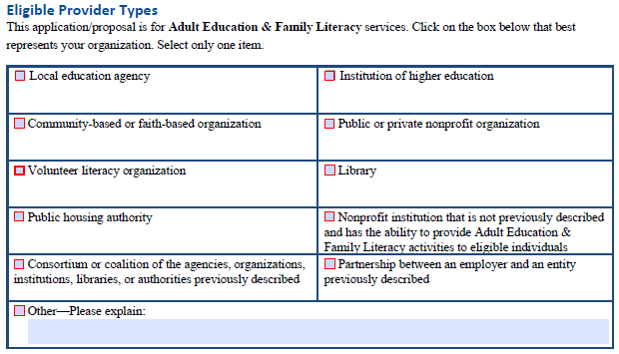
Eligible Provider Types

Slide 25

Demonstrated Effectiveness in Serving Eligible Individuals
The Federal Code of Regulations §463.24 requires that eligible grant applicants must demonstrate effectiveness in serving eligible individuals. ODCTE requires that you submit the last two years of the organization’s outcome data.
If Yes, you must complete Table 1.1 and Table 1.2.
If No, you must complete Table 1.3 and Table 1.4.

Slide 26
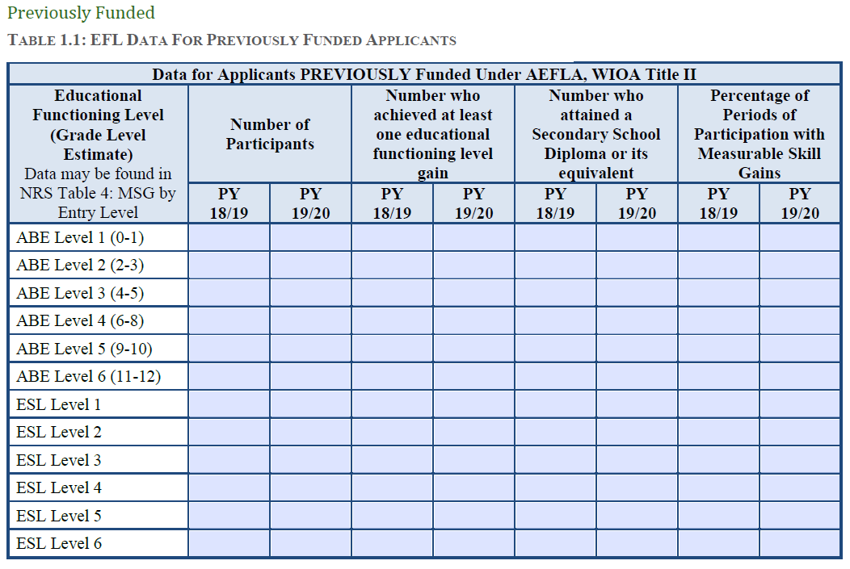
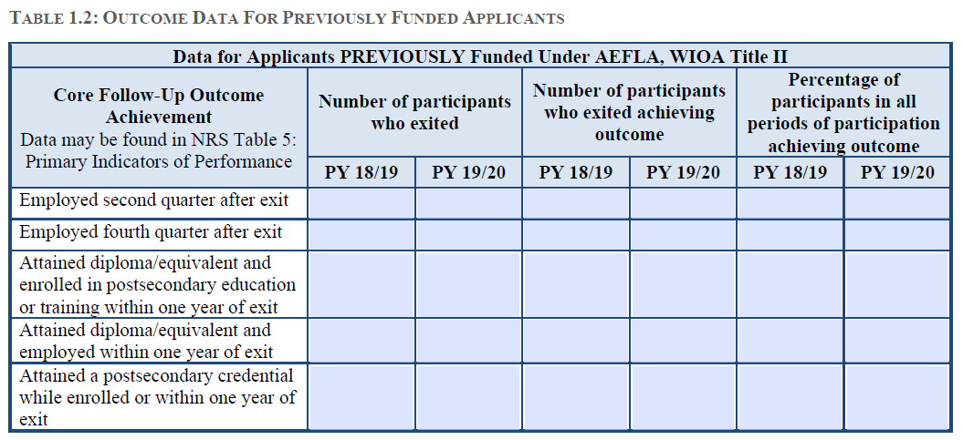
Previously Funded

Slide 27
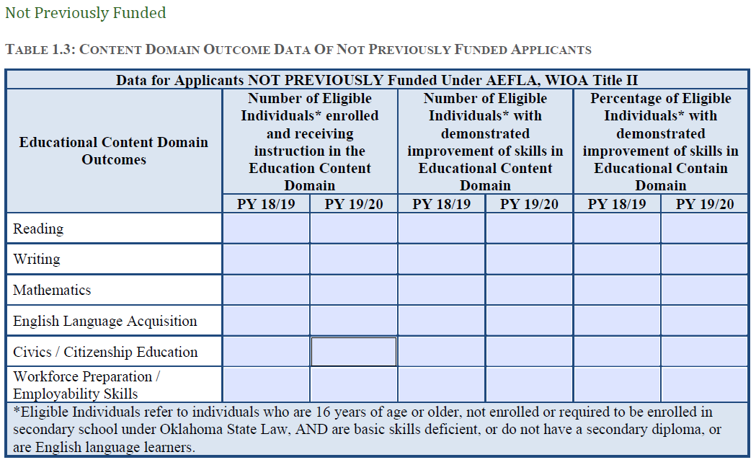
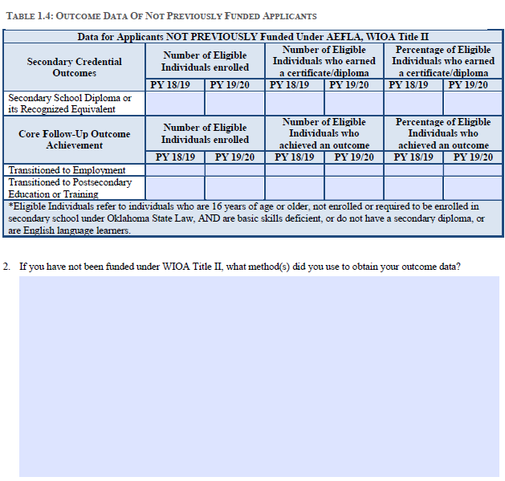
Not Previously Funded

Slide 28
Section Two:
Determining Service Area
The purpose of this section is to identify the areas that you intend to serve with your grant application.

Slide 29
Determining Service Areas
A service area is defined by counties within the state’s Workforce Development Areas.
Using Figure 2 and Table 2, applicants will check the box(es) of the counties you intend to serve.
Applicants may choose to serve multiple counties in multiple Workforce Development Areas.
If more than one applicant requests funding for a particular county, the projected federal provision by county will be allocated between multiple providers through negotiations.

Slide 30
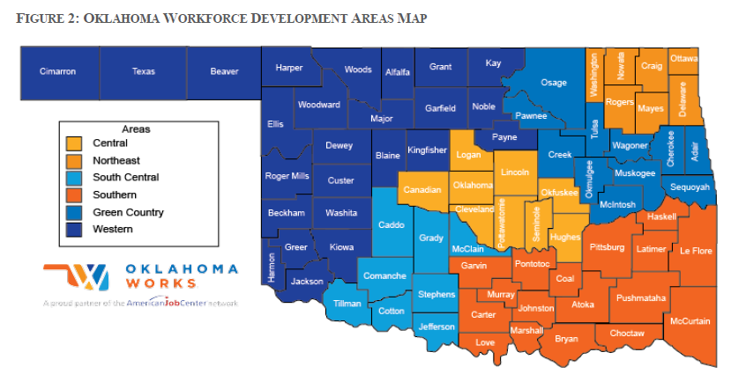
Workforce Development Areas

Slide 31
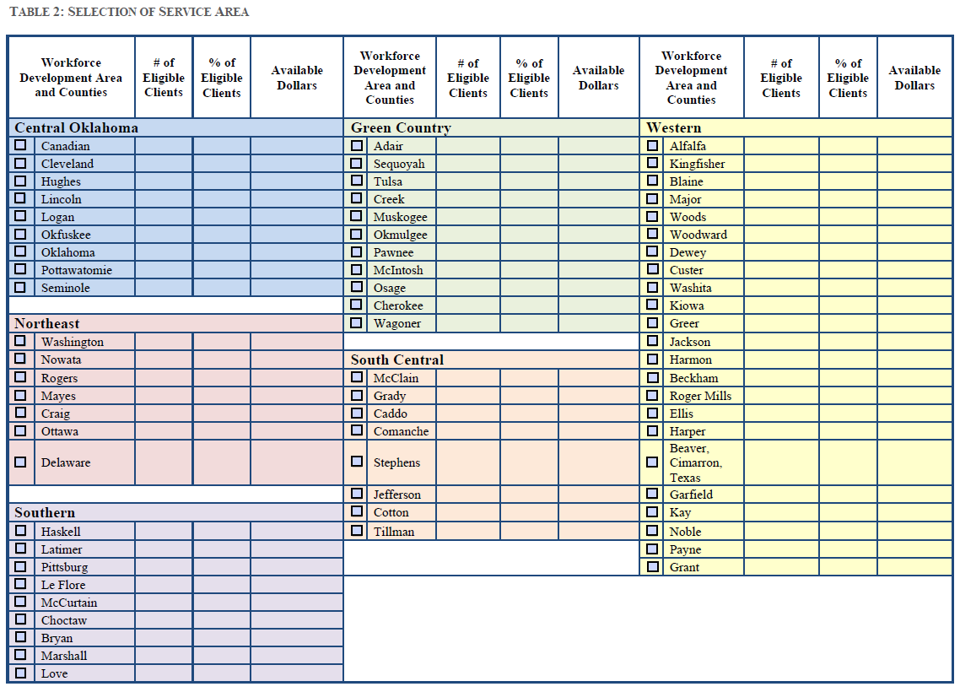
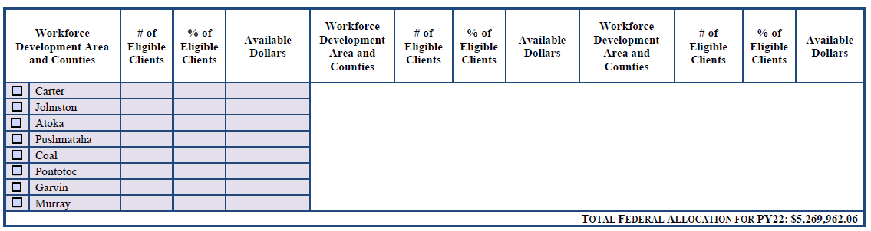
Selection of Service Areas

Slide 32
Section Three:
Application Narrative
The purpose of this section is to address the application narrative that addresses WIOA 432 requirements, the Thirteen Considerations, and additional grant requirements for IELCE and Correctional/Institutional Education.

Slide 33
Application Narrative
Using the space provided, address the questions.
All questions must be addressed.
Applicants are not expected to fill the entire space.
For reference, you may utilize Figure 3, Figure 4, and the hyperlinks for supplementary information.

Slide 34
Section Four:
Budget
The purpose of this section is to outline how funding is determined and allocated, provide guidance on determining a budget, and discuss budget narrative.

Slide 35
Budget
Eligible providers will determine a budget for providing services in the Workforce Development Area(s) requested and the ODCTE will evaluate these budgets.
Budgets should reflect counties which eligible providers plan to serve.
The ODCTE requires a local match of dollars and/or in-kind donation of 25 percent of state funds received. This match may be direct or in-kind. All match items must meet the same guidelines for allowability and allocability as the federal funds.
Negotiations will occur when more than one eligible provider is determined for a specific county.
Awards may be based on multiple factors including reasonableness of the budget relative to the service area, quality of the eligible provider application, past performance including Measurable Skill Gain attainment relative to the state performance target, expected number of individuals to be served, workforce development area board recommendations, previous year allocation, past expenditures, and results from the pre-award risk assessment.

Slide 36
Budget (Continued)
The amount received by eligible recipients will be held steady for not more than two years.
After the two-year period, allocation amounts for each service provider will be determined using a formula that accounts for the eligible individuals in an ABE service area, performance of the service provider, and provider need.
Service providers not meeting negotiated performance levels may see a reduction in their allocation for the following year(s). Those service providers meeting or exceeding their performance levels may be eligible for an increase in their allocation in their funding for the following year(s) from the pool of funds not allocated to those providers not meeting performance levels.
Performance funding will be based on the average of two years of performance data.
The ODCTE may limit the carryover of an ABE service provider.
The carryover limit may not exceed 25% of their projected allocation for the upcoming year. The overage will then be redistributed to other service providers.

Slide 37
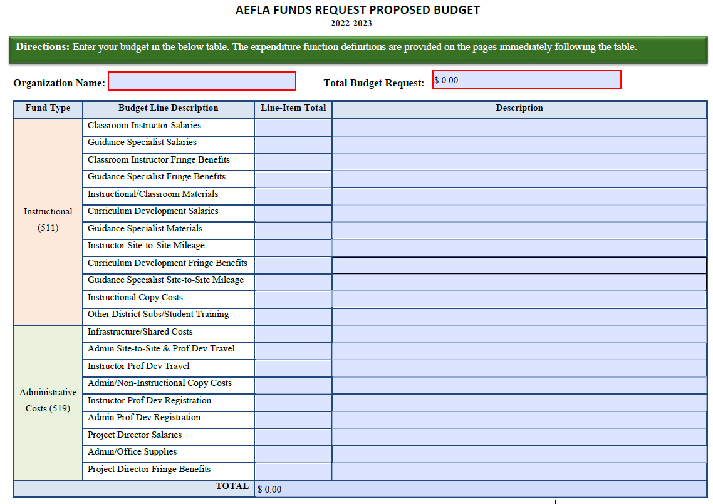
AEFLA Funds Request
Applicants will be required to submit the AEFLA Funds Request Proposed Budget worksheet.
As line-item amounts are added, they will automatically total at the bottom and top of the page.
For each requested line item, a short description is required.

Slide 38
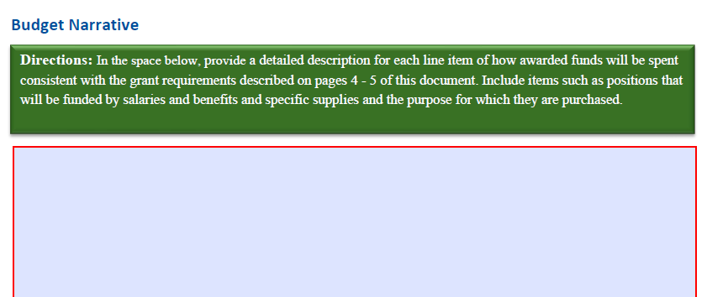
Budget Narrative
Using the space provided on the RFP application, applicants will be asked to provide a detailed description for each line item of how awarded funds will be spent consistent with the grant requirements.
Include items such as positions that will be funded by salaries and benefits and specific supplies and the purpose for which they are purchased.

Slide 39
Budget Considerations
Ask yourself:
Is it Allowable?
Is it Allocable?
Is it Reasonable?
Is it Necessary?

Slide 40
Application Submission

Slide 41
Proposal Checklist
Provide information to be considered an eligible provider with demonstrated effectiveness, including at least two years of performance data.
Complete and submit all applicable pages of the application in numerical order.
Sign RFP application. Certified digital signatures will be accepted.
All RFP applications MUST be emailed to abe@careertech.ok.gov by Tuesday, February 15, 2022, at 11:59 PM CST

Slide 42
Application Considerations

Slide 43
Application Considerations
ODCTE is seeking applications that can demonstrate collaboration and innovation by rethinking adult education and literacy skills in Oklahoma. Responses will score well that can demonstrate how:
  Adults learn anytime, anywhere, at their own pace, and can earn credentials faster.
  IELCE Applicants: Integrated education and training programs are the rule, NOT the exception.
  Opportunities for English language learners is not too limiting and prepares them for successful careers.

Slide 44
Thank You!
All correspondence related to the grant competition MUST be emailed to abe@careertech.ok.gov.
The recorded presentation will be posted to the ODCTE ABE Grant Competitions webpage shortly after conference.
All questions submitted to the chat box will be addressed in the Q&A document on the webpage by January 1, 2022.
All future grant information will be posted via the webpage.
Letha Bauter, ODCTE Federal Programs Manager
Letha.bauter@careertech.ok.gov
(405)743-5569

