Slide 1
Broadband Office
BEAD Subgrantee Selection Listening Session

Slide 2
BEAD Subgrantee Selection Framework
NETs
Applications
Scoring
Candidate Pools
Severability
Deconfliction
Tentative Awards

Slide 3
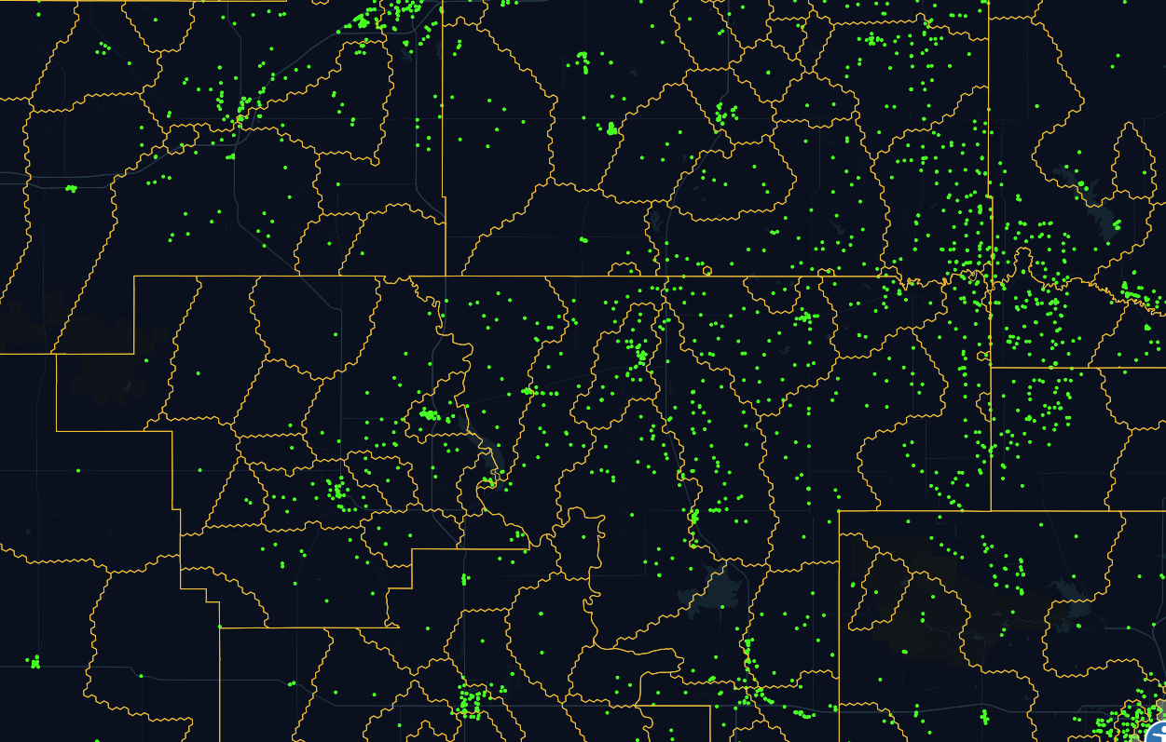
Network Expansion Territories (NETs)
The OBO will take suggestions from the RFI window and create a final set of NETs
NETs are the basis for your applications (ie: puzzle pieces or Legos)
ISPs must serve 100% of the locations within NETs they apply for and ultimately receive

Slide 4
Applications
The two highest weighted scores are for Minimum BEAD outlay (Cost per passing after the match) & Monthly Subscription Price
From application to tentative awards, the process will be automated
NET selection and timing will be critical to determine what Candidate Pool your application is in

Slide 5
Minimum BEAD Outlay
Minimum BEAD Outlay: Cost per location after the match
Formula = 65*($10,000- BEAD Program Outlay per Passing)/$10,000
Note: The number $10,000 is an arbitrary scaling factor but ensures similar treatment across candidate pools in the way that cost- effectiveness affects selection decisions.
Outlay per Location After Match | Point Value
$0*-$999.99 | 65 points
$1,000-$1,999.99 | 58.5 points
$2,000-$2,999.99 | 52 points
$3,000-$3,999.99 | 45.5 points
$4,000-4,999.99 | 39 points
$5,000-5,999.99 | 32.5 points
$6,000-6,999.99 | 26 points
$7,000-7,999.99 | 19.5 points
$8,000-8,999.99 | 13 points
$9,000-$9,999.99 | 6.5 points
$10,000-$14,999.99 | 0 points
$15,000 or more | -32.5 points

Slide 6
Affordability
Total Monthly Price | Point Value
<$30.00 | 44 points
$30.01 - $40.00 | 40 points
$40.01 - $50.00 | 35 points
$50.01 - $60.00 | 30 points
$60.01 - $70.00 | 25 points
$70.01 - $80.00 | 20 points
$80.01 - $90.00 | 10 points
$90.01 - $100.00 | 5 points
>$100.01 | 0 points
The most affordable total monthly price
1 Gbps symmetrical service, in the case of Priority Broadband Projects
100 Mbps/20 Mbps in the case of Non-Priority Broadband Projects
Inclusive of all taxes, fees and charges with no additional non-recurring costs or fees to the consumer.

Slide 7
Fair Labor Practices
Eligible applicants must give priority to projects based on an applicant’s demonstrated record of and plans to be in compliance with federal labor and employment laws.
New entrants without a record of labor and employment law compliance must be permitted to mitigate this fact by making specific, forward-looking commitments to strong labor and employment standards and protections with respect to BEAD-funding projects.
Points for Fair Labor Practices
Applicant's workforce plan does not address federal compliance with all applicable labor laws, and/or reveals substantial recent violations. | 0
Applicant certifies full compliance in the past five years (if applicable) and provides strong forward-looking commitment to future compliance. | 11

Slide 8
Speed to Deployment
Points for Speed to Deployment
Subgrantee does not provide binding commitment to provide service by an earlier date certain | 0
Applicant provides binding commitment to provide service by a date earlier than three years from the date on which the subgrantee receives the subgrant from the Eligible Entity | 2
Applicant provides binding commitment to provide service by a date earlier than two years from the date on which the subgrantee receives the subgrant from the Eligible Entity | 5
Applicant provides binding commitment to provide service by a date earlier than one year from the date on which the subgrantee receives the subgrant from the Eligible Entity | 8
All subgrantees that receive BEAD funding must deploy the planned broadband network and begin providing service to interested customers within the project area no later than four years after the date of subgrantee receiving awards.

Slide 9
Sustainability
Points for Sustainability
Weak demonstration: Forecast figures not clear or not practical, i.e., very high adoption rate, or very high revenue per unit (RPU). | 0
Moderate demonstration: (a.) quarterly cash flow and balance sheet pro forma to include EBITDA and subscriber adoption rates for 5-10 years beyond targeted completion date, depending on the useful life of network equipment deployed throughout the project area; (b.) projected EBITDA is positive but less than 5% of total revenue in less than 10 years. | 3
Strong demonstration: (a.) quarterly cash flow and balance sheet pro forma to include EBITDA and subscriber adoption rates for 5-10 years beyond targeted completion date, depending on the useful life of network equipment deployed throughout the project area; (b.) projected EBITDA is positive in a range of 5%-10% of total revenue in less than 10 years. | 6
Very Strong Demonstration: (a.) quarterly cash flow and balance sheet pro forma to include EBITDA and subscriber adoption rates for 5-10 years beyond targeted completion date, depending on the useful life of network equipment deployed throughout the project area; (b.) projected EBITDA is positive and greater than 10% of total revenue in less than 10 years. | 10
Applicants shall submit business plans and related analyses that substantiate the sustainability of the proposed project.
This can be provided in the form of pro forma statements or analyses, inclusive of quarterly cash flow, balance sheet, and customer adoption rate projections and should include 7-10 years of operating cash flow projections post targeted completion of project, depending on the useful life of equipment deployed throughout the project area.

Slide 10
Local and Tribal Coordination
Points for Local and Tribal Coordination
Applicant does not provide any letters of support from local or tribal governments within the proposed project area, or any submitted letters of support do not name the applicant. | 0
Applicant provides letter(s) of support for proposed project from at least one local and/or tribal government that has jurisdiction in some part of proposed project’s service area. | 6
Tribal Resolution of Consent is required for award. For projects that overlap areas subject to tribal jurisdiction, the tribal letter of support can strengthen a project whose footprint includes, and is in competition for, non-tribal areas.
Gating: If the project includes locations that are under tribal jurisdiction, but no tribal letter of support is provided, consideration of the project will be deferred. In such cases, the project may only be considered as a last resort if the main subgrantee selection process fails to secure a solution for parts of its footprint.

Slide 11
No Means Testing of the BEAD Low-Cost Service Option
Points for No Means Testing of the BEAD Low-Cost Service Option
Applicant offers low-cost option to eligible subscribers for 100 Mbps/20Mbps for $60 per month or less, inclusive of all taxes, fees, and charges if the subscriber does not reside on tribal land, or $75 per month or less, inclusive of all taxes, fees, and charges if the subscriber resides on tribal lands, with no additional non-recurring costs or fees to the consumer. | 0
Applicant offers low-cost option for 100 Mbps/20 Mbps service for $60 per month or less, as described in section 2.12, not only to listed categories of eligible subscribers but to all subscribers in the project areas. Applicants who take this option can therefore satisfy the low-cost service option requirement without checking whether customers are "eligible subscribers" or not, since those who in fact qualify as "eligible subscribers" can sign up for the option just like everyone else. | 7
To increase the impact of the low-cost service option, OBO encourages BEAD subgrantees to remove the means test and offer the option to all customers.

Slide 12
Speeds and Latency
Points for Speeds and Latency
Applicant able to provide 100/20 Mbps and latency below 100 milliseconds but no faster. | 0
Applicant able to provide 100 Mbps symmetrical and latency below 100 milliseconds. | 4
Applicant able to provide 1 Gbps symmetrical and latency below 100 milliseconds. | 9

Slide 13
Candidate Pools
Candidate Pool 1
Candidate Pool 2
Candidate Pool 3
Candidate Pool 4
Free Round

Slide 14
Candidate Pool 1
End to end fiber
At least 80% unserved locations
Submitted within first 3-week window
Cost below EHCPLT

Slide 15
Candidate Pool 2
End to end fiber from first candidate pool not yet funded + other reliable broadband technology
At least 80% unserved locations
Submitted within first 4-week window

Slide 16
Candidate Pool 3
End to end fiber not yet funded + other reliable broadband technology
Under 80% unserved locations
Submitted within first 5-week window
Cost below EHCPLT

Slide 17
Candidate Pool 4
All remaining reliable technology projects
Under 80% unserved locations
Submitted within the first 6-week window

Slide 18
Free Round
The scope of the final round will adjust to the required prioritizations of the BEAD program.
If the OBO has achieved a solution for all unserved locations, the final round may focus on underserved locations and Community Anchor Institutions.
If there are still gaps in the coverage plans for unserved locations, those will be the focus.

Slide 19
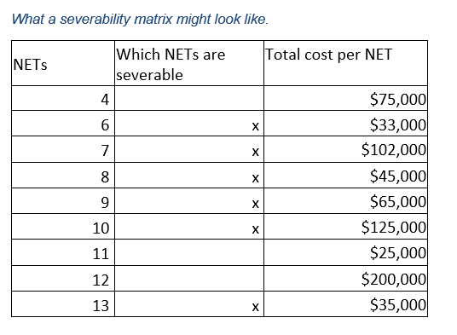
Severability
Each application (Project) needs to have options explaining which NETs they plan to serve, and which NETs they can afford to sever
An applying ISP risks receiving zero NETs if they do not list all potential NETs they can serve

Slide 20
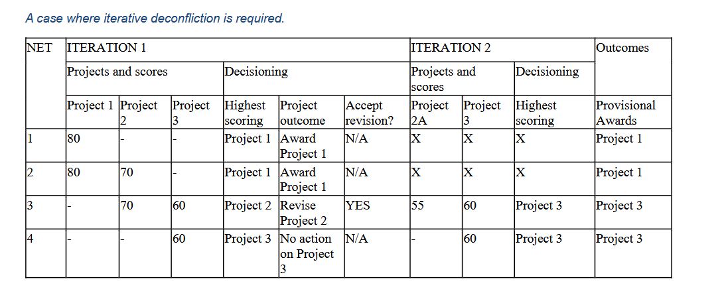
Deconfliction
The OBO is expecting multiple projects with overlapping NETs
Deconfliction will determine which application is awarded which NETs

Slide 21
Tentative Awards
When the severability and deconfliction is completed, tentative awards will be made
The Governing Board will approve tentatively awarded projects and then the list will be sent to NTIA for final approval within the OBO’s Final Proposal

Slide 22
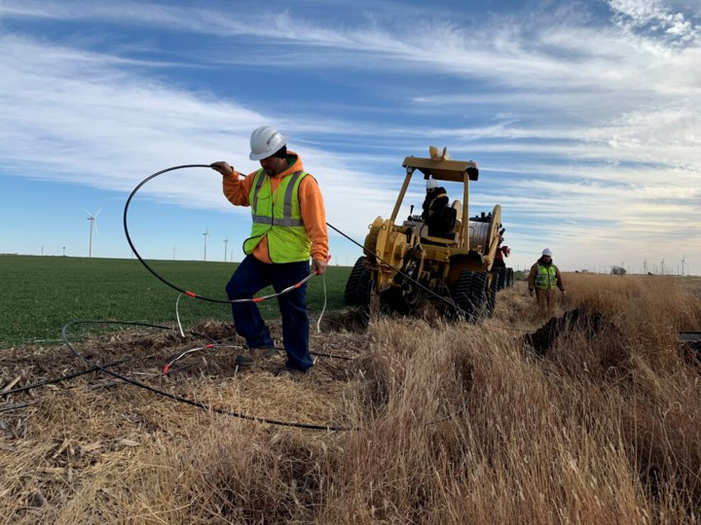
BEAD is our largest and final broadband infrastructure grant program
Volumes I and II will detail the Subrecipient and Challenge processes
Once approved by NTIA, the office will have one year to complete the program
BEAD@broadband.ok.gov

