Slide 1
Food Supply Chain Support: Training/Accreditation & Processing Services
Robert M. Kerr Food & Agricultural Products Center
Oklahoma State University
Division of Agricultural Sciences & Natural Resources

Slide 2
Robert M. Kerr Food & Agricultural Products Center (FAPC) – Impacting Oklahoma
96,000 square feet – food processing, laboratories, offices, conference space, and equipment/supplies storage
53,353 square feet (56%) of USDA/FDA inspected food processing space
Research, technology, and business/technical assistance
10-year impacts:
1,454 food industry projects
Estimated annual economic impacts of $59.7 million during that span
137 startup food businesses in 53 communities from 38 counties
$74.5 million economic impact, or $7.45 million per year
Quarterly average: businesses/entrepreneurs represent 65 communities and 40 counties
There is no other facility like the FAPC in the USA.

Slide 3
FAPC ARPA Requests
Online Food Safety Training/Accreditation Programs to Mitigate Supply Chain Disruptions
ARPA-YY000602
Purpose: Develop an online system to help food suppliers meet requirements for distribution to retail and foodservice marketing channels
$450,000 request
Facilities Upgrade for Food Industry Assistance & Inspected Meat Processing
ARPA-YY001041
Purpose: Modernize and expand the processing infrastructure of the FAPC to accommodate increased industry support and commercial production
$5,512,906 request

Slide 4
Online Food Safety Training/Accreditation Programs
FAPC scheduled and completed 1,638 food safety assistance sessions over the last 10 years
713 educational/training workshops over the last 10 years
Global Food Safety Initiative certifications
USDA required trainings/certifications
E.g., Hazard Analysis, Critical Control Points (HACCP)
FDA required trainings/certifications
E.g., Food Safety Modernization Act (2011) required trainings/certifications
15,445 workshop/training attendees (avg. 1,544 per year)

Slide 5
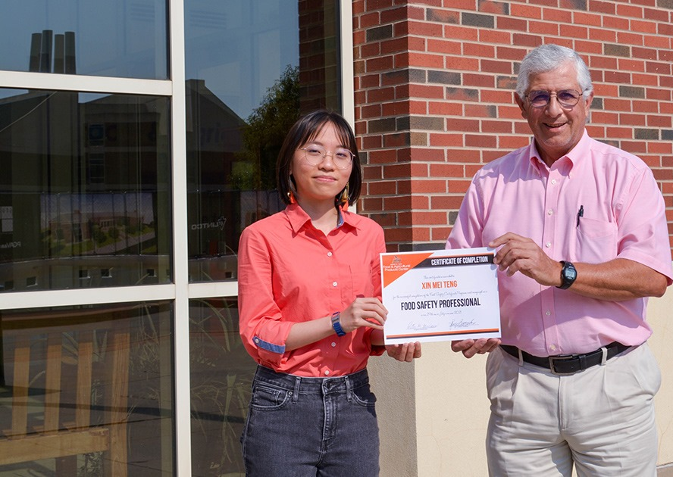
Online Food Safety Training/Accreditation Programs
Goal: Create, in accredited form, the following commonly requested/required trainings and workshops:
Preventative Controls, Human Food I
Preventative Controls, Human Food II
Internal Food Auditor for 3rd Party Auditing
Food Defense
Food Fraud
Global Standards for Food Safety, Safe Quality Foods (SQF)
Sanitation in the Food Industry

Slide 6
Online Food Safety Training/Accreditation Programs
Developing an online, accreditation-worthy program can take up to 6 months from start to finish
Up to 2,080 hours per workshop for design, accreditation approval, and online deployment
Current contract rates for developers = $100,000 per FTE
$450,000 total for the request
2, maybe 3, workshops in one year
$300,000 in FTEs for online presentation platforms, meet accreditation standards.
$150,000 in materials and software licenses to create the interactive format.

Slide 7
Facility Upgrade for Industry Assistance & Meat Processing
For 25 years, the FAPC has been one of the few USDA-inspected meat slaughter/processing facilities in Oklahoma
Service to the Oklahoma-Texas Meat Processors Association
Industry projects with all of Oklahoma’s largest meat processors
Processing resource for the state’s ranchers
Training ground for up-and-coming meat industry leaders
Aging facilities and changes in processing technologies are limiting FAPC capabilities
Refrigeration system and pathogen intervention system for livestock slaughter are two of the greatest needs to continue serving as a USDA-inspected facility.
Advances in processing technology and the inability to repair/refurbish older equipment also impacts operational potential.

Slide 8
Facility Upgrade for Industry Assistance & Meat Processing: $5,512,906
Priority Area 1 - Critical: $3,430,6356
Refrigeration upgrade, slaughter chad system, Alkar cooking system, bowl cutter
Priority Area 2 – Critical: $,136,313
Spiral chiller/griller installation, hydraulic lifts, RO system, air compressor, chopper/grinder
Priority Area 3 – Very Important: $945,957
Boiler, 2nd floor repair, fire suppression, tenderizer, brine injector, vacuum sealer, meat pumps

Slide 9
Facility Upgrade for Industry Assistance & Meat Processing
Planned use of excess capacity for more inspected slaughter and retail-ready meat production
New meat plant manager in November 2021
Current operations of one staff member and a team of students
Oklahoma Beef Council and Oklahoma Pork Council recognized FAPC for slaughter and processing services provided during the pandemic
Expanded production in 2023 as a result of facility of upgrades
Assuming upgrades can be funded
More opportunities and better facilities for industry projects
FAPC works with state, regional, and national food processors for R&D, reformulations, food safety evaluations, and new product trials

Slide 10
Impact Assessment: COVID-19, Project Impact
COVID-19 Impacts
Pandemic showed the challenges of food suppliers accessing new market channels without proper training/accreditation programs
Limited capability to provide in-person trainings
Industry and regulatory norms remained relatively consistent throughout
Market potential inside/outside of Oklahoma for online, accredited training programs to meet USDA, FDA, and GFSI requirements
Also supports other federal efforts/grants supporting food supply chain development
Project Impacts
Online program will have immediate impacts on sales generated by OK companies
Facilities upgrades will have dual impact potential
Direct economic impact from increased FAPC slaughter and retail-ready production
Direct and indirect economic impact from increased industry support functions at FAPC

Slide 11
Internal Controls for Project Management
FAPC has a published set of Accounting SOPs that identify how every step in handling funds will occur. These SOPs are reviewed and signed-off by any FAPC employee who has funding/cash/check handling responsibilities.
All FAPC accounting personnel are annually trained as per Oklahoma State University requirements.
All FAPC accounting documents and files are subject to review at any time.
The standard term of Records Retention for accounting records required by Oklahoma State University are followed.

Slide 12
Project Monitoring & Compliance
Dr. Rodney Holcomb
Project PI
Professor, Agricultural Economics; Browning Endowed Professor, FAPC
25 years of research grant-funded project leadership
Michelle German
Director of Sponsored Programs
10 years of fiduciary oversight leadership
Robert Klein
Assistant Vice President of Finance
OSU Division of Agricultural Sciences & Natural Resources
25 years of accounting and financial oversight leadership

Slide 13
Questions?

