Slide 1

ARPA Funds Request
ARPA Funds Request
University Hospitals Authority
Dec. 3, 2021

Slide 2
Statutory Mission
Statutory Mission – UHAT/OCH
Patient care, education, research
State’s largest number of providers of pediatric care (400+) in approximately 50 specialties
See patients from all 77 counties and all 50 states
Leading health care workforce development facility in the state
    Largest physician program
    Largest provider of nursing graduates
Advancing medical research; improving care for all Oklahomans

Slide 3

One-of-a-kind care
One-of-a-Kind Care
Oklahoma Children’s Hospital
Only comprehensive, freestanding pediatric hospital
Only Level 1 pediatric trauma center
Only Level IV neonatal ICU (NICU)
Only dedicated neonatal ground and air transportation
Only pediatric transplant program
Only pediatric cardiovascular ICU (CVICU)
Only pediatric chronic dialysis unit
Only pediatric comprehensive cancer center

Slide 4
Children’s Hospital by the numbers
Children’s Hospital
By the Numbers
348 total beds
96 NICU beds
  1,200 admits annually; 30% are transfers
59 PICU beds
  1,360 admits annually; state’s largest facility
60,000 Emergency Dept. visits
14,000 inpatient admits annually
9,000 pediatric surgeries
3,700 deliveries a year

Slide 5

Pediatric Mental Health Crisis
Pediatric Mental
Health Crisis
At least 20% of children/adolescents need mental health care
  50-60% do not receive needed care
Suicide is second leading cause of death for ages 10-19
  Oklahoma in Top 10 for youth suicide
  Suicidal teens are seen every shift
Pandemic increased the need for behavioral health care dramatically
  Children’s saw 31% increase in cases by October 2020; doubled by May 2021

Slide 6
Statewide Vision
The Statewide Vision
Changing lives with a world class behavioral health program
1
Become state’s leading health care center addressing growing pediatric mental health care challenges across continuum of care
2
Deliver state-of-the-art behavioral health care by leveraging research and educational opportunities
3
Grow a team of caregivers who reduce stigma around mental health care
4
Increase capacity to treat patients from across the state through expanded facilities and use of technology
Local communities through expanded workforce development and continuing medical education
5

Slide 7

Seven Critical Areas
1. Safe, specialized emergency care
2. Short-term stabilization
3. Longer-term care
4. Intensive outpatient (IOP) and partial hospitalization program (PHP)
5. Collaboration with other providers via telehealth
6. Comprehensive, evidence-based therapy
7. Ongoing patient and family support
Seven Critical Areas

Slide 8

Current Emergency Department concerns
Current Emergency Dept. Concerns
Current Emergency Dept. total volumes increased 10% over pre-pandemic numbers
Typical Emergency Dept. room has 30+ ligature points which pose suicide/harm risk for patients in mental health crisis
Due to shortage of pediatric inpatient psychiatric beds, these patients often have 48+ hour length of stay
Main Emergency Dept. is heavily utilized,
creating a busy, noisy environment
not conducive to mental health
crisis stabilization

Slide 9
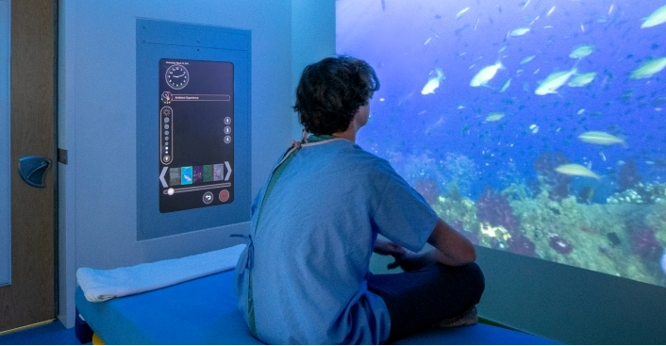
Emergency Department expansion
Emergency Dept.
Expansion Details
Each room will be anti-ligature:
Coiling shutter door to conceal equipment and items of risk
Hard deck ceiling
Reinforced, mesh wall protection
Ligature resistant fixtures (faucets, doors, furniture)
Tamper resistant outlets & screws
Adds ~6,400 square feet; 10 additional beds
Flex rooms to accommodate both medical/surgical and mental health emergencies
Allows more efficient use of space and frees up resources for medical/surgical patients
Sensory playroom equipped for neurobehavioral/autism patients
Enhanced technology to aid in patient stabilization
Shower space for patients with longer length of stay
Ample patient belonging storage space outside of patient rooms
Direct access to vehicle sally port to transport to/from new Behavioral Health Center

Slide 10
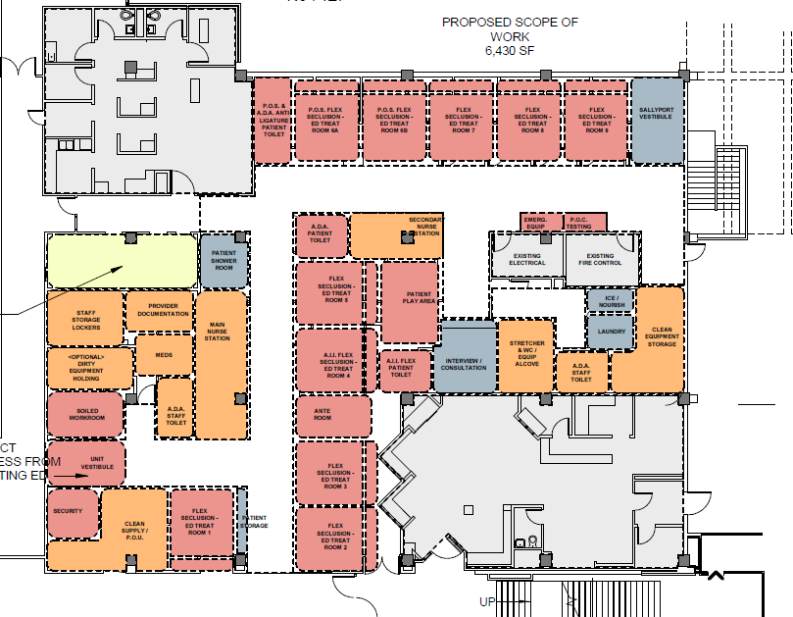
Emergency Dept. Floorplan
Emergency Dept. Floorplan

Slide 11

Emergency Dept. project timeline
Emergency Dept. Project Timeline
Programming will continue throughout entire project.
Feb. 2022
Design process complete
March 2022
Construction begins
March 2023
Project completion

Slide 12
Emergency Dept. workforce timeline
Emergency Dept.
Workforce Timeline
1
Clinicians – recruiting early 2022
Pediatricians, psychiatrists, NPs, LCSWs
2
Leadership – recruiting late 2022
Charge nurses
3
Clinical Staff – recruiting late 2022
RNs, behavioral health technicians, social workers, case managers
4
Support Staff – recruiting late 2022
Registration, housekeeping, etc.

Slide 13
The investment and the impact
The Investment
$7.5 million to provide:
$7M to renovate
$500K to add secure, controlled and private vehicle entrance
The Impact
Add 10+ Emergency Dept. beds for youth in mental health crisis
Increase capacity for other medical/surgical emergencies, reducing the number of patients diverted out of state
Improves the security and privacy for patients and providers

Slide 14
Behavioral health center details
Behavioral Health Center Details
Facility will be one of a kind in Oklahoma and one of the premier facilities in the country
Multi-story center with approximately 72 inpatient beds
One floor for intensive outpatient (IOP) and partial hospitalization program (PHP)
Dedicated neurodevelopmental/autism unit
Shell space for possible OJA/county detention unit (or other partner needs)
Space for families to stay with children
Two-story gymnasium, outdoor respite spaces, conference areas, family resource spaces
Specialized environment will provide best care in an appropriate setting, freeing up beds at OCH and other facilities statewide

Slide 15
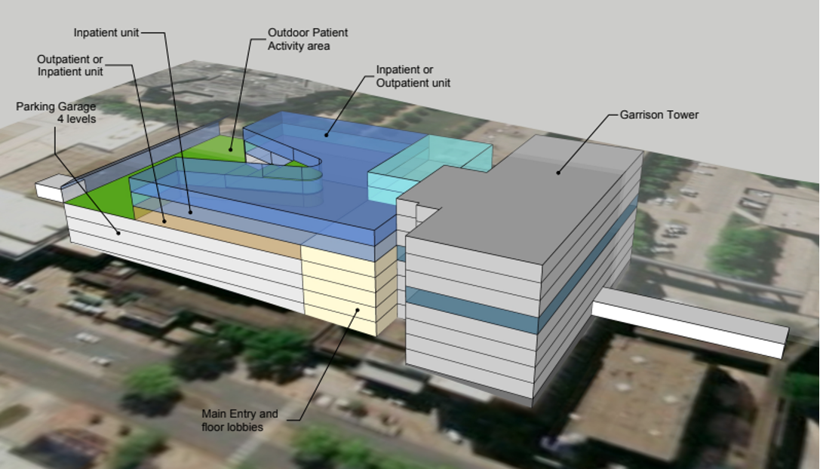
Behavioral health center rendering
Behavioral Health Center Rendering

Slide 16
Partnerships
Partnerships
State Partners
Oklahoma Health Care Authority
Oklahoma Dept. of Mental Health
and Substance Abuse Services
Oklahoma Juvenile Affairs
State Dept. of Education
Oklahoma Dept. of Human Services
OU Health Sciences Center
  Child Study Center
  Center for Child Abuse and Neglect
  Dept. of Psychology
  College of Nursing
  College of Medicine
External Partners
Oklahoma City Public Schools, other districts
Statewide county detention centers
Rural and urban hospitals and outpatient/clinical providers
Community organizations and philanthropic entities

Slide 17
BH investments and impact
The Investment
$49.3 million to provide:
$19.8M in acceleration of appropriated funds
$29.5M to expand behavioral health services and study brain disorders
The Impact
Become a national leader in providing evidence-based behavioral health treatment, changing lives for patients and their families
Relieve stress and fiscal strain on partner entities by treating health issues early; treat youth with behavioral health issues before they reach state supervision or criminal justice systems
Create inpatient unit designed for pediatric patients with autism
spectrum disorder and other developmental disabilities
Expand state’s mental health workforce

Slide 18
Educational and workforce impact
Educational and Workforce Impact
Behavioral health care expansion will provide training and education for:
Nursing students
Psychiatric mental health nurse practitioner (PMHNP)
Pharmacy students
Clinical social work interns
Occupational therapy students
3rd and 4th year medical school students
Psychiatry residents
Pediatric residents
Child and adolescent psychiatry fellows
Adolescent medicine fellows
Psychology interns
Neuropsychology fellows
Autism behavior health analysts
Physician assistants and other advanced practice providers

Slide 19

Research impact
Research Impact
Attract grant money
Provide access to newer, more-specific treatments which may not be available or covered by insurance otherwise
Allow doctors and students to conduct groundbreaking research
Enhance institutional reputation, retain graduates and physicians, attract new talent to enhance access to and quality of care

Slide 20

Behavioral health center timeline
Winter 2022
Remediation begins
Spring/Fall 2022
Structural demolition
Fall 2022
Construction documents received
Winter 2023
Construction commences
Winter 2025
Fully operational
Behavioral Health Center Timeline
Programming will continue throughout entire project.

Slide 21
Behavioral health center workforce timeline
Behavioral Health Center Workforce Timeline
1
Clinicians – recruiting ongoing
Psychiatrists, psychologists, NPs, LCSWs
Leadership – recruiting 2023
Directors, managers, charge nurses
2
Clinical Staff – recruiting late 2024
Behavioral health RNs, health technicians, social workers, case managers
3
4
Support Staff – recruiting early 2025
Protective services officers, clinical staff,
expressive therapists, teachers, other

Slide 22
Funding share
Funding Share

Slide 23
Behavioral health center/emergency dept funding
Behavioral Health Center/
Emergency Dept. Funding
State Appropriations
University Hospitals Trust
Philanthropy & other partnerships
ARPA
ARPA (ED/Sally port)
ARPA (Appropriations acceleration)
$10 million
$23 million
$26 million
$29.5 million
$7.5 million
$19.8 million
Preliminary estimated budget
$115.8 million

Slide 24

Bottom line
Bottom Line
This investment has the potential to break down barriers and forge new pathways to well-being for Oklahoma’s most vulnerable children.

