Slide 1
Child and Family Well-Being in Pandemic: Outlook Worsens in Oklahoma
September 8, 2021
Joint Committee on Pandemic Relief Funding
HHS Work Group Meeting
Linda Manaugh, Director, Communications & Program Support
Potts Family Foundation
lmanaugh@pottsfamilyfoundation.org

Slide 2
Adverse Childhood Experiences and Adverse Community Environments

Slide 3
Pair of ACES

Slide 4
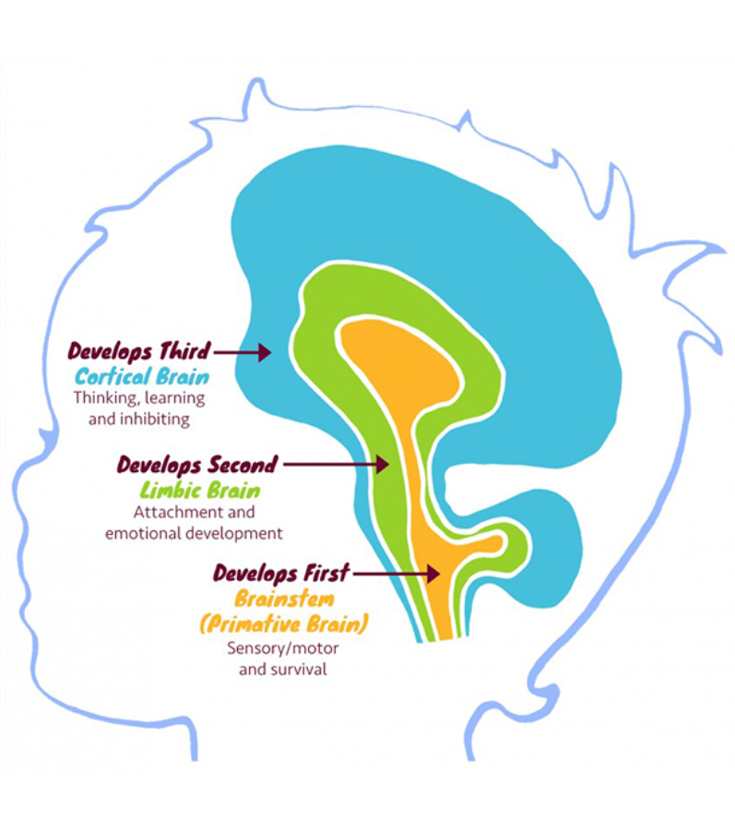
Child development
Childhood is “one time” only. There are sensitive periods
of brain development that influence a lifetime of learning,
relationships, mental, physical and behavioral
health, and workforce productivity.
Without mitigation, the effects of overwhelming
stress caused by adversities, including natural disasters
and economic downturns, can last a lifetime.
For example, a child who lives in poverty for even one
year because a parent lost employment during the pandemic
is less likely to reach important adult milestones, like
high school graduation.

Slide 5
Child development cont.
Because of the lifelong and costly impact of ACEs, we take a multi-generational view when analyzing issues and opportunities. We know that the well-being of parents, caregivers and children are inter-related. Safety, security, health, and well-being are developed through healthy adult-child interactions supported by vital communities and well-functioning systems, like health care, education, and the economy.

Slide 6
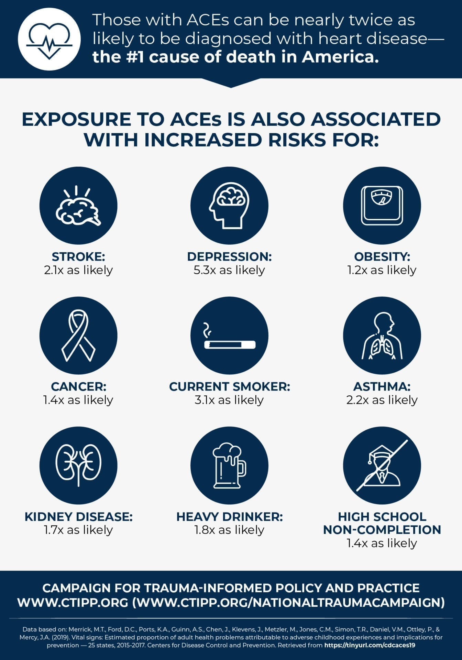
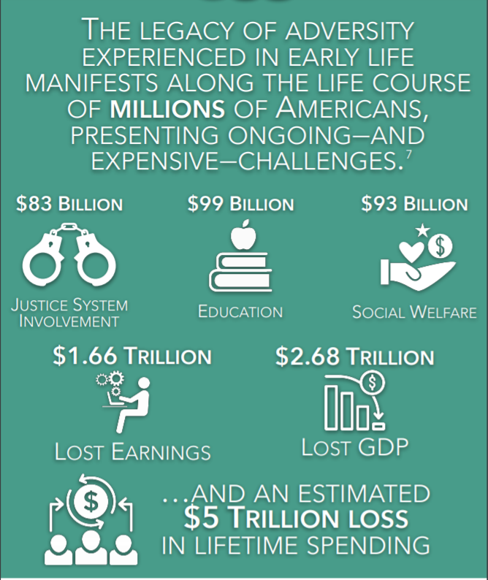
Traumatic effects of childhood
The traumatic effects of childhood adversity occur early in life, but there is a legacy of impact through adulthood.
Pre-pandemic, Oklahoma ranked among the worst ten states for the number of ACEs Oklahomans have experienced.

Slide 7
Housing Instability
Poor Housing Quality and/or Affordability is an element of an Adverse Community Environment. Housing instability causes family stress which makes it correlate highly with child maltreatment.
Housing | Oklahoma | National | Time Period
Households with children that are not caught up on rent or mortgage and are very or extremely likely to have to leave this home due to eviction or foreclosure in the next two months in Oklahoma | 43% | 34% | March 3 – March 29, 2021
Children living in households with a high housing cost burden in Oklahoma | 25% | 30% | Pre-Pandemic: 2019

Slide 8
Financial Instability
Living in poverty is an element of an Adverse Community Environment. Financial instability causes family stress which makes it correlate highly with child maltreatment.
Insufficient Income | Oklahoma | National | Time Period
Households with children that had difficulty paying for usual household expenses | 36% | 28% | June 9 – July 5, 2021
Adults reporting that households didn’t have enough to eat | 12% | 10% | June 9 – July 5, 2021

Slide 9
Generational poverty
> 35% poverty in a community is a tipping point where taxes cannot keep up with the complex needs of the citizens.
Notes:
Statewide:
12 zip codes with 50% or more of families living below poverty
43 zip codes with 33% to 49% families living below poverty
65 zip codes with 15 to 32% families living below poverty

Slide 10
Mental Health Issues and Substance Use
Mental health issues and Substance Use Disorders are Adverse Childhood Experiences. Mental health issues are the leading cause for work performance loss and absenteeism.
Mental Health | Oklahoma | National | Time Period
Adults living in households with children who felt nervous, anxious or on edge for more than half of the days or nearly every day in Oklahoma | 31% | 28% | May 12 – June 7, 2021
Adults living in households with children who felt down, depressed or hopeless for more than half of the days or nearly every day | 27% | 19% | June 9 – July 5, 2021

Slide 11
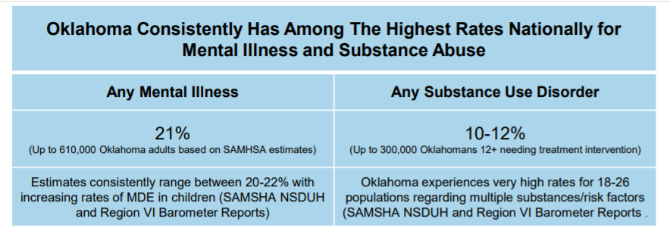
Mental Health Issues and Substance Use

Slide 12
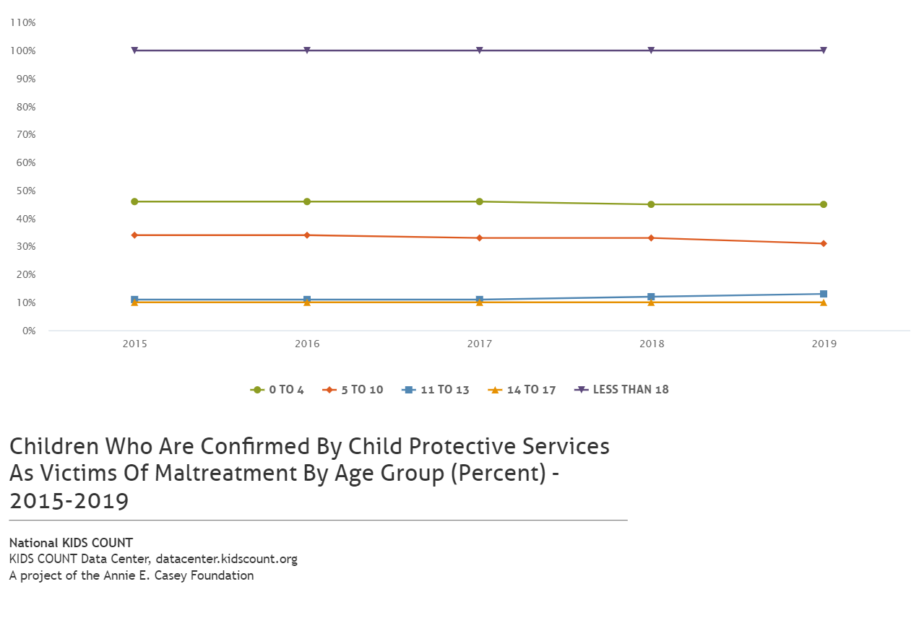
Child abuse and neglect
Child abuse and neglect are Adverse Childhood Experiences. Child neglect is often conflated with poverty.

Slide 13
2012 kids count data

