Slide 1
American Rescue Plan Act Making the Case: Investing in Health Care Workforce
Patti Davis, President
February 10, 2022

Slide 2
Setting the Stage: Pre Pandemic

Slide 3
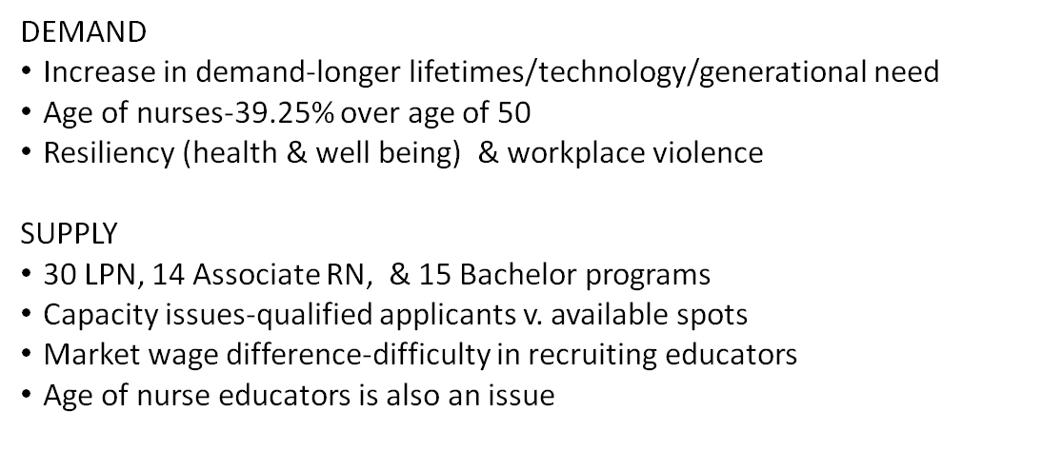
Setting the Stage

Slide 4
Employment Locations
Slide Courtesy of Oklahoma Nurses Association – Jane Nelson
Notes:
As you can see from these graphs, RNs are more likely to be employed by Hospitals than LTC – in FY 2019 23,922 RNs were employed in hospitals with 1621 RNs in long term care. LPNs are more likely to be employed in Long Term Care with 4,178 and 2479 in hospitals. Of those employed in long term care 37% are over the age of 50.
As care in the hospitals became more complex, it was noted that there was a decline in the numbers of LPNs practicing in Oklahoma hospitals with numbers going as low as 2,454 in 2018 – a loss of 320 hospital LPNs. As shortages of RNs continue, we now see more hospitals hiring LPNs to deliver care with there being a slight increase in numbers in 2019. The hospital-based LPNs are a bit younger than they were in 2015 with only about 34% being over 50.

Slide 5
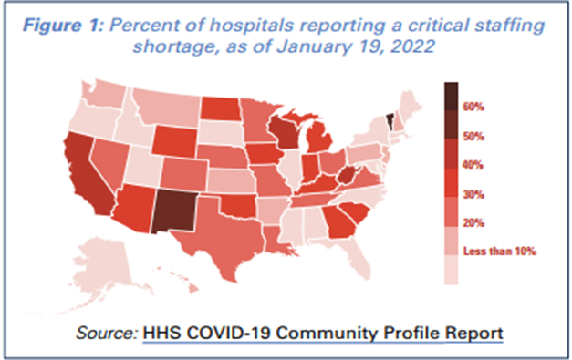
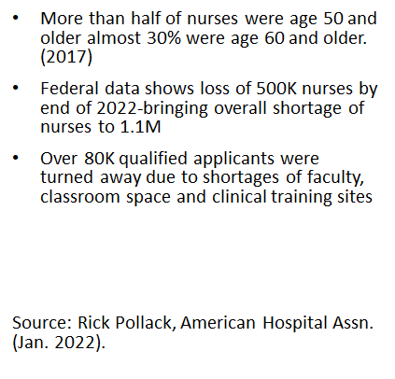
National Statistics

Slide 6
Associate and Generic Baccalaureate Degree RN Graduates in Oklahoma

Slide 7
Effect of the Pandemic Hospitals Continue to Have Less Staffed Beds with Each Surge
Reasons:
Employees leaving for high paying traveling jobs
Burn Out
Retirement
Fear of Illness

Slide 8
The shortage is not just nursing.......
Traveler demand still high for hospitals:
All nursing categories
Registered respiratory therapist
Med techs
Med lab techs
Imaging techs
Physician extenders
Physicians
"Most CEOs (94 percent) ranked a deficit of registered nurses as the most pressing within the category of personnel shortages, with technicians (85 percent), therapists (67 percent) and physician extenders (31 percent) following."
Becker's (February 4, 2022)

Slide 9
After Two Decades of Study:
This is a Transformational Opportunity
Health care jobs are:
Quality jobs
STEM jobs
Regional jobs
Increasing health care educational capacity will benefit all Oklahomans in the future.

