Slide 1
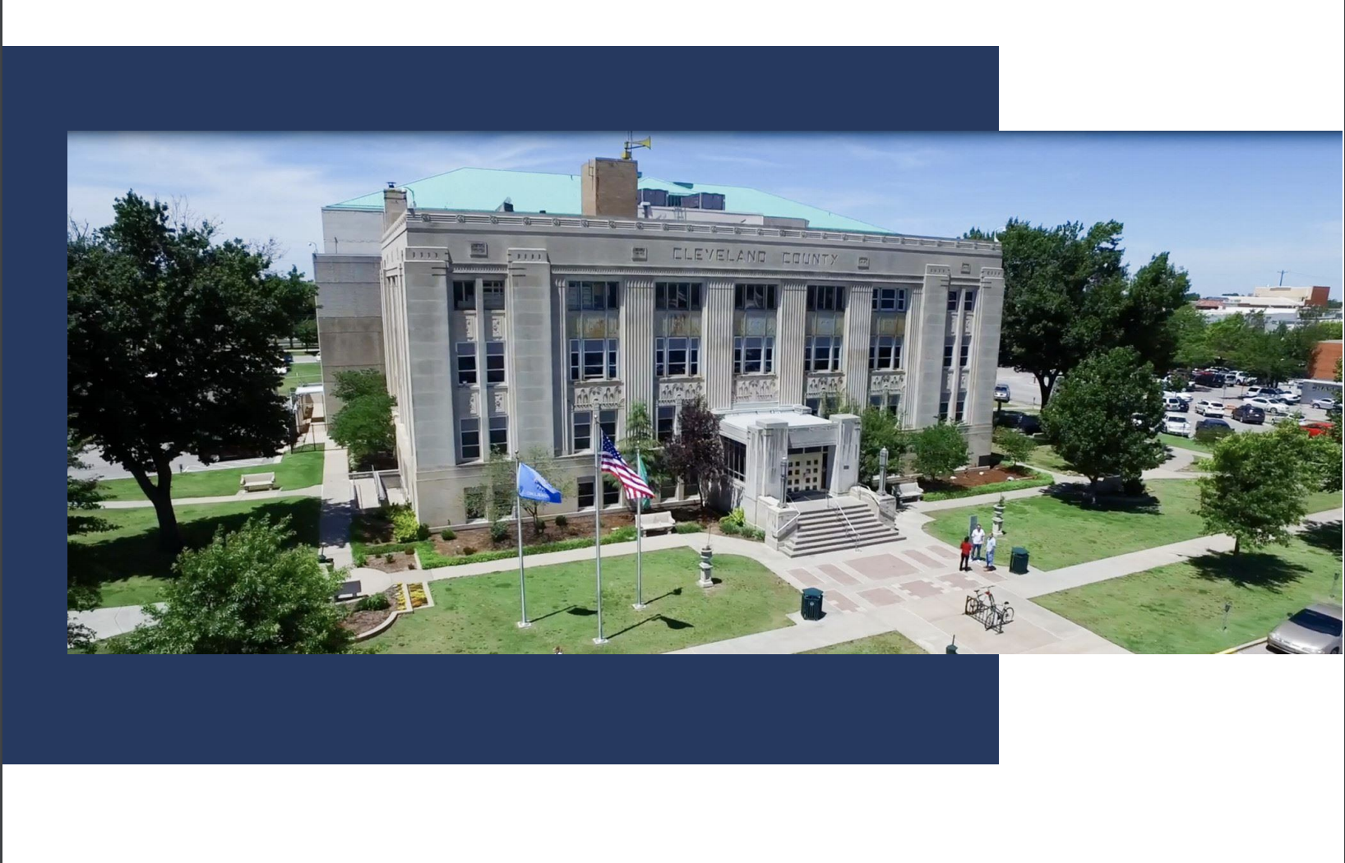
COVI-19 impact
Covid-19: The Impact, Rapid Response and Responsible Recovery
Cleveland County

Slide 2
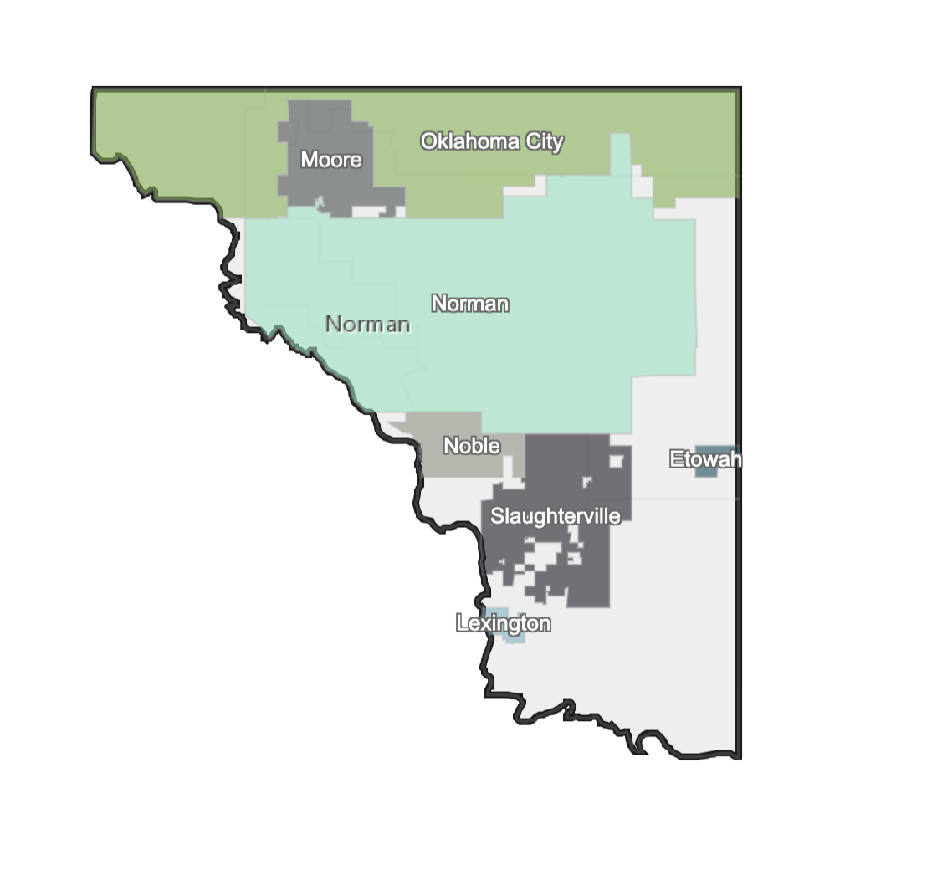
County map
500 Square Miles
295,000 Residents

Slide 3
Strategy
Evidence-based Strategy
Public Feedback
Business Community Feedback
Input from Cities, Mayors, County
Learning Agenda Working Group
Stakeholder Input

Slide 4
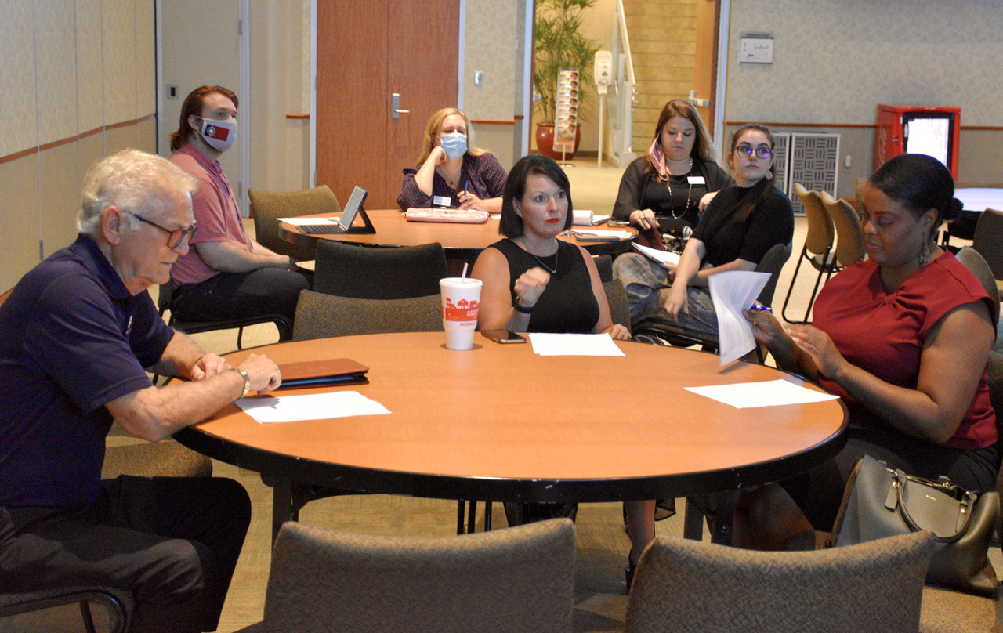
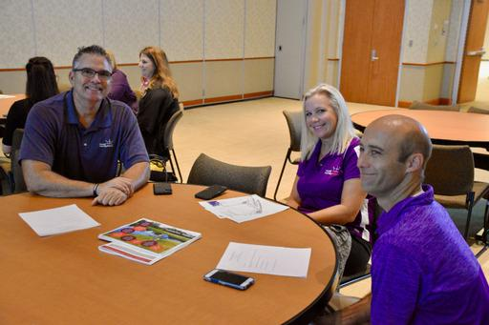
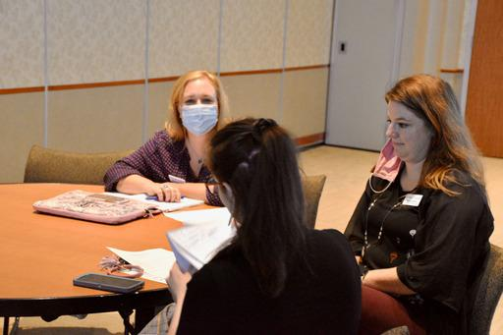
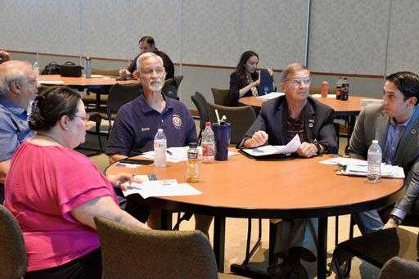
photos
Evidence-based Strategy
Public Feedback
Business Community Feedback
Input from Cities, Mayors, County
Learning Agenda Working Group
Stakeholder Input

Slide 5
Partnerships
Impact on Cleveland County Operations
Workforce Impact
Cleveland County Health Department
Cleveland County Sheriff's Department and Detentions Center
Court and County Clerks, Treasure

Slide 6
County operations
Impact on Cleveland County Operations
Judicial System
Infrastructure Projects and
Vendor Relations

Slide 7
recovery
Responsible Recovery
Over 600 Online Surveys Completed
60% Mental Health
35% Physical Health
42% Employment

Slide 8
funding
Responsible Recovery
Navigating the Funding Opportunities

Slide 9
Contact info
Cleveland County
Commissioner Darry Stacy, District 2
dstacy@clevelandcountyok.com
(405) 639-8145

