Slide 1
Pandemic Workforce Recovery
Oklahoma Employment Security Commission
Executive Director Shelley Zumwalt

Slide 2
Current Situation
Oklahoma | OESC

Slide 3
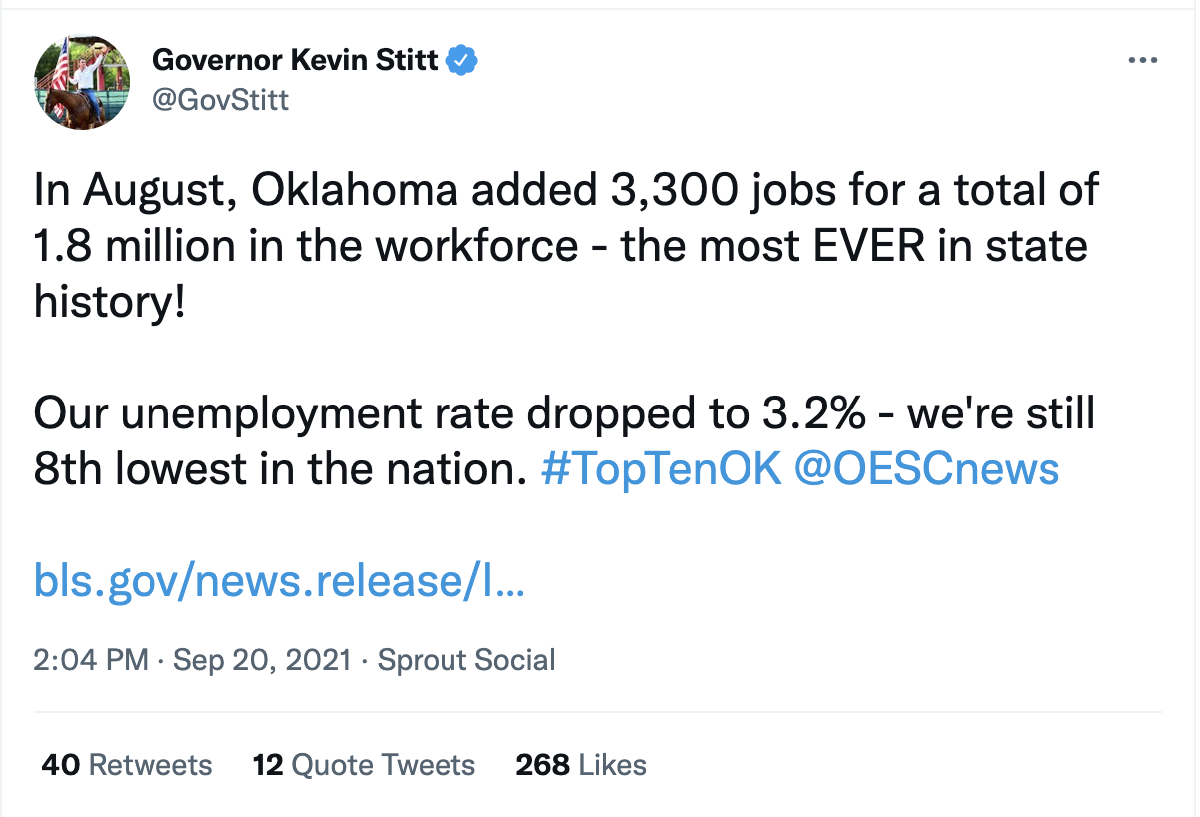
Unemployment in Oklahoma
August 2021
Oklahoma reached a 3.2% unemployment rate in August, ranking 8th for lowest unemployment in the nation
OESC paid out $37 million in unemployment benefits to Oklahomans
September 2021
To date, the continued claims four-week moving average has decline for the past seven consecutive weeks
Oklahoma continues to near pre-pandemic unemployment levels
State UI Trust Fund paying out less than $5M/week in UI benefits.

Slide 4
UI Trust Fund and Conditional Factor
Oklahoma Employer Tax Rate
For 2022, tax rates for most Oklahoma employers will either remain flat or decrease. This is a direct result of the legislature's and the agency's focus on managing the UI Trust Fund and keeping it solvent while also prioritizing keeping employer rates as low as possible.
More than 18% of employers will see a decrease in their employer tax rate.
UI Trust Fund
Oklahoma’s UI Trust Fund is in the top ten for most solvent in the nation
For the first 26 weeks of 2021, Oklahoma employers paid more than $251 million into the UI Trust Fund

Slide 6
Initial Pandemic Situation and Response
Oklahoma | OESC

Slide 7
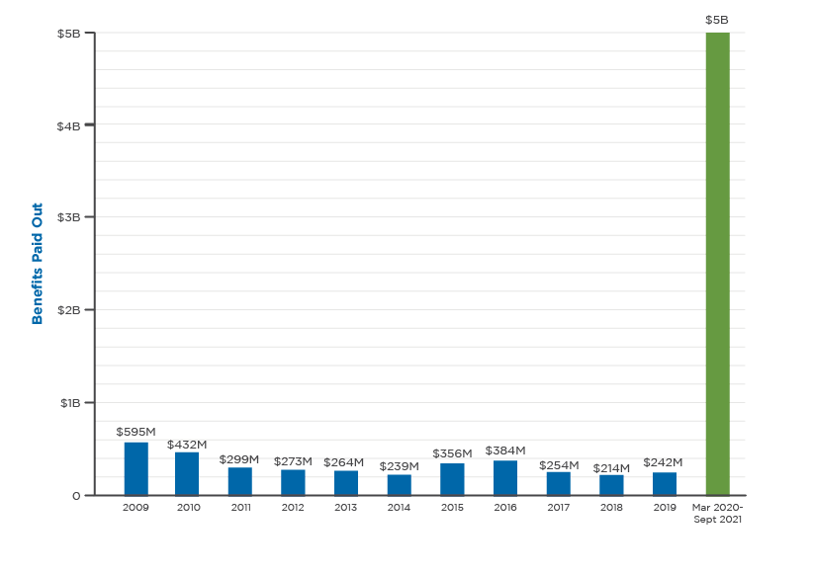
Unemployment Claims Volume
June-July 2020
Within a month of leadership change, OESC hosted claims fairs in OKC, Tulsa and Ardmore serving over 10,000 claimants in a little over a month
Backlog claims reduced from over 129,000 to under 10,000
February 2021
Unemployment claims declined for 35 consecutive weeks
September 2021
Paid out $5B in benefits since March 2020, more than the past decade combined

Slide 8
Improving Agency Systems
Fraudulent Activity
March 2020
One week waiting period for all claims waived nationally.
Three new claim types introduced overnight for agency to implement.
April 2020
OESC sees fraudulent claims rise significantly and identity theft used as main tool to file fraudulent claims. Manual fraud processes used by agency ill equipped to handle situation.
June 2020
Way2Go Cards required in hand for direct deposit, restricted three financial institutions
August 2020
Average turnaround time to recover funds from a fraudulent claim decreased from about 10-12 weeks to about 5-7 days
September 2020
Launched VerifyOK to address unemployment fraud
October 2020
OESC awarded $1.8 million from DOL for fraud prevention efforts
February 2021
OESC launched an internal fraud scoring tool in partnership with Google and SpringML
OESC brings together a task force of state and federal law enforcement partners
February 2021
OESC launched an internal fraud scoring tool in partnership with Google and SpringML
OESC brings together a task force of state and federal law enforcement partners
Call Volume and Resolution Rate
In May 2020, OESC’s first call resolution rate was below 5%
Now, first call resolution rate has reached more than 80%
Call volume has decreased by 80%
On average, call wait times are less than 10 minutes
Agency Operations Continue to be Streamlined
During the last quarter of 2020 adjudication times had expanded to 10-12 weeks.
By the end of January 2021, agency staff had cut the wait time to an average of less than 20 days where it continues to be evaluated and refined to expedite the process.
Staff has reinstated and improved auditing of job search requirement reporting to ensure claimants are completing all requirements fully to receive benefits.
Details of RFP to replace current job match system being finalized to release in coming month.

Slide 9
Workforce Recovery and Development

Slide 10
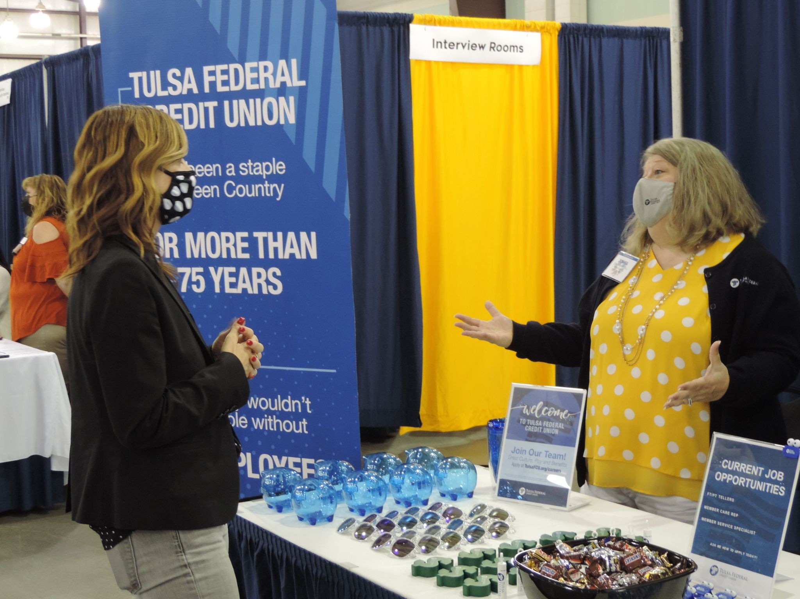
Career Fairs
May 2021
OESC hosted 7 in-person and a virtual career fair across the state to connect employers with Oklahomans looking for work
CARES money allowed us to waive employer fees
More than 300 employers participated both online and in-person representing thousands of open jobs
June 2021
Hosted 2 additional career fairs in Tulsa and Oklahoma City to address statewide workforce shortage
The events brought in nearly 550 participants in Tulsa and around 400 in Oklahoma City
July 2021
Agency prioritizing grant funding from USDOL and state partnerships through The Force focusing on rural and small business workforce challenges.

Slide 11
Agency Goals

Slide 12
Digital Transformation
Funding will support the agency’s transformation, BT40, that will modernize OESC’s digital infrastructure to meet the needs of Oklahomans and Oklahoma employers. This supports the agency’s focus on not only providing unemployment benefits to claimants, but also assisting them with finding re-employment opportunities that match their skills. This includes:
Continuing to build the team that is leading and implementing OESC’s technology modernization efforts
Improving the employer experience
Improving the claimant experience through their interactions online and in person
Improve communications with both employers, claimants and employees with digital communication tools
Updating and streamlining OESC’s digital processes
Proving a secure and safe means for claimants and employers to share information and interact with the agency.
Accurate data and reporting for agency grants and to drive agency processes and success through key performance metrics and goal setting.

Slide 13
OESC Team
Funding will enable the agency to ensure we are providing the services employers, employees and claimants require, we must have a team that has the skill sets needed and support this team with appropriate professional development, alignment and compensation. Our team members are critical to our success in serving Oklahomans and the success of our technology modernization initiative. This funding will allow us to:
Implement long term plan for agency concentrating on creating a highly skilled, tech enabled, knowledgeable and motivated workforce to provide best in class service to state citizens.
Increase staff training and professional development.
Ensure alignment and proper agency structure
Once optimal compensate employees appropriately and improve retention rate
Hire a human resources consultant to support our optimal staffing and structure development efforts
Stand up pilot program for workforce case management staff and utilize pay for performance plan to drive outcomes in workforce placement.

Slide 14
Additional Grant Funding
Equity Grant:
$4.5 million in funds to provide innovation in equity through communication, technology and access to benefits
OESC plans to use these funds for digital transformation to prioritize the needs of Oklahomans
Good Jobs Challenge
Multi million-dollar funding is available to grow Oklahoma’s regional workforces by providing training and sectoral partnerships
OESC hopes to target historically underserved populations, with an emphasis on rural Oklahomans
Workforce System Technical Assistance Collaborative Grant
Up to $3.5 million in funds to provide strategic, short and long-term technical assistance to grow the workforce
OESC hopes to use funds to identify areas of need and potential growth to bridge gaps between workers and quality jobs
National Governor’s Association Workforce Innovation Funding
$100,000 to advance digital skill development to provide more equitable economic participation that aligns with the state’s vision for Oklahoma’s workforce
OESC plans to respond to the impacts of Covid-19 on Oklahoma’s workforce by advancing digital skills and literacy for workers

Slide 15
Thank you

