Slide 1
CHAPTER 15. OKLAHOMA 9-1-1 MANAGEMENT AUTHORITY RULES
SUBCHAPTER 11. NG9-1-1 COMPLIANCE REQUIREMENTS
145:15-11-2. 9-1-1 geographic information system (GIS)
(G) PSAPs must synchronize their NG9-1-1 GIS data centerlines and site/structure address points data with their MSAG and ALI (TN) records to 98% accuracy as stated in NENA INF 71-501. This process must continue until the tabular MSAG is replaced by a GEO MSAG used by an NG9-1-1 core services provider.
The Oklahoma GIS Toolkit has a tool (MSAG/TN-NG911 Comparison) to assist with this requirement.

Slide 2
PSAPs must perform maintenance of the Master Street Address Guide (MSAG)
The MSAG (master street address guide) is:
  a database that catalogs street names and address number ranges within a specific geographic area
  links them to emergency service zones (ESZs) and their associated emergency service numbers (ESNs).
In Oklahoma, the Telephone Number (TN) or ALI database and the MSAG database are accessed through the AT&T Public Safety Platform (PSP) portal. The PSP is a secure platform which requires logon credentials.
This data ensures 9-1-1 calls are routed correctly to the appropriate emergency responders, and it enables automatic location identification (ALI).

Slide 3
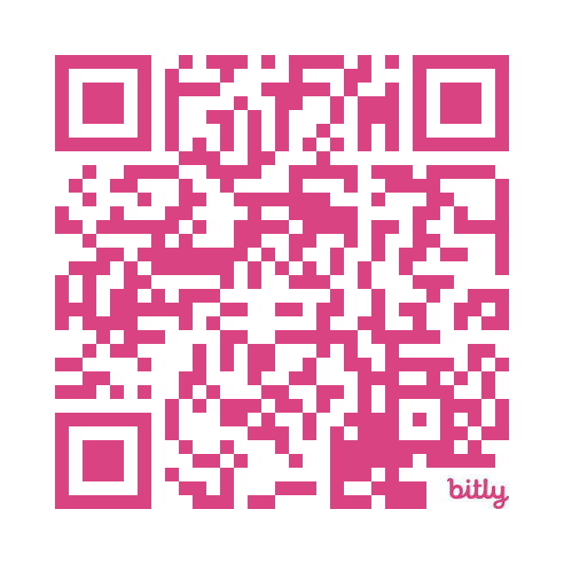
NENA MSAG Definitions and documents
MSAG Coordinator/MSAG Administrator
The individual with the 9‑1‑1 Governing Authority or 9‑1‑1 Authority who has responsibility for all daily maintenance of the 9‑1‑1 database, to include, but not limited to MSAG maintenance, 9‑1‑1 Inquiry resolution, notifying Service Providers of address changes or corrections for a resident.
NENA 71-501, NENA Information Document for Synchronizing Geographic Information System databases with MSAG & ALI

Slide 4
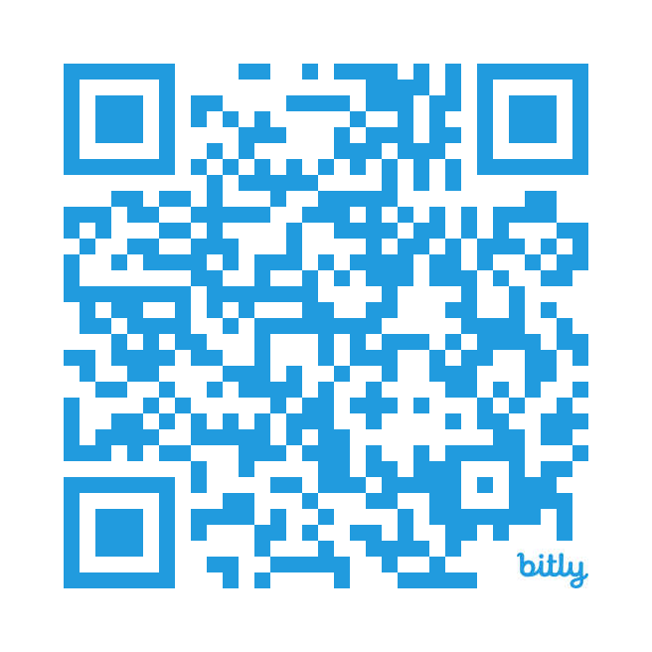
NEW ACCESS REQUEST FOR AT&T’s PUBLIC SAFETY (PSP) PLATFORM
Please allow 5-7 business days for new AT&T PSP User ID requests to fully process. Your login credentials will be emailed once complete.

Slide 5


AT&T MSAG contact
att911database@att.com
1-800-879-4090

Slide 6

Notes:
This course is not intended to teach you how to use the PSP software to create and maintain MSAG or TN records. Please reference the PSP User Manual and AT&T for periodic training opportunities. The manual is available for download when you logon to the PSP.
This course will only review the two types of queries used to produce the database records needed to use the MSAG/TN Compare tools in the Oklahoma GIS Toolkit.

Slide 7

Home Screen with MSAG tools selected

Slide 8
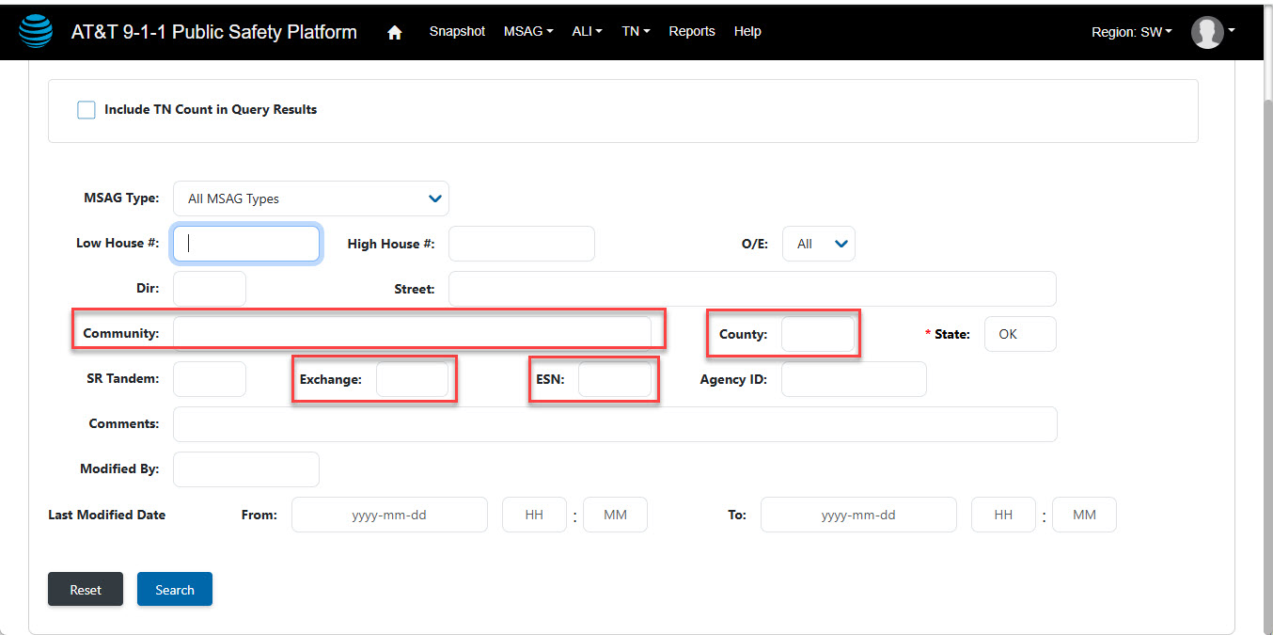
Format your query so the records returned by the query encompass the same geographical area as the GIS data to be compared.
Use values in the fields highlighted below to customize the query parameters.

Slide 9
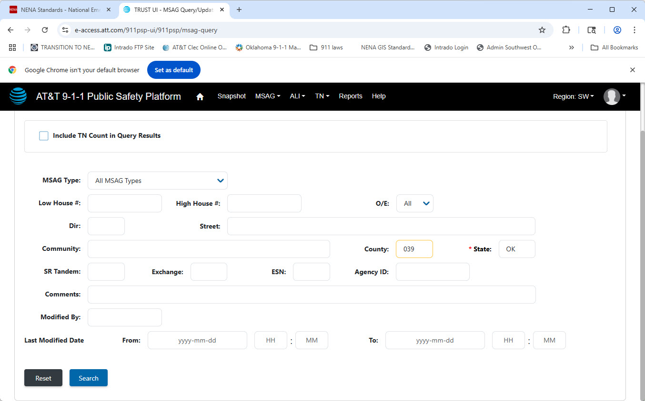
This example will use the FIPS code in the “County” field to pull every MSAG record in Custer County

Slide 10
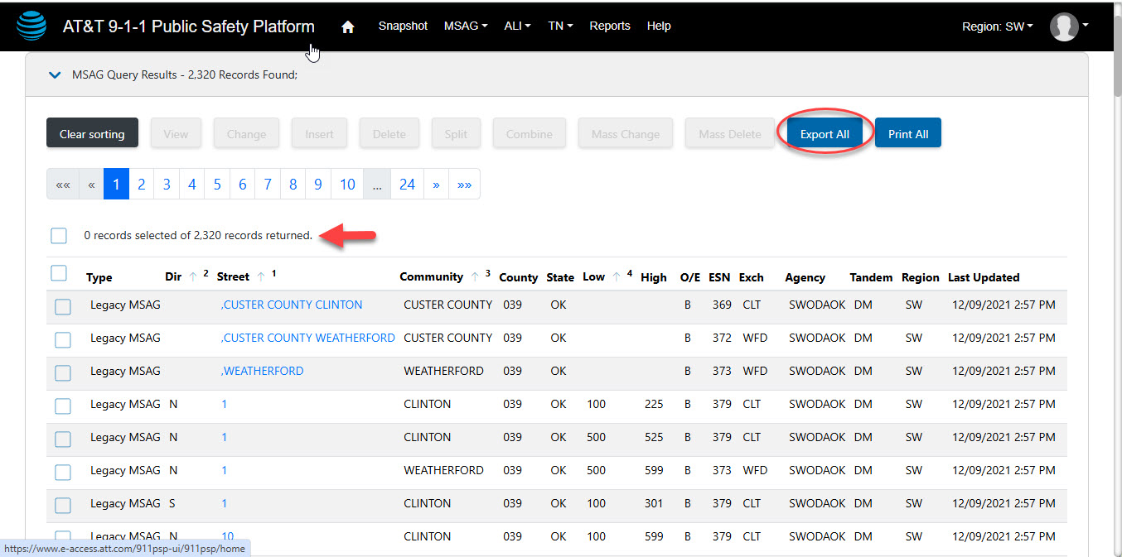
If the query returns > 10,000 records, the export will only include the first 10,000
Notes:
If your PSAP boundary encompasses a geographical area that contains more that 10,000 MSAG records you have 2 solutions. First you can reach out to your AT&T account manager and request an export of all records in your PSAP area. There may be a cost for this service from AT&T. Second, you can perform multiple MSAG queries using smaller geographical areas such as Communities or ESNs. Then merger the records from the multiple queries to create the complete set of MSAG records that reflect your entire PSAP boundary area.

Slide 11
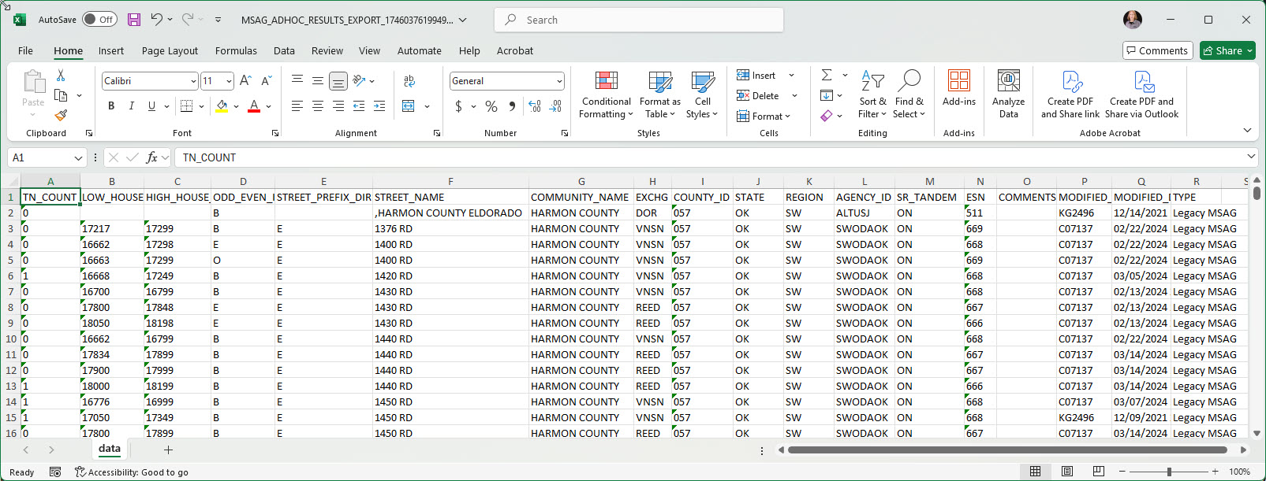
This is the format of the .csv file generated from an MSAG query that is exported.
Notes:
Make note of the field headers. You will map certain fields in this report to similar fields in the MSAG/TN Compare Tool.

Slide 12
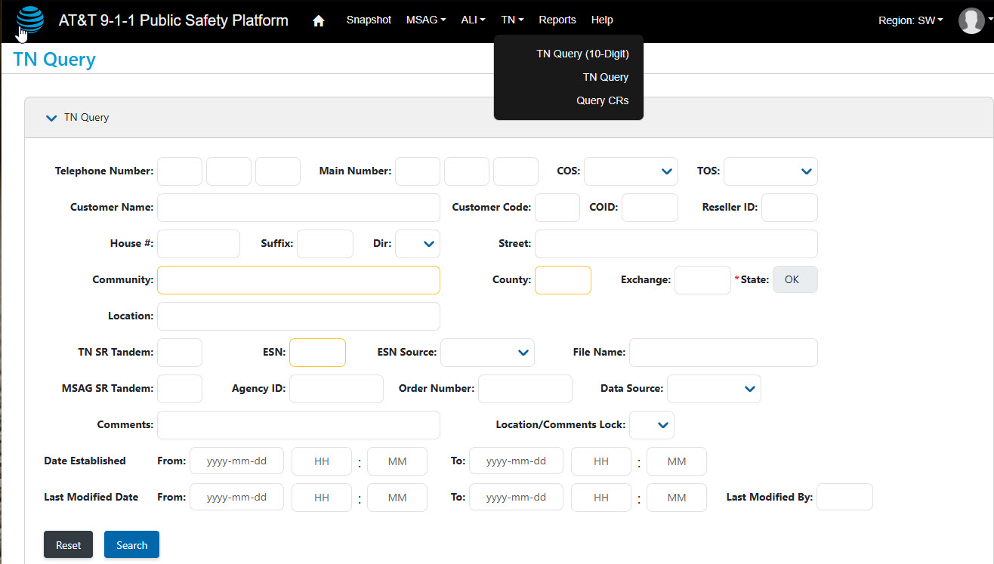
Use the same methods under TN Query to produce a .csv file for the TN compare tool

Slide 13
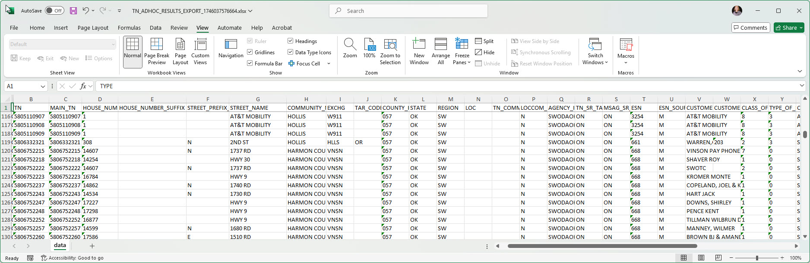
This is the format of the .csv file generated from an TN query that is exported.
Notes:
Again, make not of the field headers that must be mapped to similar field names in the TN Compare tool.

