Slide 1
Newborn Screening
Oklahoma State Department of Health
Newborn Screening Program
Phone: (405) 426-8310
Toll Free: 1 (800) 766-2223
Fax: (405) 900-7556
NewbornScreen@health.ok.gov

Slide 2

Newborn Bloodspot Screening
Purpose
  Newborn screening (NBS) is the practice of testing every newborn for harmful or potentially fatal disorders that are not otherwise apparent at birth.
  Early detection and prompt treatment can make the difference between healthy development or lifelong impairment and possible death.

Slide 3

Screening vs. Diagnostic
The newborn screen is just that… a screen.
  Screening results, by themselves, cannot determine the presence or absence of a disorder.
Diagnostic results refer to the combination of signs, symptoms, and test results that allows the doctor to confirm the diagnosis of a respective disease.

Slide 4
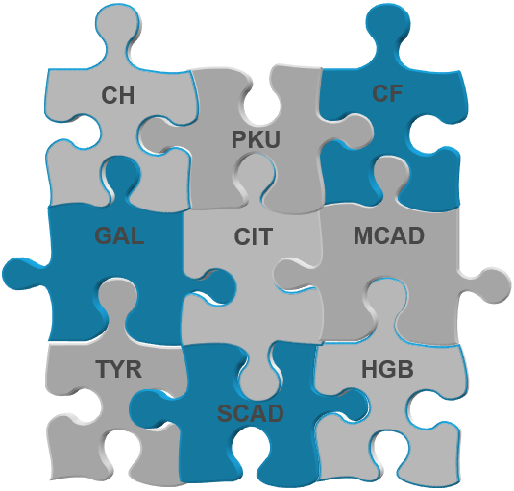
Who Decides?
In 2022 the Oklahoma legislature passed statute stating that the Oklahoma NBS panel will match the national recommended uniform screening panel (RUSP) to the extent practicable.
Once a condition is added to the RUSP the NBS Program (lab and follow up) will determine practicability and readiness.
Then the Infant and Children's Health Advisory Committee will
  provide recommendations to the Commissioner of Health to add
  the disorder.
The Commissioner of Health will give final approval.
Oklahoma currently screens for
over 50 possible hidden disorders.
Oklahoma will continue to expand.

Slide 5
Autosomal Recessive
        Most NBS disorders are autosomal recessive with the exception of:
          Congenital Hypothyroidism (CH)
          Some forms of Severe Combined Immunodeficiency (SCID)
          X-Linked Adrenoleukodystrophy
        Usually no prior family history
        Risk for each pregnancy if both parents are a carrier of a disorder:

Slide 6
Parent Education
NBS is collected on every baby born in Oklahoma.
Importance of correct contact info & PCP for follow-up.
  No news is not good news! Update NBS Program with changes in home address and/or PCP.
Review hidden disorders, using NBS pamphlet as a guide.
Specimens are kept by the OSDH lab for 42 days before being destroyed.
Explain that most affected newborns do not exhibit signs & symptoms early on.
Prompt identification & treatment of disorders is critical.

Slide 7
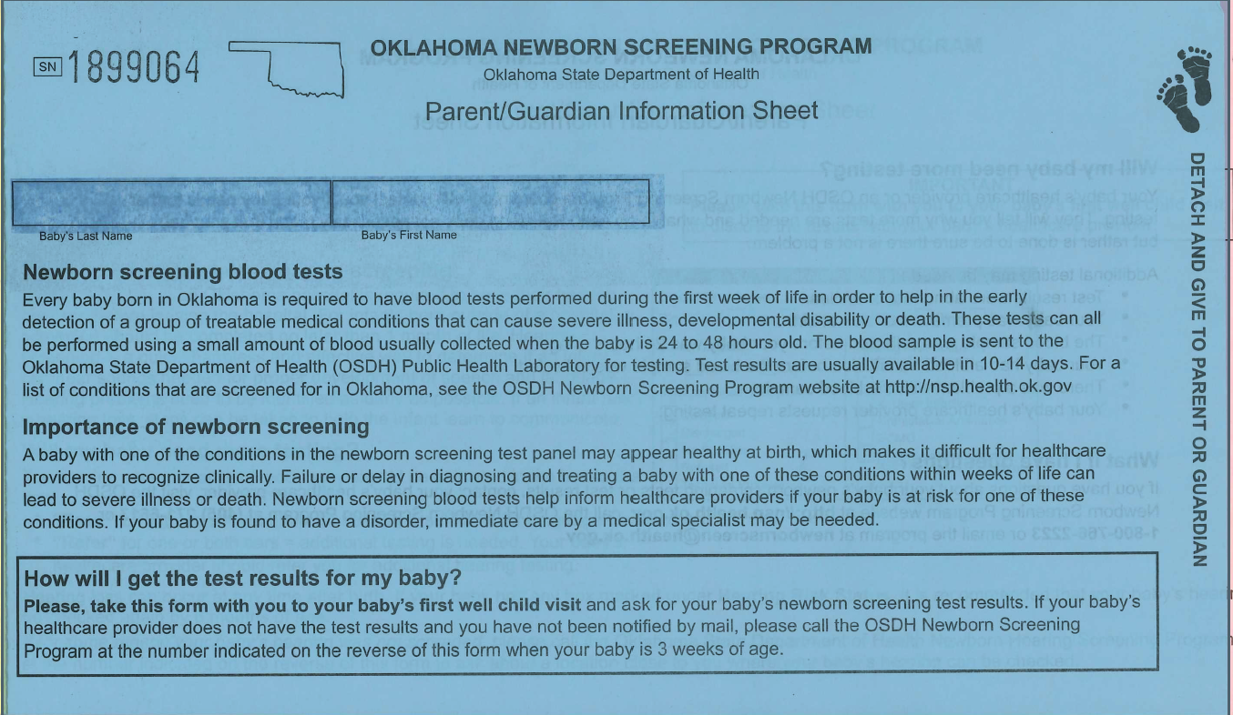
Parent Education
Instruct parents to ask for screen results on first visit to PCP.
Tell parents to bring the Blue or Pink slip to their baby’s first doctor’s visit.

Slide 8
Parent Education
Review reasons why a repeat screen may be needed:
  Unsatisfactory Specimen
  Out-of-range results
    Possible disorder identified
    Hgb Trait condition
  Specimens collected less than 24 hours
    Risk for missing some disorders
  Premature or Sick Infants (TPN & antibiotics could affect results)
  Not collected prior to a blood transfusion

Slide 9
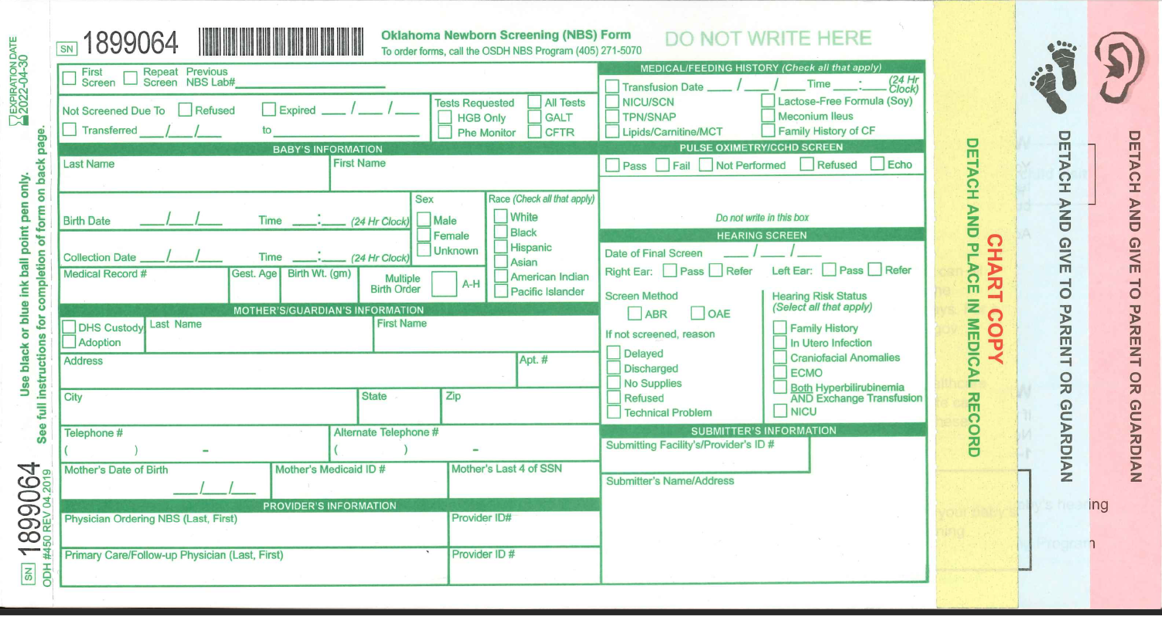
Filling out the Form
  Specimen testing will be delayed if the form is incomplete!

Slide 10
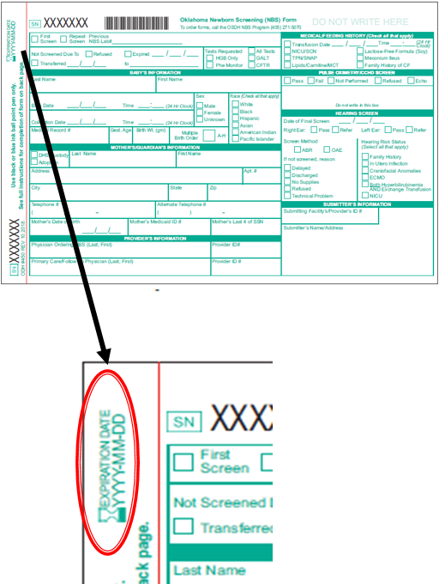
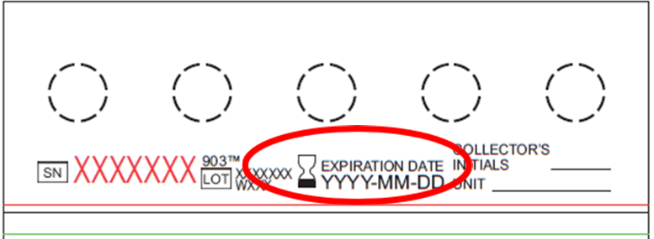
Filling out the Form
Specimen testing will be delayed if the form is incomplete!
Check expiration date
  If the filter paper is expired, discard the paper, and check the stock of filter paper kits and discard all expired kits.
  Collect the specimen on a kit that is not expired.

Slide 11
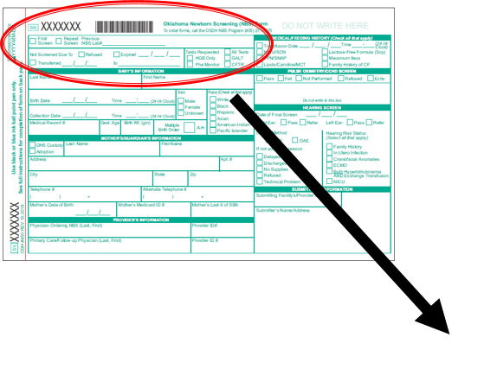
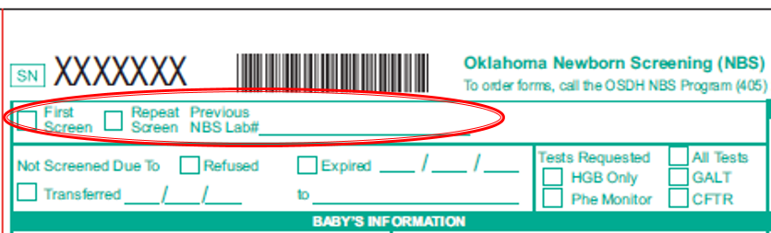
Filling out the Form: Specimen Information
Specimen testing will be delayed if the form is incomplete!
If this is the first specimen collected for the baby, check the “First Screen” box.
If baby has had a previous screen, check the “Repeat Screen” box.
  List the previous OSDH Lab Number, if applicable.

Slide 12
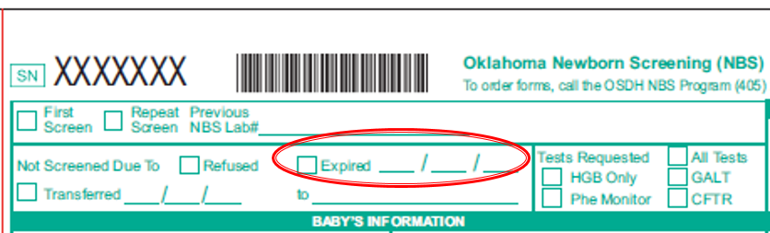
Filling out the Form: Specimen Information
Specimen testing will be delayed if the form is incomplete!
If baby expires before a screen can be collected:
  Check the “Expired” box
  Enter the date that baby passed away
  Submit the filter paper form to the OSDH PHL

Slide 13
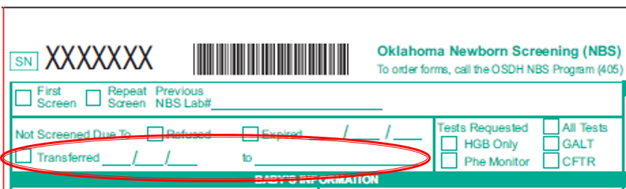
Filling out the Form: Specimen Information
Specimen testing will be delayed if the form is incomplete!
If baby is transferred prior to specimen collection:
  Check the “Transferred ” box
  Enter the date that baby transferred and the facility that baby was transferred to
  It is the responsibility of the receiving facility to collect the newborn screen

Slide 14
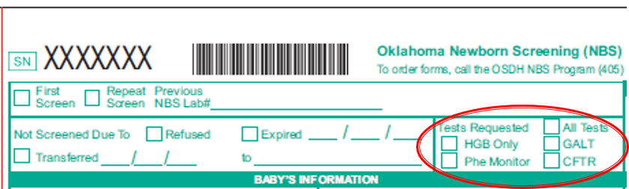
Filling out the Form: Specimen Information
Specimen testing will be delayed if the form is incomplete!
Tests Requested: Check all that apply.
  All Tests- always check unless test is for HGB Only or Phe Monitor. This ensures the lab screens for all disorders on the NBS panel.
  HGB Only- Check if repeat screen is for follow-up of initial abnormal HGB result.
  GALT- Check GALT in addition to All Tests if there is a family history of galactosemia or if baby is on lactose-free (soy) formula at time screen is collected.
  Phe Monitor- Check only if baby has been diagnosed with PKU (typically metabolic specialists only)
  CFTR- Check in addition to All Tests if baby has clinical concerns for CF, meconium ileus, and/or family history of CF.

Slide 15
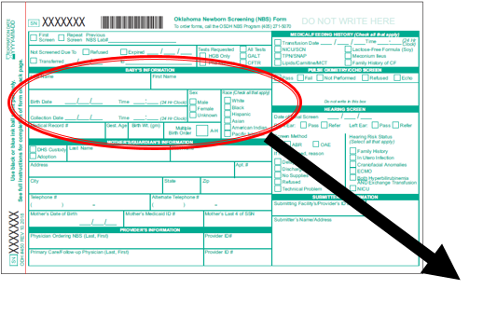
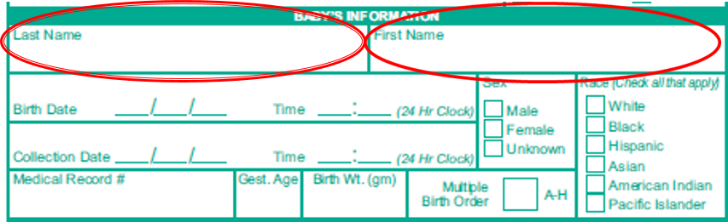
Filling out the Form: Infant’s Information
Specimen testing will be delayed if the form is incomplete!
  Baby’s first and last name (use legal name as displayed on the birth certificate).
  If baby’s first name is unknown, “BG” or “Female”, “BB” or “Male” may be used.

Slide 16
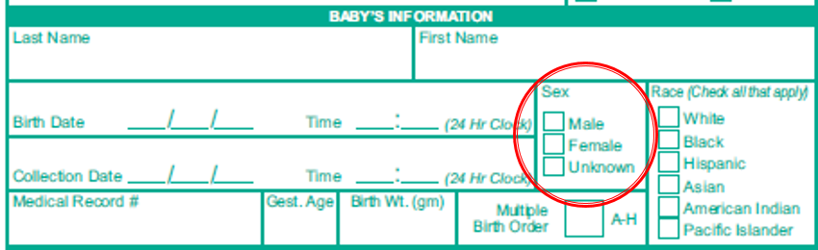
Filling out the Form: Infant’s Information
Specimen testing will be delayed if the form is incomplete!
Sex/Gender
  Check “Male”, “Female”, or “Unknown”

Slide 17
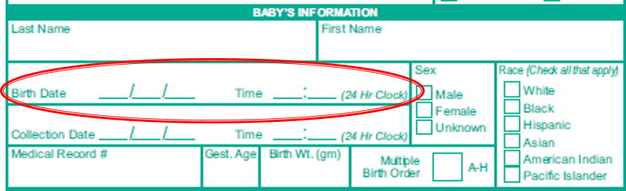
Filling out the Form: Infant’s Information
Specimen testing will be delayed if the form is incomplete!
Date & Time of birth
  Enter the time using the 24 hour clock. For example 1PM would be entered as 13:00.

Slide 18
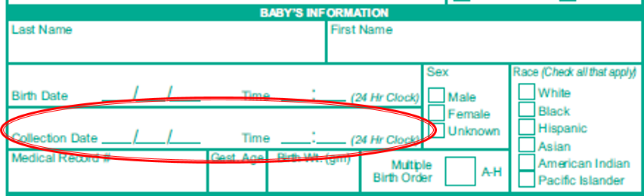
Filling out the Form: Infant’s Information
Specimen testing will be delayed if the form is incomplete!
Date & Time of specimen collection
  Ideal time for well, term newborn:
  24 hours + 1minute of age
  Enter the time using the 24 hour clock. For example 1PM would be entered as 13:00.

Slide 19
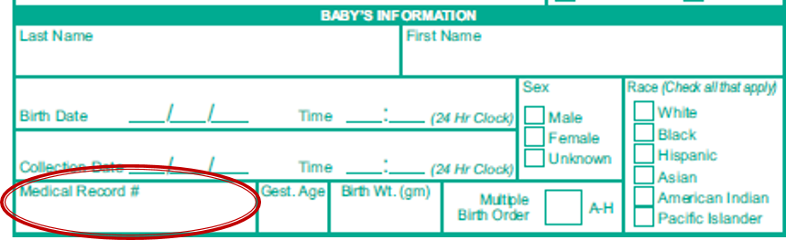
Filling out the Form: Infant’s Information
Specimen testing will be delayed if the form is incomplete!
Medical record number
  Baby’s medical record number

Slide 20
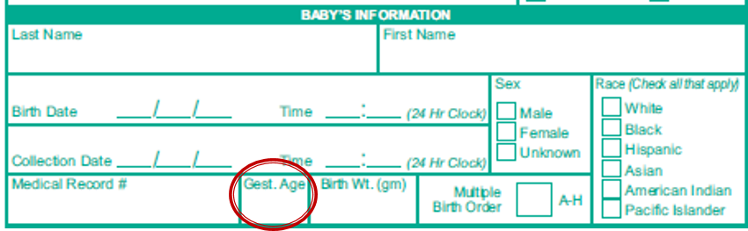
Filling out the Form: Infant’s Information
Specimen testing will be delayed if the form is incomplete!
Gestational Age
  List gestational age at birth.
  Lab cut off values for abnormal severe combined immunodeficiency (SCID) are gestational age dependent.

Slide 21
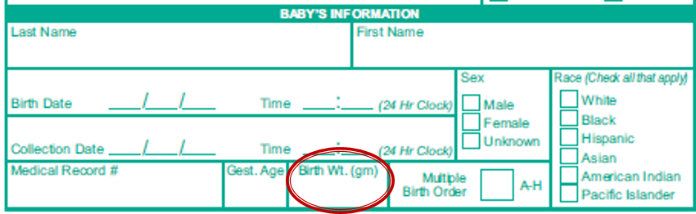
Filling out the Form: Infant’s Information
Specimen testing will be delayed if the form is incomplete!
Birthweight (in grams)
  Lab cut off values for abnormal congenital adrenal hyperplasia (CAH) results are dependent on birth weight.

Slide 22
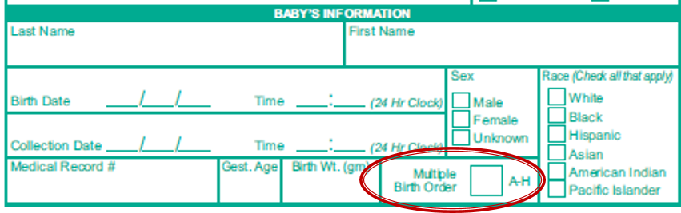
Filling out the Form: Infant’s Information
Specimen testing will be delayed if the form is incomplete!
Birth order (if multiple birth is present)
  Indicate “A”, “B”, “C”, etc. if baby is of multiple birth (twin, triplet, etc.).
  Do NOT mark anything in this space if baby is a single birth.

Slide 23
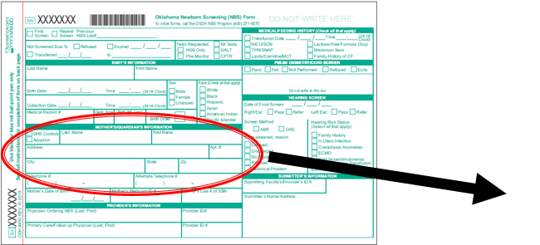
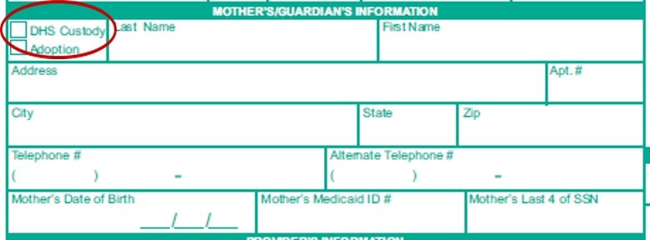
Filling out the Form: Mom’s Information
Specimen testing will be delayed if the form is incomplete!
DHS Custody or Adoption
Note: If baby is adopted, be sure to check the Adoption box on the filter paper form and enter the agency/law firm information in this section. If DHS is involved, enter case worker information in this section and check the DHS Custody box.

Slide 24
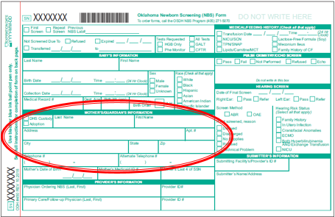
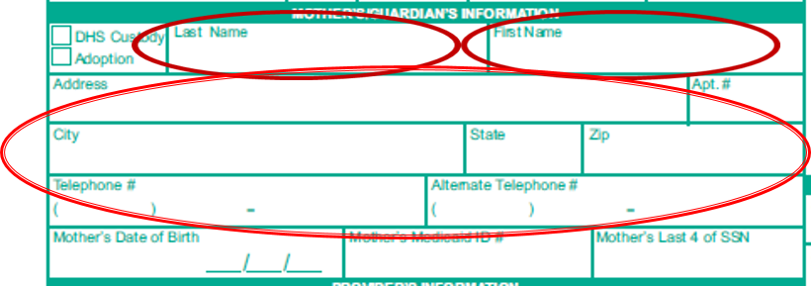
Filling out the Form: Mom’s Information
Specimen testing will be delayed if the form is incomplete!
Mom’s first and last name
Mom’s mailing address:
  Street, Apt # (if applicable), City, State, Zip
Mom’s telephone number:
  Extremely important to include in case newborn screen results are abnormal and require follow-up.

Slide 25
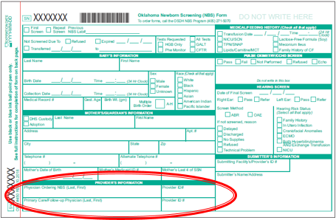
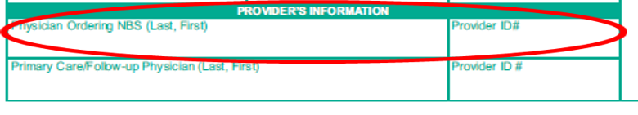
Filling out the Form: Provider’s Information
Specimen testing will be delayed if the form is incomplete!
Physician Ordering the NBS:
  Include first and last name
  Enter the NBS Provider ID #, if known
  If Provider ID # unknown, document name and phone number

Slide 26
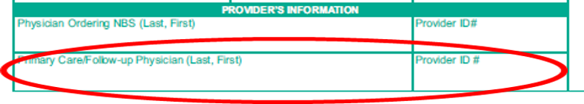
Filling out the Form: Provider’s Information
Specimen testing will be delayed if the form is incomplete!
Primary Care/Follow-up Physician:
  Planned health care provider upon discharge from birthing facility
  Include first and last name
  Enter the NBS Provider ID #, if known
  Extremely important that this is correct in case newborn screen results are abnormal and require follow up

Slide 27
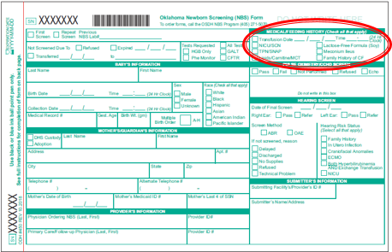
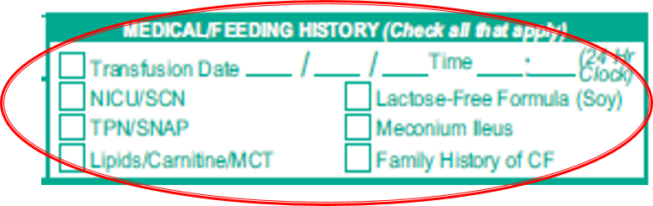
Filling out the Form: Medical/Feeding History
Specimen testing will be delayed if the form is incomplete!
Check all that apply for baby at the time of specimen collection
  If transfused enter the date and time of transfusion
  NICU/Special Care Nursery
  TPN/SNAP
  Lipids/Carnitine/MCT
  Lactose-Free (Soy) Formula
  Meconium Ileus
  Family History of Cystic Fibrosis (CF)

Slide 28
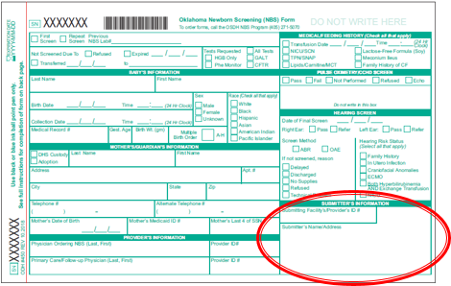
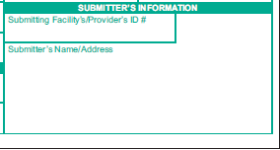
Filling out the Form: Submitter ID
Specimen testing will be delayed if the form is incomplete!
Submitting Health Provider ID #
  This is the ID of the provider/facility who collected the specimen
  Write or stamp in facility name and address

Slide 29
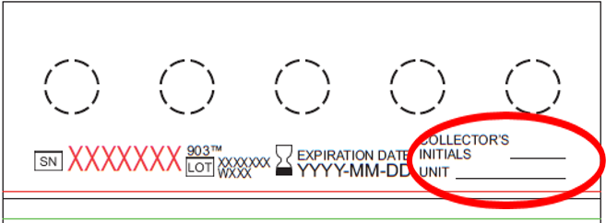
Filling out the Form
Specimen testing will be delayed if the form is incomplete!
Unsatisfactory Specimen Follow-up
  Specimen collectors can place their initials and unit in the area below for identification purposes, in the event of an unsatisfactory specimen. This allows for easier identification of the individual who collected the specimen so that further education and/or training can be provided.
Note: Do not touch the filter paper in any other area when writing initials and unit.

Slide 30
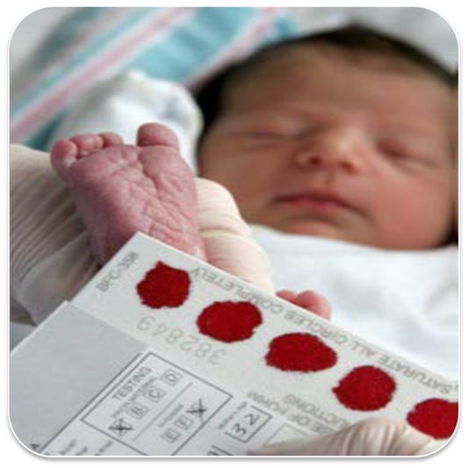
Collecting the Specimen

Slide 31
Time of Screening: Healthy Newborn
“24 hours plus one minute” of age
Or
Prior to discharge
**WHICHEVER COMES FIRST**

Slide 32
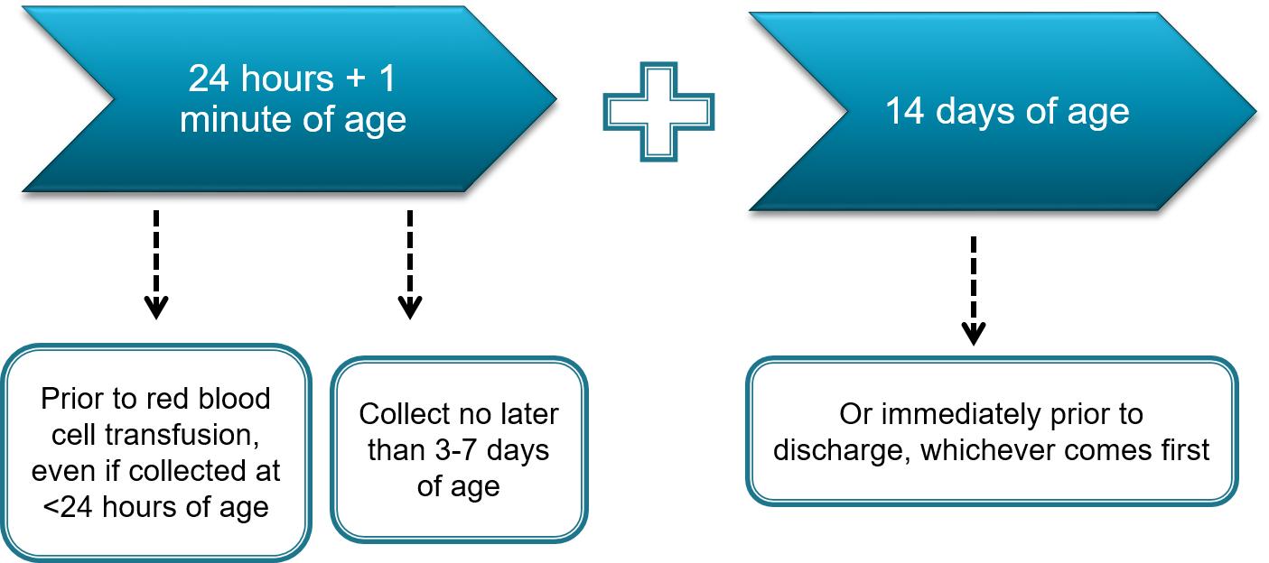
Time of Screening:
Premature or Sick Newborns

Slide 33
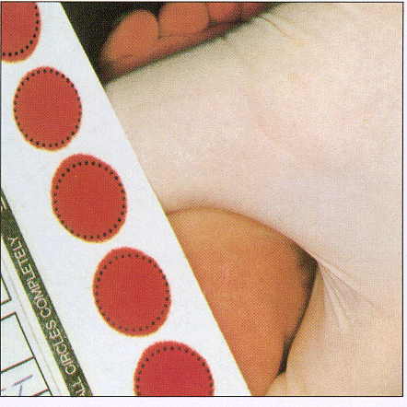
Specimen Collection
Heel Stick / Direct Application
  Preferred, recommended method
Start with clean, dry hands before handling
the filter paper.

Slide 34
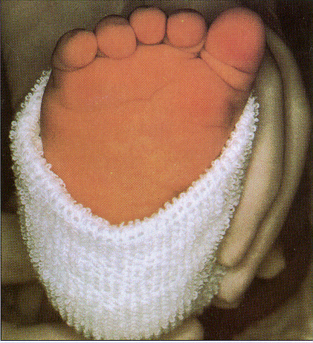
Direct Application
Warm the heel with a heel warmer or a soft cloth, moistened with warm water up to 41 C for 3 to 5 minutes.
  Warmth leads to vasodilation, which increases bloodflow and chance of collection success.
  *Follow your hospital protocol regarding which warming device to use*
Prepare the Site

Slide 35
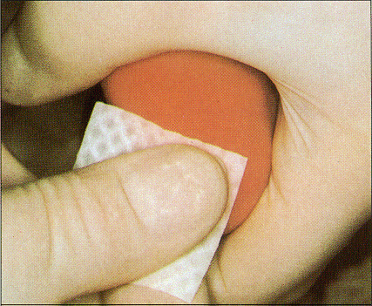
Direct Application
Prepare the Site
Encourage skin-to-skin contact between newborn and parent during specimen collection.
  Decreases stress response in newborn
  Encourages bonding
Position the infant’s leg lower than the heart.
  This increases venous pressure, which results in increased blood flow and a greater chance of collection success.
Wearing gloves, wipe the infant’s heel with 70% isopropyl alcohol.
Allow the heel to air dry!
  Residual alcohol can affect NBS results and/or lead to unsat specimens.

Slide 36
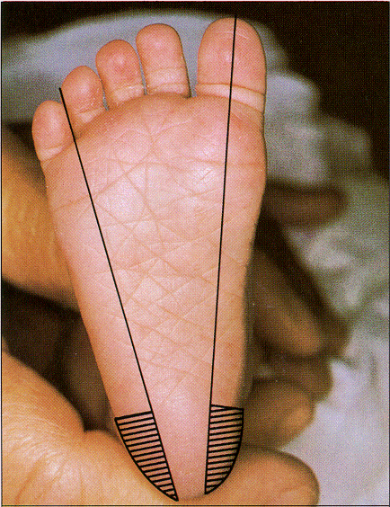
Direct Application
Lancet Placement
Hatched areas are safe for puncture
  Damage to nerves and/or the heel bone may occur for punctures outside of the hatched region.

Slide 37
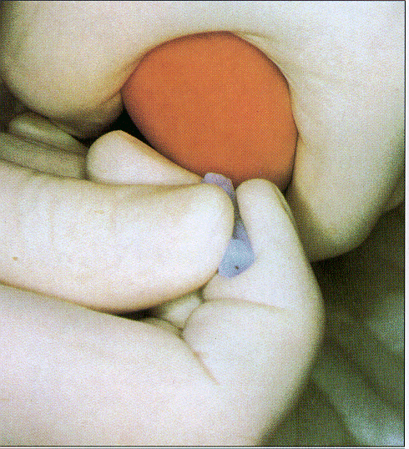
Direct Application
Perform the Puncture
Using a sterile lancet, perform the puncture.
Gently wipe off the first drop of blood with a sterile gauze or cotton ball.
Apply gentle pressure with thumb and around heel but not near the puncture site; ease intermittently as drops of blood form.
Avoid “milking” the puncture site.

Slide 38
Direct Application
Application
Gently touch the filter paper card to the blood drop and fill each printed circle with one large drop of blood.
Apply blood to one side only.
Observe the saturation of each printed circle as the blood flows through the filter paper.

Slide 39
Alternative Specimen Collection
  What about capillary tubes?
  Not preferred
    Higher risk for collection error
  If used, must be sterile/clean & plain.
    No additives! Must be anti-coagulant free.
    However… no anti-coagulants = risk for clotting
  Risk of scratching the filter paper.
    Avoid touching the capillary tip to the paper.
  Use a new tube for each pre-printed circle.
  Anti-coagulants
  - EDTA, citrate, & heparin -
  interfere with test results!

Slide 40
Alternative Specimen Collection
What about venous samples?
  Discouraged
  May be appropriate under certain circumstances (e.g. NICU).
  More invasive than a heel stick.
  Do not draw blood from extremity with infusing IV fluids.
  Please refer to current CLSI guidelines for more information.

Slide 41
Alternative Specimen Collection
What about umbilical catheters?
  Discouraged
  May be appropriate under certain circumstances (e.g. NICU).
  Ensure the line is cleared by withdrawing 2 – 2.5 cc (mL) of blood prior to collection a specimen for NBS.
  Please refer to current CLSI guidelines for more information.

Slide 42
Alternative Specimen Collection
What about umbilical cord blood?
  Discouraged
  May be appropriate under certain circumstances (e.g. NICU).
  Risk for maternal blood contamination.
  Repeat the newborn screen using the heel stick method when indicated.
  Please refer to current CLSI guidelines for more information.

Slide 43
Specimen Collection: What NOT to Do
  Do NOT dab or “color in” the filter paper circles.
  Do NOT apply multiple drops of blood per circle.
  Do NOT scratch the filter paper.
  Do NOT contaminate specimens.
    insufficient drying of alcohol, oils on hands, lotions, compressing the circles, spills, etc..
  Do NOT stack specimens.
    risk for leaching & cross-contamination between specimens
  Do NOT submit wet specimens.
  Do NOT place specimens in direct sunlight or in front of air vents or other sources of moving air.
  Do NOT place specimens in plastic bags.
  Do NOT batch (hold onto) specimens.

Slide 44
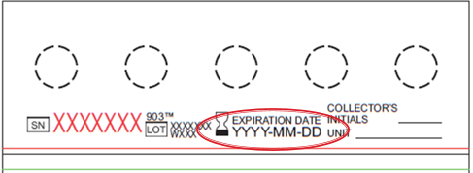
Collection Reminders
Pre-collection:
Check the Expiration Date of the filter paper
If filter paper is expired, discard the paper, check the stock of filter paper kits it came from to ensure they are not all expired, and collect on a kit that is not expired.
Post-collection:
Air dry specimen horizontally for 3-4 hours
  Transporting wet specimens can make them unsatisfactory for testing.
Send specimen with Courier within 24 hours of collection
  Delayed receipt of specimens to the Public Health Laboratory can delay identification of and treatment for a disorder, which can result in lifelong disability or even death for Oklahoma newborns.
  Know the courier schedule and location for your facility! Ensure all staff involved in newborn screening are also aware of the process.
Maintain specimen collection log & ensure screening results are received & recorded
Ensure that everybody who handles the filter paper or is involved in the newborn bloodspot collection process is trained

Slide 45
NBS Filter Paper Review
Unsatisfactory (“Unsat”) Specimen Examples

Slide 46
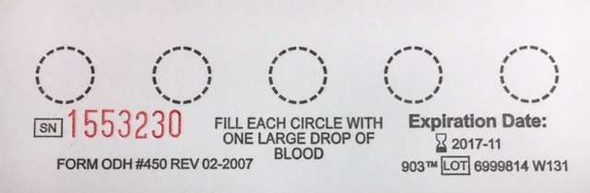
Filter Paper
The filter paper is part of the NBS Form. It is a medical device designed to absorb a specific volume of blood within each pre-printed filter paper circle.
If an analyte for any disorder is either too high or too low, this is an indication that additional testing is needed.
Accurate results depend upon proper absorption of blood onto the filter paper.
  Too much or too little blood may result in inaccurate results.

Slide 47
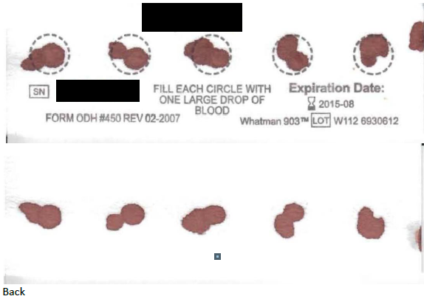
Multiple Application
Front
Back
Why Unsat?
  When bloodspots overlap or touch, as is the case in the sample above, it creates an uneven absorption of blood.
  Analyte levels cannot be accurately measured.
  Testing these specimens will result in inaccurate results.

Slide 48
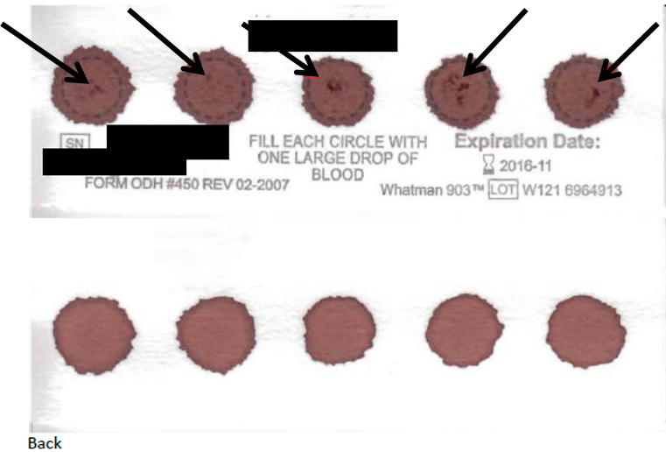
Clotted or Caked Blood
Front
Back
Why Unsat?
  Clots can occur using capillary tubes or if too much blood is applied to the pre-printed circles.
  Samples with clots are not suitable for testing.

Slide 49
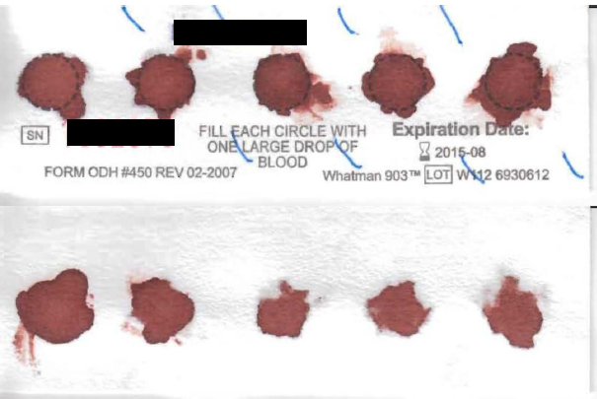
Serum Rings
Front
Back
Why Unsat?
  Notice the halos around the periphery of most of the pre-printed circles above. This can occur due to the following:
    Insufficient drying of alcohol on the baby’s heel prior to heelstick
    Drying the specimen vertically instead of horizontally
    Closing the flap of the filter paper on top of the circles while the specimen is still wet
    Placing wet specimens in plastic bags
    Milking or squeezing the puncture site

Slide 50
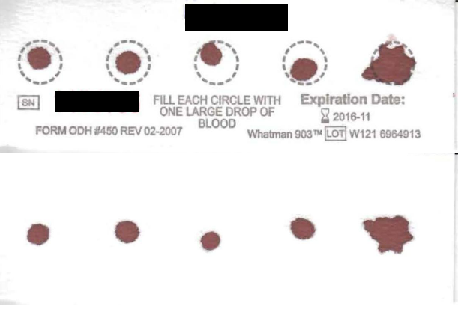
Inadequate Amount of Blood
Front
Back
Why Unsat?
  The above filter paper circles are not sufficiently filled with blood for testing.

Slide 51
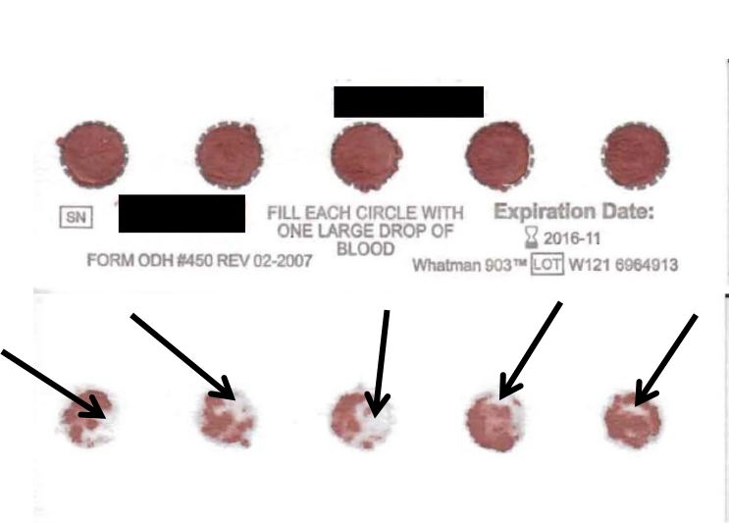
Under-Saturation
Front
Back
Why Unsat?
  Notice how the blood has not soaked all the way through the filter paper. There simply is not enough blood in this sample for testing.

Slide 52
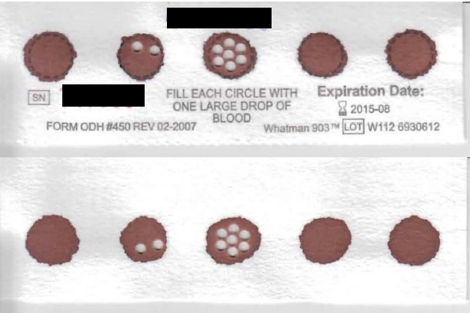
Acceptable Filter Paper
Front
Back
Why Acceptable?
  Pre-printed circles are completely filled with blood
  Blood has soaked all the way through the filter paper
  Absence of clots or caked blood
  Absence of serum rings

Slide 53
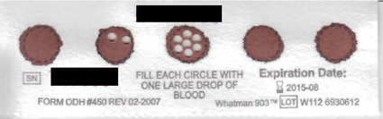
Are All 5 Circles Needed?
Yes!
    Why?
    If a result is flagging out-of-range, the specimen will be retested and the final result with be an average of three results. Each test requires an additional punch to be taken from the pre-printed circles.
    If the results for Congenital Adrenal Hyperplasia (CAH) are out-of-range, two entire pre-printed circles will be removed & shipped to another laboratory for steroid profile testing.
    Disorders will continue to be added to the newborn screening panel.
    The specialist and family may request for the specimen to be sent to another laboratory for additional testing to assist in determining diagnosis.

Slide 54
For Reference…
Refer to Clinical and Laboratory Standards Institute (CLSI) for collection guidelines.

Slide 55
NICU & Special Considerations

Slide 56
NICU Special Considerations
Infant
Prematurity & LBW may affect TSH & 17-OHP results
Hypoxia, CMV, septicemia, trisomies, biliary atresia may affect IRT levels
Treatment
Maternal
PTU therapy or radioactive iodine may affect infant TSH results
Steroids may affect infant 17-OHP results
Collection Issues
Carrier status may affect all NBS results
ECLS & blood transfusions may affect all NBS results
TPN, SNAP, & carnitine may affect amino acid, fatty acid, or organic acid results
Steroids may affect 17-OHP results
Contamination: oils/lotion from hands, spills, standing water, residual alcohol, heat/humidity
Early/delayed specimen collection
Unsatisfactory specimens
Transit time delays
Liver immaturity may affect amino acid results

Slide 57
Additional Information

Slide 58
Hospital Responsibilities
Ensure all infants are screened prior to discharge.
Ensure specimens are received in a timely manner to the OSDH PHL for testing.
Infants who are transferred:
  Receiving hospital to ensure the NBS is collected.
Submit Satisfactory specimens:
  Collected properly
  All requested information is documented on the filter paper
  Submitted timely

Slide 59
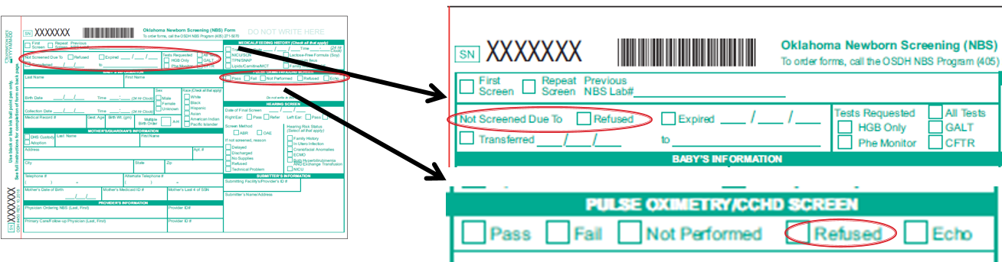
Refusal
Religious Tenets and Practices only.
Check the box(es) on the filter paper form if parents refuse the NBS and/or the pulse oximetry screen.
  Provide parents with a NBS blood spot and/or pulse oximetry brochure(s) & answer any questions they might have about the screen(s).
Ensure the parents fill out a Refusal Form. Keep a copy for baby’s record & fax a copy to the NBS Program using fax # 405-900-7556.

Slide 60
Transit Time
Prompt delivery of specimens to the Public Health Laboratory for testing can make all the difference.

Slide 61
Transit Time: What is it?
“The time between the collection of a newborn screening specimen to its receipt at the OSDH Public Health Laboratory for testing.”

Slide 62
Transit Time
Guidelines:
  Specimens should be received at the OSDH Lab within 48 hours from the time of collection.
  Oklahoma Law: OS 63 Sections 1-533 and 1-534
Delays in receiving the specimen
Delays in testing the specimen
Delays in diagnosis & treatment

Slide 63
Transit Time: Tips for Improvement
Ensure everyone involved in NBS collection/handling knows about courier pick-up time, location, and importance.
Do not batch specimens.
Ensure the NBS is collected at 24 hr + 1 min of age & goes out with the courier as soon as possible after it has dried (~3-4 hours of drying time).
Set timelines and goals specific for your facility.
Maintain a courier/transport log.
Review transit time reports.
Contact the PHL if the courier does not present to pick up the NBS specimens.

Slide 64
Pulse Oximetry
Screening

Slide 65
Pulse Oximetry Screening
Purpose:
  Screen all newborns between 24-48 hours of life with pulse oximetry to detect select defects related to critical congenital heart disease.
Rationale
  Some newborns may appear healthy at first despite having a CCHD. Early detection and prompt treatment can prevent lifelong disability and early death.

Slide 66
Implications
Congenital heart disease is the most common birth defect
1 in 110 infants will have a heart defect
  25% of those cases will have a CCHD
Most affected are asymptomatic early on
Most will require surgery shortly after birth

Slide 67
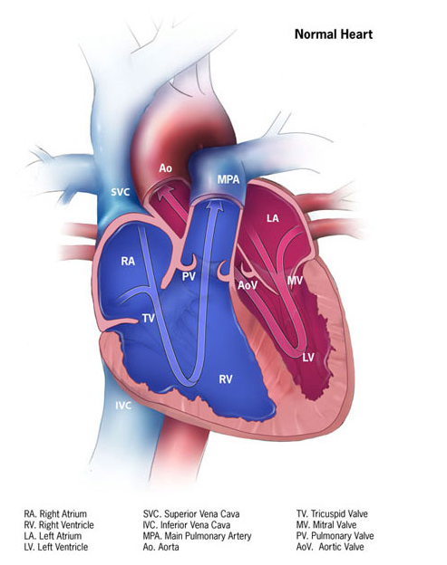
Normal Heart: Blood Flow
Blood from body tissues goes to the right side of the heart and enters the lungs, where the blood becomes oxygenated. The blood is then delivered to the left side of the heart, which is responsible for pumping the oxygenated blood out to the body in order to provide oxygenation to the body tissues. After being utilized, the deoxygenated blood is returned to the right side of the heart, and the cycle continues. Valves within the heart help to prevent backflow of blood during this process.
Fetal openings between the atria, ventricles, and blood vessels begin to close shortly after birth.
Image credit: CDC (2014)

Slide 68
Fetal-Neonatal Circulation
The first breath of life leads to important changes in neonatal circulation:
  Makes way for use of neonatal lungs (The lungs were not utilized in utero, as the placenta provided oxygenation to the fetus; after birth, however, an enormous amount of pressure is necessary in order for the newborn to close the diversions used to bypass the lungs in utero and instead allow for use of the lungs.)
  Increased pressure change in the left side of heart compared to the right (The left side becomes the body’s “pump”) resulting in:
    Closure of the Ductus Arteriosus (fetal opening between aorta and pulmonary artery)
    Closure of the Foramen Ovale (fetal opening between the right and left atria)
Failure of closure of fetal openings can result in complications

Slide 69
CCHD: Screening Targets & Symptomatology

Slide 70
CCHD Targets
Most likely detected by pulse oximetry screening
Hypoplastic Left Heart Syndrome (HLHS)
Pulmonary Atresia
Tetralogy of Fallot
Total Anomalous Pulmonary Venous Return
Transposition of the Great Arteries
Tricuspid Atresia
Truncus Arteriosus
These heart defects lead to low levels of oxygen in the blood.

Slide 71
CCHD Targets
Potentially detected by pulse oximetry screening
Double Outlet Right Ventricle (DORV)
Ebstein’s Anomaly
Coarctation of the Aortic Arch
Interruption of the Aortic Arch
Single Ventricle
Also potentially detected by pulse oximetry screening: other hypoxic cardiac or non-cardiac conditions.

Slide 72
CCHD: What to Watch For
Signs:
  Cyanosis
  Tachypnea
  Increased work of breathing
  Swelling
  Tires easily during feeds
  Sweating
  Poor weight gain
If at any time, the newborn should become symptomatic, the family should immediately take the baby to the closest emergency room for evaluation.

Slide 73
Pulse Oximetry: the Screen & the Oximeter

Slide 74
Pulse Oximetry: Context
Who is screened?
All newborns:
    Must be calm & well; not crying
    Warm extremities (temperature affects readings)
    Skin clean & dry (dried blood affects readings)
    Using room air; not on supplemental oxygen
When is screening performed?
Healthy Newborn: Between 24-48 hours of life
Sick Newborn: Between 24-48 hours of life
      May delay if on supplemental oxygen
Before 24 hours: higher risk for false positives (fetal-neonatal circulation transition not fully established)
After 48 hours: delayed identification & treatment of affected newborns

Slide 75
The Pulse Oximeter
What is it?
Screening tool: measures the percent of oxygen saturation of hemoglobin in the blood; and pulse rate
  Simple
  Painless
  Non-invasive
  Quick

Slide 76
The Pulse Oximeter
Oximeter Probe: 2 main parts
  light emitter
  Photodetector
Where is the probe placed?
  Right hand: preductal measurement
  Either foot: postductal measurement

Slide 77
Points to Consider
  Pulse oximeter must be FDA approved (AAP, 2015)
  Regular calibration of the oximeter is required
  Pulse oximetry readings are averages
  Skin color and jaundice do not affect pulse oximetry readings
  Continuous pulse oximetry monitoring does not replace the pulse oximetry screen.

Slide 78
Screening How-To, Protocol, & Guidelines

Slide 79
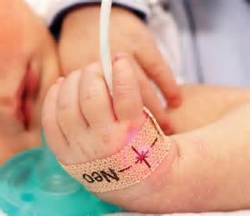

How is the Screen Performed?
Select site: right hand; either foot.
Place photodetector on outer aspect of hand/foot (under 4th-5th finger/toe).
Wrap sensor tape around extremity.
Ensure light emitter is directly opposite the photodetector.
If using a reusable sensor, secure the sensor using wrap recommended by vendor; do not tape or use hand to secure sensor to site.
                Photo credit: Masimo 2011

Slide 80
Guidance for Screeners
Pulse Ox Dos
If disposable, use a new, clean sensor; if reusable, clean between use
Clean according to manufacturer recommendations
Ensure newborn is calm and warm, not crying; encourage family involvement
Ensure newborn skin is clean and dry
Ensure no gaps between sensor and newborn’s skin
Light emitter and photodetector should be directly opposite of one another
Use alongside physical examination
Ensure pulse: no pulse, no oximetry!
Pulse Ox Don’ts
Do not use an adult probe
Do not tape pulse oximeter in place (use disposable wrap as indicated)
Do not use your own hand to hold sensor in place
Do not obtain reading from same extremity with blood pressure cuff
Bilirubin lamps & surgical lights can affect accuracy of reading; cover pulse oximetry sensor with a blanket if such instruments are in use
Do not use in isolation

Slide 81

Pulse Oximetry Screening Protocol

Slide 82
Interpretation of Results & Follow-Up

Slide 83
Screening Results
Negative Screen (Pass):
  Oxygen saturation > 95% in Right Hand and/or Left or Right Foot
  AND
  Difference between the Right Hand and Left/Right Foot < 3%
Positive Screen (Refer/Fail):
  Oxygen saturation < 90% in Right Hand or Left/Right Foot during any screen
  Oxygen saturation 90 - 94% for all 3 screens (1 hour between each screen)
  Difference between the Right Hand and Left/Right Foot > 3% for all 3 screens (1 hour between each screen)
If at any time, the newborn should become symptomatic, the family should immediately take the baby to the closest emergency room for evaluation.

Slide 84
Interpretation of Results
Negative = Pass
Results are in-range
Blood oxygen level WNL
CCHD still possible (if symptomatic, a cardiac evaluation is warranted)
Monitor baby’s status:
  Heart rate – too fast/slow?
  Energy – overly sleepy/fussy/lethargic?
  Appearance – pale/blue skin?
  Respiration – too fast/slow?
  Temperature – cold to touch?
  Feeding – difficulties?
  Positive = Fail/Refer
Results are out-of-range
Blood oxygen level is low
High risk; not diagnostic
Confirmatory procedures & referral for treatment are warranted

Slide 85

Reference:
Michigan Department of Community Health. Critical Congenital Heart Disease Newborn Screening Program. (2013). Pulse ox screening visual aid. Retrieved from http://www.michigan.gov/documents/mdch/PO_Screen_Graphic_422859_7.pdf

Slide 86


Reporting Results for CCHD:
Filter Paper
Pulse Oximetry Screen: Check Only ONE
  Pass
  Fail
  Not Performed
  Refused
  Echo
Note: If parents refuse the pulse oximetry screen, provide them with a pulse oximetry brochure and answer any questions they might have about the screen. Ensure the parents fill out a Refusal Form; keep a copy for baby’s record & fax a copy to the NBS Program using fax # 405-900-7556.

Slide 87

Reporting Results for CCHD
Pulse Oximetry Result Form

Slide 88
Newborn Screening Contacts
Bloodspot, Pulse Oximetry, & Hearing Screening
Public Health Laboratory
  Screening & Special Services
  123 Robert S. Kerr
  Oklahoma City, OK 73102-6406
Phone: 1-405-426-8220
Toll Free: 1-800-766-2223
Fax: 1-405-900-7556
NewbornScreen@health.ok.gov
  Newborn Screening Section
  Public Health Laboratory Service
  4615 W. Lakeview RD
  Stillwater, OK 74075
Phone: 1-405-564-7750
Toll Free: 1-800-766-2223
Fax: 1-405-900-7611
Publichealthlab@health.ok.gov

